Slide 1

The Epidermis
Notes:
Recruitment: during enrolment it is essential that key staff are in place to provide correct information. Initial screening must be used to signpost study support mechanisms possible transfers. Induction must focus on the student experience and give as much support as possible. 8 week VTCT rule to register. Crucial that staff are not trigger happy with equal prior to this. Retention .TRO ,All staff /DHoS Sl’s to check parent level retention on ARC and communicate instantly effectively across all staff learners at risk. Retention is currently 12% higher than last year at
Attainment must improve from 78% to targeted 92% . All HAT staff are driving measures forward under my direction to achieve this. Task and Finish groups address the QDP issues from the SAR . Mature learners are 49% across provision, exciting calendar of events , inspire, employer engagement, competitions and educational visits / European wplacements. Formalis d exam schedule involving penalty fees of £20 no show £10 each resist. This is showing a huge improvement from previously, missed opportunity assessments and flexible approach to support all students . Main aim to prevent end loading of assessments and assessment fatigue.

Slide 2
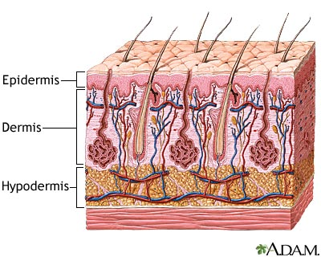
3 Main Layers of the Skin
Notes:
Recruitment: during enrolment it is essential that key staff are in place to provide correct information. Initial screening must be used to signpost study support mechanisms possible transfers. Induction must focus on the student experience and give as much support as possible. 8 week VTCT rule to register. Crucial that staff are not trigger happy with equal prior to this. Retention .TRO ,All staff /DHoS Sl’s to check parent level retention on ARC and communicate instantly effectively across all staff learners at risk. Retention is currently 12% higher than last year at
Attainment must improve from 78% to targeted 92% . All HAT staff are driving measures forward under my direction to achieve this. Task and Finish groups address the QDP issues from the SAR . Mature learners are 49% across provision, exciting calendar of events , inspire, employer engagement, competitions and educational visits / European wplacements. Formalis d exam schedule involving penalty fees of £20 no show £10 each resist. This is showing a huge improvement from previously, missed opportunity assessments and flexible approach to support all students . Main aim to prevent end loading of assessments and assessment fatigue.

Slide 3
3 Layers of the Skin
The skin can be divided into two distinct layers:-
The EPIDERMIS – the outer thinner layer (most superficial).
The DERMIS – the inner thicker layer.
The SUBCUTANEOUS layer is attached to the underlying organs and tissues lies below the dermis.
Notes:
Recruitment: during enrolment it is essential that key staff are in place to provide correct information. Initial screening must be used to signpost study support mechanisms possible transfers. Induction must focus on the student experience and give as much support as possible. 8 week VTCT rule to register. Crucial that staff are not trigger happy with equal prior to this. Retention .TRO ,All staff /DHoS Sl’s to check parent level retention on ARC and communicate instantly effectively across all staff learners at risk. Retention is currently 12% higher than last year at
Attainment must improve from 78% to targeted 92% . All HAT staff are driving measures forward under my direction to achieve this. Task and Finish groups address the QDP issues from the SAR . Mature learners are 49% across provision, exciting calendar of events , inspire, employer engagement, competitions and educational visits / European wplacements. Formalis d exam schedule involving penalty fees of £20 no show £10 each resist. This is showing a huge improvement from previously, missed opportunity assessments and flexible approach to support all students . Main aim to prevent end loading of assessments and assessment fatigue.

Slide 4
The Epidermis
Topmost layer of the skin.
Made up of 5 different layers.
Epidermal cells.
Barrier between you and outside world.
Made up of three different types of epidermal cells:
- Keratinocytes
- Melanocytes
- Langerhan cells
Notes:
Recruitment: during enrolment it is essential that key staff are in place to provide correct information. Initial screening must be used to signpost study support mechanisms possible transfers. Induction must focus on the student experience and give as much support as possible. 8 week VTCT rule to register. Crucial that staff are not trigger happy with equal prior to this. Retention .TRO ,All staff /DHoS Sl’s to check parent level retention on ARC and communicate instantly effectively across all staff learners at risk. Retention is currently 12% higher than last year at
Attainment must improve from 78% to targeted 92% . All HAT staff are driving measures forward under my direction to achieve this. Task and Finish groups address the QDP issues from the SAR . Mature learners are 49% across provision, exciting calendar of events , inspire, employer engagement, competitions and educational visits / European wplacements. Formalis d exam schedule involving penalty fees of £20 no show £10 each resist. This is showing a huge improvement from previously, missed opportunity assessments and flexible approach to support all students . Main aim to prevent end loading of assessments and assessment fatigue.

Slide 5
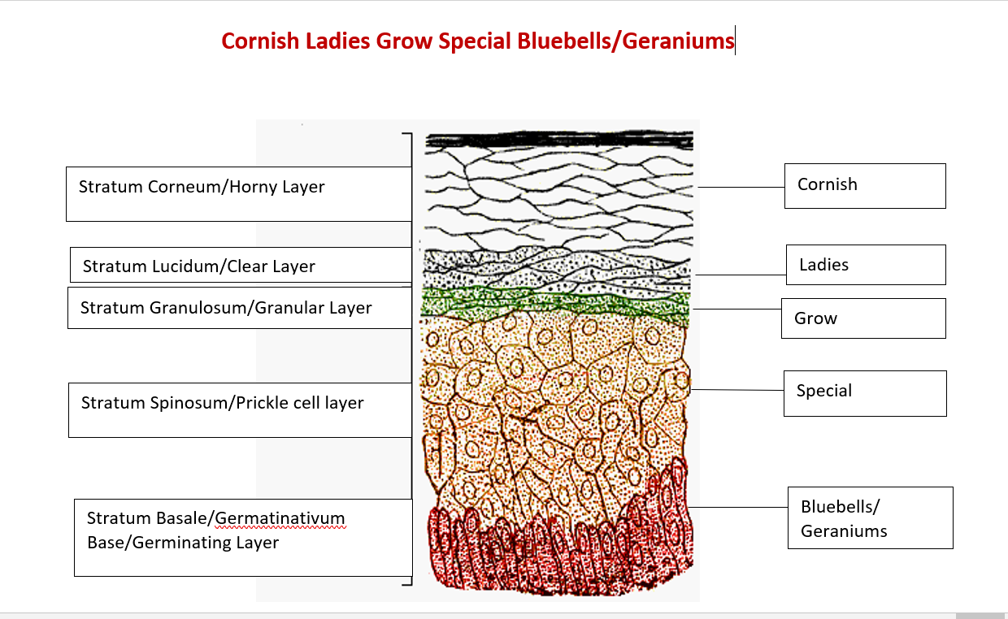
The five layers of the epidermis are:
Stratum Corneum.
Stratum Lucidum.
Stratum Granulosum.
Stratum Spinosum.
Stratum Germinativum.
Notes:
Recruitment: during enrolment it is essential that key staff are in place to provide correct information. Initial screening must be used to signpost study support mechanisms possible transfers. Induction must focus on the student experience and give as much support as possible. 8 week VTCT rule to register. Crucial that staff are not trigger happy with equal prior to this. Retention .TRO ,All staff /DHoS Sl’s to check parent level retention on ARC and communicate instantly effectively across all staff learners at risk. Retention is currently 12% higher than last year at
Attainment must improve from 78% to targeted 92% . All HAT staff are driving measures forward under my direction to achieve this. Task and Finish groups address the QDP issues from the SAR . Mature learners are 49% across provision, exciting calendar of events , inspire, employer engagement, competitions and educational visits / European wplacements. Formalis d exam schedule involving penalty fees of £20 no show £10 each resist. This is showing a huge improvement from previously, missed opportunity assessments and flexible approach to support all students . Main aim to prevent end loading of assessments and assessment fatigue.

Slide 6
Notes:
Recruitment: during enrolment it is essential that key staff are in place to provide correct information. Initial screening must be used to signpost study support mechanisms possible transfers. Induction must focus on the student experience and give as much support as possible. 8 week VTCT rule to register. Crucial that staff are not trigger happy with equal prior to this. Retention .TRO ,All staff /DHoS Sl’s to check parent level retention on ARC and communicate instantly effectively across all staff learners at risk. Retention is currently 12% higher than last year at
Attainment must improve from 78% to targeted 92% . All HAT staff are driving measures forward under my direction to achieve this. Task and Finish groups address the QDP issues from the SAR . Mature learners are 49% across provision, exciting calendar of events , inspire, employer engagement, competitions and educational visits / European wplacements. Formalis d exam schedule involving penalty fees of £20 no show £10 each resist. This is showing a huge improvement from previously, missed opportunity assessments and flexible approach to support all students . Main aim to prevent end loading of assessments and assessment fatigue.

Slide 7
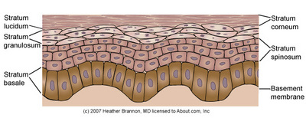
Notes:
Recruitment: during enrolment it is essential that key staff are in place to provide correct information. Initial screening must be used to signpost study support mechanisms possible transfers. Induction must focus on the student experience and give as much support as possible. 8 week VTCT rule to register. Crucial that staff are not trigger happy with equal prior to this. Retention .TRO ,All staff /DHoS Sl’s to check parent level retention on ARC and communicate instantly effectively across all staff learners at risk. Retention is currently 12% higher than last year at
Attainment must improve from 78% to targeted 92% . All HAT staff are driving measures forward under my direction to achieve this. Task and Finish groups address the QDP issues from the SAR . Mature learners are 49% across provision, exciting calendar of events , inspire, employer engagement, competitions and educational visits / European wplacements. Formalis d exam schedule involving penalty fees of £20 no show £10 each resist. This is showing a huge improvement from previously, missed opportunity assessments and flexible approach to support all students . Main aim to prevent end loading of assessments and assessment fatigue.

Slide 8
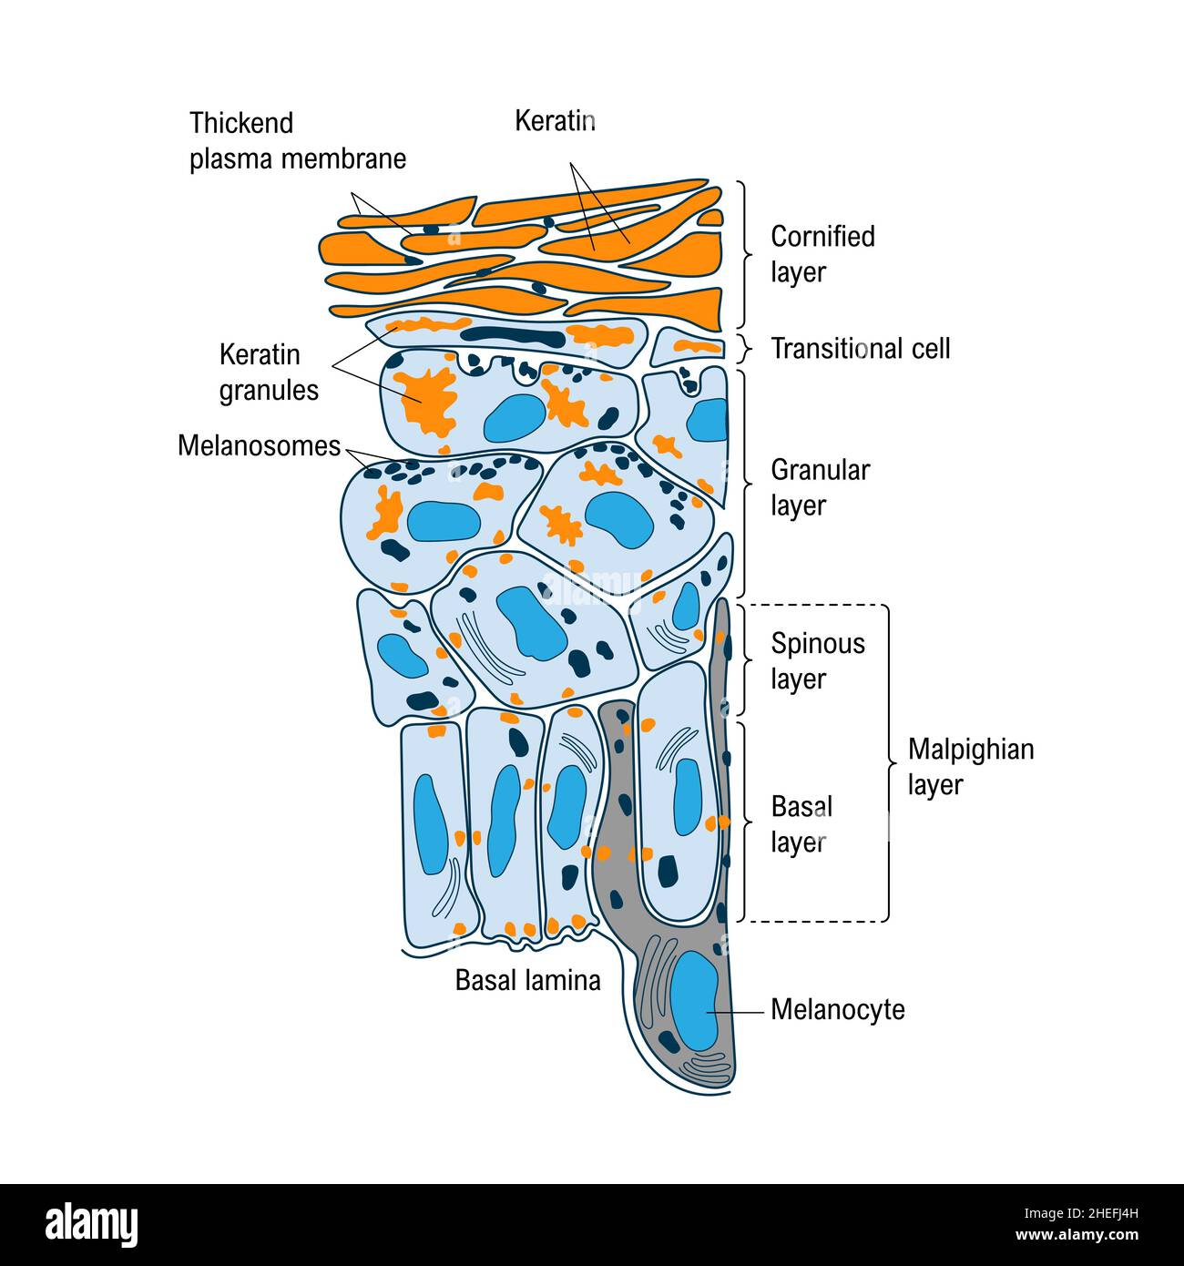
Cornified and Malphigian Layer
The cornified layer is made up of the:
Stratum Corneum
Stratum Lucidum
Stratum Granulosum
The malphigian layer is made up of:
Stratum Spinosum
Stratum Germinativum
Notes:
Recruitment: during enrolment it is essential that key staff are in place to provide correct information. Initial screening must be used to signpost study support mechanisms possible transfers. Induction must focus on the student experience and give as much support as possible. 8 week VTCT rule to register. Crucial that staff are not trigger happy with equal prior to this. Retention .TRO ,All staff /DHoS Sl’s to check parent level retention on ARC and communicate instantly effectively across all staff learners at risk. Retention is currently 12% higher than last year at
Attainment must improve from 78% to targeted 92% . All HAT staff are driving measures forward under my direction to achieve this. Task and Finish groups address the QDP issues from the SAR . Mature learners are 49% across provision, exciting calendar of events , inspire, employer engagement, competitions and educational visits / European wplacements. Formalis d exam schedule involving penalty fees of £20 no show £10 each resist. This is showing a huge improvement from previously, missed opportunity assessments and flexible approach to support all students . Main aim to prevent end loading of assessments and assessment fatigue.

Slide 9
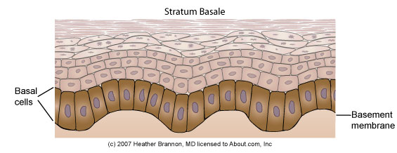
Stratum Basale/
Stratum germinativum
Also known as the basal layer or the stratum germinativum.
Bottom layer of the epidermis. Basale means bottom.
Single layer of columnar cells that rest on the basement membrane and contain a nucleus (alive).
This separates the epidermis and the dermis
These cells are constantly dividing and regenerating.
Cells divide by a process called mitosis where the old cells are pushed up to next layer.
Notes:
Recruitment: during enrolment it is essential that key staff are in place to provide correct information. Initial screening must be used to signpost study support mechanisms possible transfers. Induction must focus on the student experience and give as much support as possible. 8 week VTCT rule to register. Crucial that staff are not trigger happy with equal prior to this. Retention .TRO ,All staff /DHoS Sl’s to check parent level retention on ARC and communicate instantly effectively across all staff learners at risk. Retention is currently 12% higher than last year at
Attainment must improve from 78% to targeted 92% . All HAT staff are driving measures forward under my direction to achieve this. Task and Finish groups address the QDP issues from the SAR . Mature learners are 49% across provision, exciting calendar of events , inspire, employer engagement, competitions and educational visits / European wplacements. Formalis d exam schedule involving penalty fees of £20 no show £10 each resist. This is showing a huge improvement from previously, missed opportunity assessments and flexible approach to support all students . Main aim to prevent end loading of assessments and assessment fatigue.

Slide 10
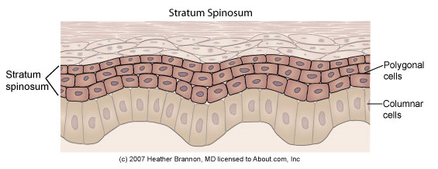
Stratum Spinosum
Stratum Spinosum also known as prickle-cell layer. 2-6 rows of elongated cells.
Cells are pushed from the Stratum Basale to the Stratum Spinosum.
Each cell has a short projection which make contact with neighbouring cells giving a prickly appearance.
Keratin production begins.
Capable of mitotic division. Cells are moving away from blood supply.
Notes:
Recruitment: during enrolment it is essential that key staff are in place to provide correct information. Initial screening must be used to signpost study support mechanisms possible transfers. Induction must focus on the student experience and give as much support as possible. 8 week VTCT rule to register. Crucial that staff are not trigger happy with equal prior to this. Retention .TRO ,All staff /DHoS Sl’s to check parent level retention on ARC and communicate instantly effectively across all staff learners at risk. Retention is currently 12% higher than last year at
Attainment must improve from 78% to targeted 92% . All HAT staff are driving measures forward under my direction to achieve this. Task and Finish groups address the QDP issues from the SAR . Mature learners are 49% across provision, exciting calendar of events , inspire, employer engagement, competitions and educational visits / European wplacements. Formalis d exam schedule involving penalty fees of £20 no show £10 each resist. This is showing a huge improvement from previously, missed opportunity assessments and flexible approach to support all students . Main aim to prevent end loading of assessments and assessment fatigue.

Slide 11
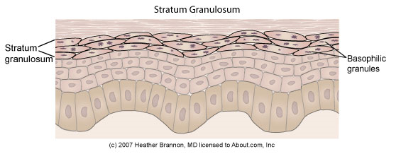
Stratum Granulosum
Stratum Granulosum also known as granular layer.
Found above the prickle-cell layer.
Contains granules.
Keratinisation occurs where cells begins to harden and transform into keratin (protein).
Notes:
Recruitment: during enrolment it is essential that key staff are in place to provide correct information. Initial screening must be used to signpost study support mechanisms possible transfers. Induction must focus on the student experience and give as much support as possible. 8 week VTCT rule to register. Crucial that staff are not trigger happy with equal prior to this. Retention .TRO ,All staff /DHoS Sl’s to check parent level retention on ARC and communicate instantly effectively across all staff learners at risk. Retention is currently 12% higher than last year at
Attainment must improve from 78% to targeted 92% . All HAT staff are driving measures forward under my direction to achieve this. Task and Finish groups address the QDP issues from the SAR . Mature learners are 49% across provision, exciting calendar of events , inspire, employer engagement, competitions and educational visits / European wplacements. Formalis d exam schedule involving penalty fees of £20 no show £10 each resist. This is showing a huge improvement from previously, missed opportunity assessments and flexible approach to support all students . Main aim to prevent end loading of assessments and assessment fatigue.

Slide 12
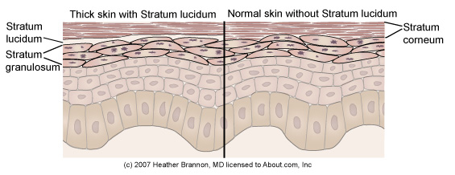
Stratum Lucidum
Also known as the clear layer.
Layer found between the Stratum Granulosum and the Stratum Corneum.
Thickness varies throughout the body.
Thickest in soles of feet and palms of hands.
Composed of 3–4 rows of flattened, dead cells.
Transparent cells that allow light to pass through
Only found in thick skin.
Notes:
Recruitment: during enrolment it is essential that key staff are in place to provide correct information. Initial screening must be used to signpost study support mechanisms possible transfers. Induction must focus on the student experience and give as much support as possible. 8 week VTCT rule to register. Crucial that staff are not trigger happy with equal prior to this. Retention .TRO ,All staff /DHoS Sl’s to check parent level retention on ARC and communicate instantly effectively across all staff learners at risk. Retention is currently 12% higher than last year at
Attainment must improve from 78% to targeted 92% . All HAT staff are driving measures forward under my direction to achieve this. Task and Finish groups address the QDP issues from the SAR . Mature learners are 49% across provision, exciting calendar of events , inspire, employer engagement, competitions and educational visits / European wplacements. Formalis d exam schedule involving penalty fees of £20 no show £10 each resist. This is showing a huge improvement from previously, missed opportunity assessments and flexible approach to support all students . Main aim to prevent end loading of assessments and assessment fatigue.

Slide 13
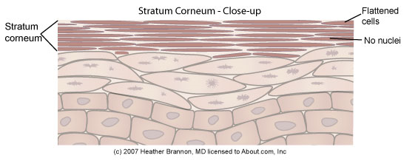
Stratum Corneum
Also known as the horny layer.
Visible part of the epidermis.
Stratum Corneum is completely regenerated every 3-5 weeks and desquamation occurs.
Stratum Corneum contains dead cells.
Effective barrier against heat, light and bacteria.
Notes:
Recruitment: during enrolment it is essential that key staff are in place to provide correct information. Initial screening must be used to signpost study support mechanisms possible transfers. Induction must focus on the student experience and give as much support as possible. 8 week VTCT rule to register. Crucial that staff are not trigger happy with equal prior to this. Retention .TRO ,All staff /DHoS Sl’s to check parent level retention on ARC and communicate instantly effectively across all staff learners at risk. Retention is currently 12% higher than last year at
Attainment must improve from 78% to targeted 92% . All HAT staff are driving measures forward under my direction to achieve this. Task and Finish groups address the QDP issues from the SAR . Mature learners are 49% across provision, exciting calendar of events , inspire, employer engagement, competitions and educational visits / European wplacements. Formalis d exam schedule involving penalty fees of £20 no show £10 each resist. This is showing a huge improvement from previously, missed opportunity assessments and flexible approach to support all students . Main aim to prevent end loading of assessments and assessment fatigue.

Slide 14
Keratinisation
KERATINISATION is the process when cells change from living cells with a nucleus (essential for growth and reproduction) to dead, cornified cells without a nucleus.
The keratinised cells form a waterproof covering preventing the penetration of bacteria and protect the body from minor injury.
Notes:
Recruitment: during enrolment it is essential that key staff are in place to provide correct information. Initial screening must be used to signpost study support mechanisms possible transfers. Induction must focus on the student experience and give as much support as possible. 8 week VTCT rule to register. Crucial that staff are not trigger happy with equal prior to this. Retention .TRO ,All staff /DHoS Sl’s to check parent level retention on ARC and communicate instantly effectively across all staff learners at risk. Retention is currently 12% higher than last year at
Attainment must improve from 78% to targeted 92% . All HAT staff are driving measures forward under my direction to achieve this. Task and Finish groups address the QDP issues from the SAR . Mature learners are 49% across provision, exciting calendar of events , inspire, employer engagement, competitions and educational visits / European wplacements. Formalis d exam schedule involving penalty fees of £20 no show £10 each resist. This is showing a huge improvement from previously, missed opportunity assessments and flexible approach to support all students . Main aim to prevent end loading of assessments and assessment fatigue.

Slide 15
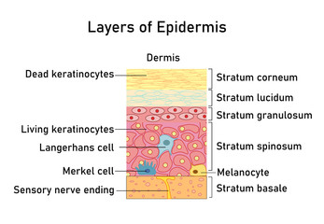
Keratinocytes
Produce protein called Keratin.
Constantly dividing.
Cells mature, lose water, harden, flatten and move upwards to the top part of the skin – Stratum Corneum
Notes:
Recruitment: during enrolment it is essential that key staff are in place to provide correct information. Initial screening must be used to signpost study support mechanisms possible transfers. Induction must focus on the student experience and give as much support as possible. 8 week VTCT rule to register. Crucial that staff are not trigger happy with equal prior to this. Retention .TRO ,All staff /DHoS Sl’s to check parent level retention on ARC and communicate instantly effectively across all staff learners at risk. Retention is currently 12% higher than last year at
Attainment must improve from 78% to targeted 92% . All HAT staff are driving measures forward under my direction to achieve this. Task and Finish groups address the QDP issues from the SAR . Mature learners are 49% across provision, exciting calendar of events , inspire, employer engagement, competitions and educational visits / European wplacements. Formalis d exam schedule involving penalty fees of £20 no show £10 each resist. This is showing a huge improvement from previously, missed opportunity assessments and flexible approach to support all students . Main aim to prevent end loading of assessments and assessment fatigue.

Slide 16
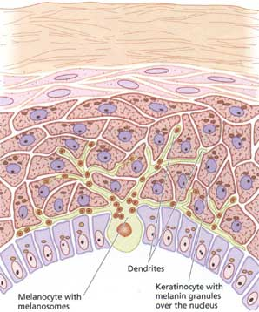
Melanocytes
Create the pigment melanin.
More melanin in the skin the darker the skin colour.
Found in the bottom layer of the epidermis – Stratum Basale.
Freckles – clusters of melanin.
Notes:
Recruitment: during enrolment it is essential that key staff are in place to provide correct information. Initial screening must be used to signpost study support mechanisms possible transfers. Induction must focus on the student experience and give as much support as possible. 8 week VTCT rule to register. Crucial that staff are not trigger happy with equal prior to this. Retention .TRO ,All staff /DHoS Sl’s to check parent level retention on ARC and communicate instantly effectively across all staff learners at risk. Retention is currently 12% higher than last year at
Attainment must improve from 78% to targeted 92% . All HAT staff are driving measures forward under my direction to achieve this. Task and Finish groups address the QDP issues from the SAR . Mature learners are 49% across provision, exciting calendar of events , inspire, employer engagement, competitions and educational visits / European wplacements. Formalis d exam schedule involving penalty fees of £20 no show £10 each resist. This is showing a huge improvement from previously, missed opportunity assessments and flexible approach to support all students . Main aim to prevent end loading of assessments and assessment fatigue.

Slide 17
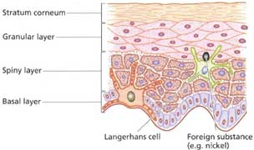
Langerhan Cells
First line of protection against infections.
Create antigens.
Found in the prickle-cell layer.
Notes:
Recruitment: during enrolment it is essential that key staff are in place to provide correct information. Initial screening must be used to signpost study support mechanisms possible transfers. Induction must focus on the student experience and give as much support as possible. 8 week VTCT rule to register. Crucial that staff are not trigger happy with equal prior to this. Retention .TRO ,All staff /DHoS Sl’s to check parent level retention on ARC and communicate instantly effectively across all staff learners at risk. Retention is currently 12% higher than last year at
Attainment must improve from 78% to targeted 92% . All HAT staff are driving measures forward under my direction to achieve this. Task and Finish groups address the QDP issues from the SAR . Mature learners are 49% across provision, exciting calendar of events , inspire, employer engagement, competitions and educational visits / European wplacements. Formalis d exam schedule involving penalty fees of £20 no show £10 each resist. This is showing a huge improvement from previously, missed opportunity assessments and flexible approach to support all students . Main aim to prevent end loading of assessments and assessment fatigue.

Slide 18
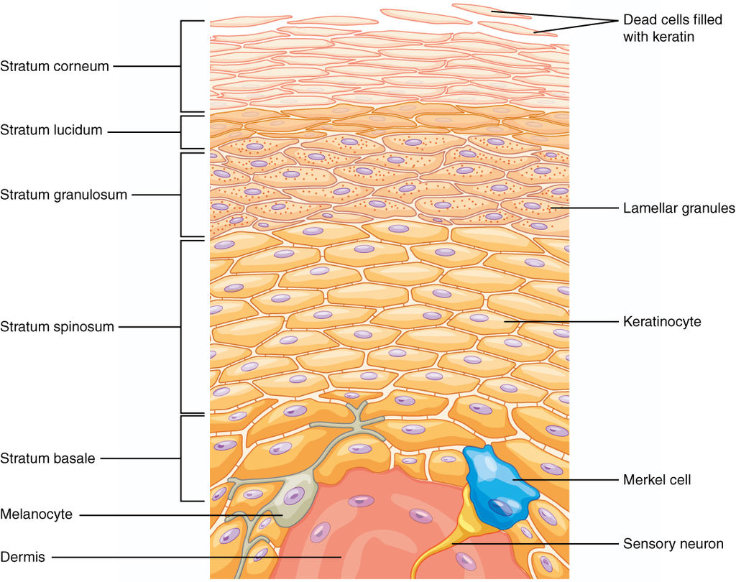
Merkel Cells
Merkel cells contribute to sensation in the skin.
Notes:
Recruitment: during enrolment it is essential that key staff are in place to provide correct information. Initial screening must be used to signpost study support mechanisms possible transfers. Induction must focus on the student experience and give as much support as possible. 8 week VTCT rule to register. Crucial that staff are not trigger happy with equal prior to this. Retention .TRO ,All staff /DHoS Sl’s to check parent level retention on ARC and communicate instantly effectively across all staff learners at risk. Retention is currently 12% higher than last year at
Attainment must improve from 78% to targeted 92% . All HAT staff are driving measures forward under my direction to achieve this. Task and Finish groups address the QDP issues from the SAR . Mature learners are 49% across provision, exciting calendar of events , inspire, employer engagement, competitions and educational visits / European wplacements. Formalis d exam schedule involving penalty fees of £20 no show £10 each resist. This is showing a huge improvement from previously, missed opportunity assessments and flexible approach to support all students . Main aim to prevent end loading of assessments and assessment fatigue.

Slide 19
Carotene
Carotene is a pigment that occurs in epidermal cells and is yellow.
If there is more melanin produced in the skin, then carotene contributes less to skin colour.
Notes:
Recruitment: during enrolment it is essential that key staff are in place to provide correct information. Initial screening must be used to signpost study support mechanisms possible transfers. Induction must focus on the student experience and give as much support as possible. 8 week VTCT rule to register. Crucial that staff are not trigger happy with equal prior to this. Retention .TRO ,All staff /DHoS Sl’s to check parent level retention on ARC and communicate instantly effectively across all staff learners at risk. Retention is currently 12% higher than last year at
Attainment must improve from 78% to targeted 92% . All HAT staff are driving measures forward under my direction to achieve this. Task and Finish groups address the QDP issues from the SAR . Mature learners are 49% across provision, exciting calendar of events , inspire, employer engagement, competitions and educational visits / European wplacements. Formalis d exam schedule involving penalty fees of £20 no show £10 each resist. This is showing a huge improvement from previously, missed opportunity assessments and flexible approach to support all students . Main aim to prevent end loading of assessments and assessment fatigue.

Slide 20
Desquamation
Desquamation is the natural process of shedding dead skin.
Notes:
Recruitment: during enrolment it is essential that key staff are in place to provide correct information. Initial screening must be used to signpost study support mechanisms possible transfers. Induction must focus on the student experience and give as much support as possible. 8 week VTCT rule to register. Crucial that staff are not trigger happy with equal prior to this. Retention .TRO ,All staff /DHoS Sl’s to check parent level retention on ARC and communicate instantly effectively across all staff learners at risk. Retention is currently 12% higher than last year at
Attainment must improve from 78% to targeted 92% . All HAT staff are driving measures forward under my direction to achieve this. Task and Finish groups address the QDP issues from the SAR . Mature learners are 49% across provision, exciting calendar of events , inspire, employer engagement, competitions and educational visits / European wplacements. Formalis d exam schedule involving penalty fees of £20 no show £10 each resist. This is showing a huge improvement from previously, missed opportunity assessments and flexible approach to support all students . Main aim to prevent end loading of assessments and assessment fatigue.

