Slide 1
Introduction
to the
Integumentary System
Notes:
Recruitment: during enrolment it is essential that key staff are in place to provide correct information. Initial screening must be used to signpost study support mechanisms possible transfers. Induction must focus on the student experience and give as much support as possible. 8 week VTCT rule to register. Crucial that staff are not trigger happy with equal prior to this. Retention .TRO ,All staff /DHoS Sl’s to check parent level retention on ARC and communicate instantly effectively across all staff learners at risk. Retention is currently 12% higher than last year at
Attainment must improve from 78% to targeted 92% . All HAT staff are driving measures forward under my direction to achieve this. Task and Finish groups address the QDP issues from the SAR . Mature learners are 49% across provision, exciting calendar of events , inspire, employer engagement, competitions and educational visits / European wplacements. Formalis d exam schedule involving penalty fees of £20 no show £10 each resist. This is showing a huge improvement from previously, missed opportunity assessments and flexible approach to support all students . Main aim to prevent end loading of assessments and assessment fatigue.

Slide 2
The Skin
Skin is the largest organ in the body.
The skin is made up of different parts that cover the muscles, bones and other internal organs.
It is known as the integumentary system.
Notes:
Recruitment: during enrolment it is essential that key staff are in place to provide correct information. Initial screening must be used to signpost study support mechanisms possible transfers. Induction must focus on the student experience and give as much support as possible. 8 week VTCT rule to register. Crucial that staff are not trigger happy with equal prior to this. Retention .TRO ,All staff /DHoS Sl’s to check parent level retention on ARC and communicate instantly effectively across all staff learners at risk. Retention is currently 12% higher than last year at
Attainment must improve from 78% to targeted 92% . All HAT staff are driving measures forward under my direction to achieve this. Task and Finish groups address the QDP issues from the SAR . Mature learners are 49% across provision, exciting calendar of events , inspire, employer engagement, competitions and educational visits / European wplacements. Formalis d exam schedule involving penalty fees of £20 no show £10 each resist. This is showing a huge improvement from previously, missed opportunity assessments and flexible approach to support all students . Main aim to prevent end loading of assessments and assessment fatigue.

Slide 3
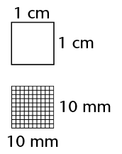
Average adult skin makes up between 15% - 20% of total body weight.
Each cm² contains 6 million cells, 5,000 sensory points, 100 sweat gland and 15 sebaceous (oil) glands.
Skin is constantly regenerated.
2 to 3 billion cells shed daily.
Notes:
Recruitment: during enrolment it is essential that key staff are in place to provide correct information. Initial screening must be used to signpost study support mechanisms possible transfers. Induction must focus on the student experience and give as much support as possible. 8 week VTCT rule to register. Crucial that staff are not trigger happy with equal prior to this. Retention .TRO ,All staff /DHoS Sl’s to check parent level retention on ARC and communicate instantly effectively across all staff learners at risk. Retention is currently 12% higher than last year at
Attainment must improve from 78% to targeted 92% . All HAT staff are driving measures forward under my direction to achieve this. Task and Finish groups address the QDP issues from the SAR . Mature learners are 49% across provision, exciting calendar of events , inspire, employer engagement, competitions and educational visits / European wplacements. Formalis d exam schedule involving penalty fees of £20 no show £10 each resist. This is showing a huge improvement from previously, missed opportunity assessments and flexible approach to support all students . Main aim to prevent end loading of assessments and assessment fatigue.

Slide 4
The skin varies in thickness on different parts of the body (0.05 – 3mm).
The skin is thinnest on the lips and eyelids which must be light and flexible.
The skin is thickest on the soles of the feet and palms of the hands where friction is needed for gripping.
Client’s skin varies in colour, texture and sensitivity.
Notes:
Recruitment: during enrolment it is essential that key staff are in place to provide correct information. Initial screening must be used to signpost study support mechanisms possible transfers. Induction must focus on the student experience and give as much support as possible. 8 week VTCT rule to register. Crucial that staff are not trigger happy with equal prior to this. Retention .TRO ,All staff /DHoS Sl’s to check parent level retention on ARC and communicate instantly effectively across all staff learners at risk. Retention is currently 12% higher than last year at
Attainment must improve from 78% to targeted 92% . All HAT staff are driving measures forward under my direction to achieve this. Task and Finish groups address the QDP issues from the SAR . Mature learners are 49% across provision, exciting calendar of events , inspire, employer engagement, competitions and educational visits / European wplacements. Formalis d exam schedule involving penalty fees of £20 no show £10 each resist. This is showing a huge improvement from previously, missed opportunity assessments and flexible approach to support all students . Main aim to prevent end loading of assessments and assessment fatigue.

Slide 5
Notes:
Recruitment: during enrolment it is essential that key staff are in place to provide correct information. Initial screening must be used to signpost study support mechanisms possible transfers. Induction must focus on the student experience and give as much support as possible. 8 week VTCT rule to register. Crucial that staff are not trigger happy with equal prior to this. Retention .TRO ,All staff /DHoS Sl’s to check parent level retention on ARC and communicate instantly effectively across all staff learners at risk. Retention is currently 12% higher than last year at
Attainment must improve from 78% to targeted 92% . All HAT staff are driving measures forward under my direction to achieve this. Task and Finish groups address the QDP issues from the SAR . Mature learners are 49% across provision, exciting calendar of events , inspire, employer engagement, competitions and educational visits / European wplacements. Formalis d exam schedule involving penalty fees of £20 no show £10 each resist. This is showing a huge improvement from previously, missed opportunity assessments and flexible approach to support all students . Main aim to prevent end loading of assessments and assessment fatigue.

Slide 6
The Integumentary System
‘’The integumentary system is the largest organ of the body that forms a physical barrier between the external environment and the internal environment that it serves to protect and maintain. The integumentary system includes the epidermis, dermis, hypodermis, associated glands, hair, and nails.’’ https://www.ncbi.nlm.nih.gov/books/NBK554386/#:~:text=Introduction,glands%2C%20hair%2C%20and%20nails. 1 May 2023
Notes:
Recruitment: during enrolment it is essential that key staff are in place to provide correct information. Initial screening must be used to signpost study support mechanisms possible transfers. Induction must focus on the student experience and give as much support as possible. 8 week VTCT rule to register. Crucial that staff are not trigger happy with equal prior to this. Retention .TRO ,All staff /DHoS Sl’s to check parent level retention on ARC and communicate instantly effectively across all staff learners at risk. Retention is currently 12% higher than last year at
Attainment must improve from 78% to targeted 92% . All HAT staff are driving measures forward under my direction to achieve this. Task and Finish groups address the QDP issues from the SAR . Mature learners are 49% across provision, exciting calendar of events , inspire, employer engagement, competitions and educational visits / European wplacements. Formalis d exam schedule involving penalty fees of £20 no show £10 each resist. This is showing a huge improvement from previously, missed opportunity assessments and flexible approach to support all students . Main aim to prevent end loading of assessments and assessment fatigue.

Slide 7
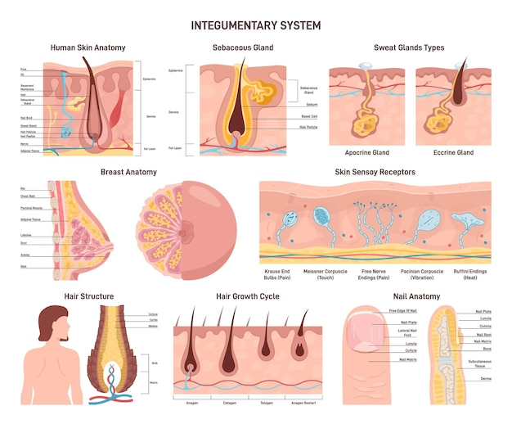
The Integumentary System
Notes:
Recruitment: during enrolment it is essential that key staff are in place to provide correct information. Initial screening must be used to signpost study support mechanisms possible transfers. Induction must focus on the student experience and give as much support as possible. 8 week VTCT rule to register. Crucial that staff are not trigger happy with equal prior to this. Retention .TRO ,All staff /DHoS Sl’s to check parent level retention on ARC and communicate instantly effectively across all staff learners at risk. Retention is currently 12% higher than last year at
Attainment must improve from 78% to targeted 92% . All HAT staff are driving measures forward under my direction to achieve this. Task and Finish groups address the QDP issues from the SAR . Mature learners are 49% across provision, exciting calendar of events , inspire, employer engagement, competitions and educational visits / European wplacements. Formalis d exam schedule involving penalty fees of £20 no show £10 each resist. This is showing a huge improvement from previously, missed opportunity assessments and flexible approach to support all students . Main aim to prevent end loading of assessments and assessment fatigue.

