Slide 1
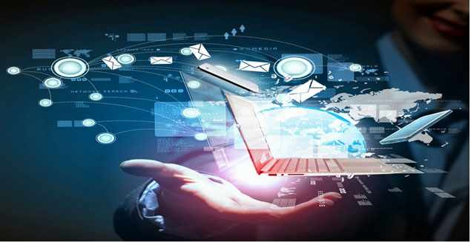
Unit 2: Technology Systems
BTEC Level 1 / Level 2 First in Information and Creative Technology

Slide 2
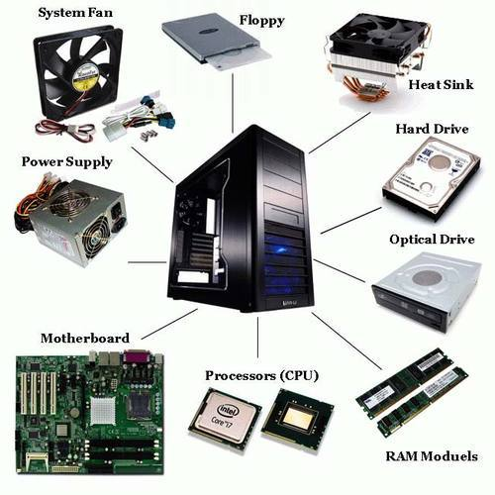
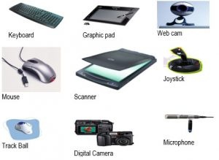
Computer Hardware Devices
The term hardware is used to describe any of the physical devices and components used within a technology system.
It includes different types of computer and other digital devices, for inputting and outputting data, and for data storage.

Slide 3
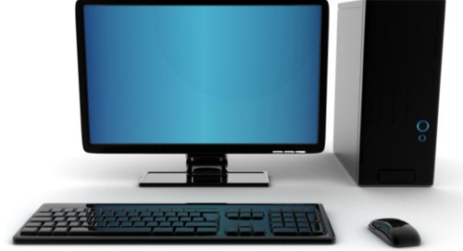
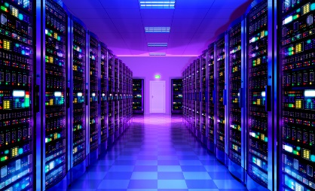
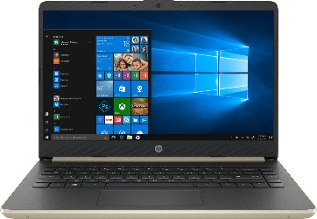
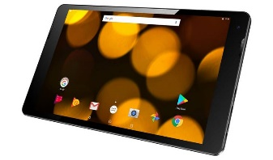
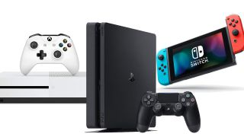
Hardware Devices
You need to know the features and uses of hardware devices including:
Personal computer (PC) – used for running applications, such as word processing and spreadsheets, surfing the web, etc.
Server – a powerful computer with lots of RAM and disk space, used for controlling a network.
Laptop – a portable computer used for mobile computing
Tablet – a touch screen computer used for web browsing
Games console – a computer designed for gaming with high-quality graphics card, used for gaming.
Programmable digital devices – anything with digital control, e.g. a microwave oven, controls hardware.

Slide 4
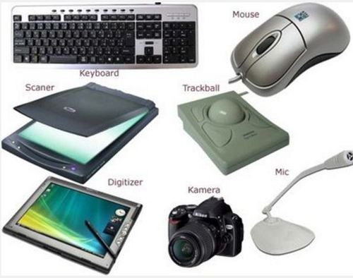
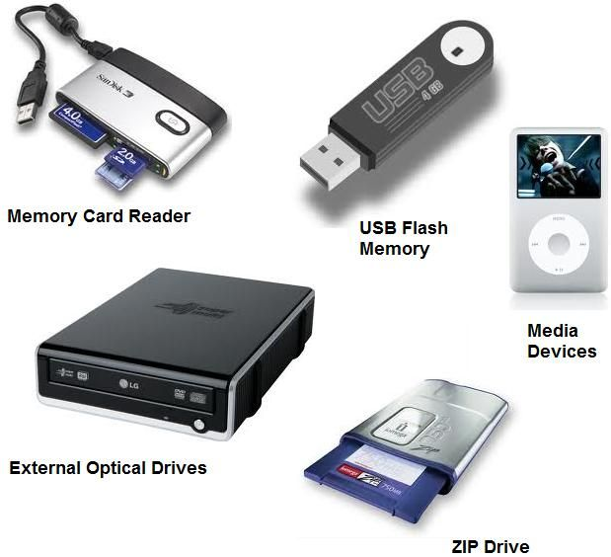
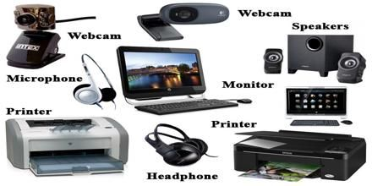
Hardware Devices
Hardware devices are also used by technology devices for:
Inputting: to accept information and commands into the system. Input devices include keyboard, mouse, sensors, touch screen, microphone, scanner and digital camera.
Outputting: to transfer information out of the system. Output devices include printers, speakers, force feedback devices, actuators, screens, projectors, robot arm and other control devices.
Force feedback device – a device used to provide you with touch output from a computer device, e.g. a games controller when it vibrates. An area for future development is a device to give surgeons feedback when carrying out an operation remotely using a robot arm.
Actuator – motors that can be controlled by a technology system such as a motor used to move part of a robot arm.
Storage: to hold information when the hardware device or system is turned off. Storage devices include solid state drives (SSD), optical media such as DVDs and magnetic media such as hard disks.

Slide 5
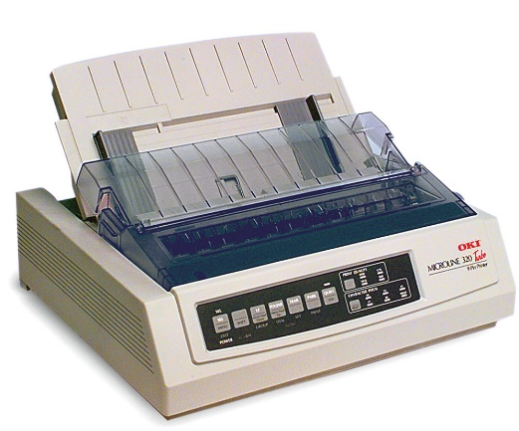
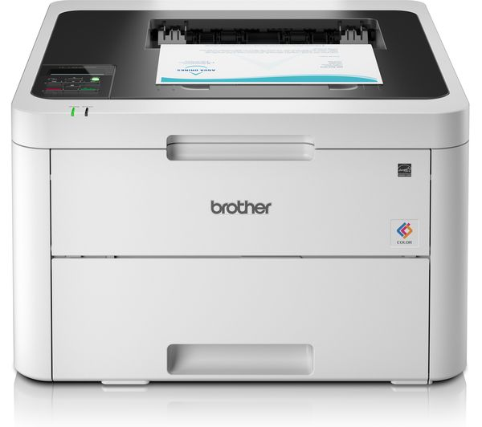
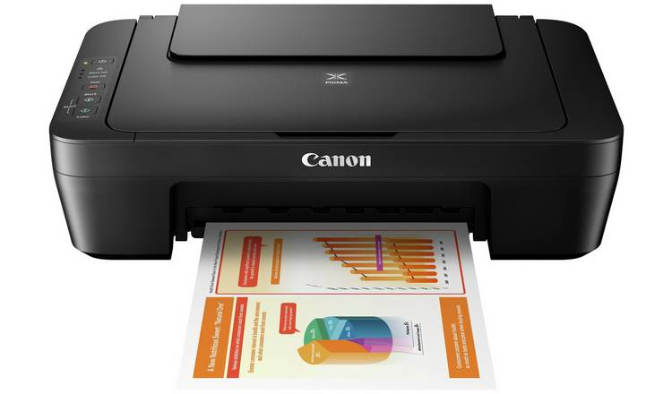
Printers
There are many different types of printer:
Inkjet printer – used in homes and small offices. They are cheap to buy, reasonably cheap to operate and produce good-quality colour output, but are poor at large volume printing.
Laser printers – again used in many homes and businesses. They are relatively cheap to buy, reasonably cheap to operate and are good at large volume printing. They are often black and white but colour laser printers are becoming more widely available.
Impact dot-matrix printer – used by some businesses to print multi-part stationery, which can be separated into copies for the customer and the business. These are more expensive to buy, are loud and have poor print quality, but they are very cheap to run.

Slide 6
Automated Systems
Automated system – a system that uses technology and control systems. It doesn’t usually require human intervention.
In addition to the traditional hardware devices associated with computer systems, different sectors use specialist devices to help improve the efficiency and productivity of their businesses.
Automated technology systems, also know as automated computer systems, monitor and perform activities on our behalf. For example, central heating systems that regulate our environment and robots that explore the universe.

Slide 7
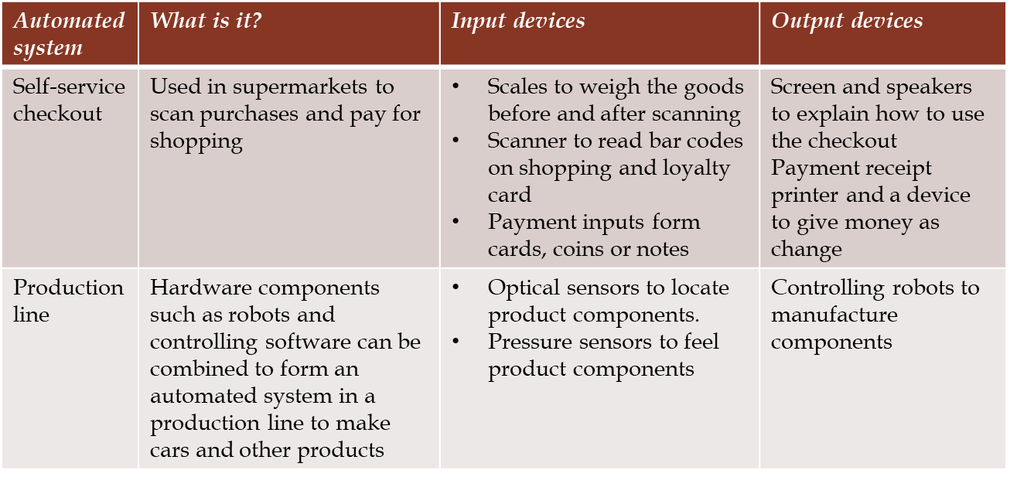
Automated Systems
These are commonly used in supermarkets, factories and many other places. Two examples are provided in the table below:

Slide 8
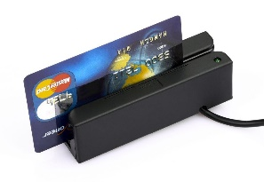
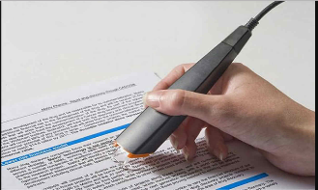
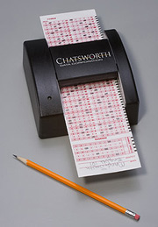
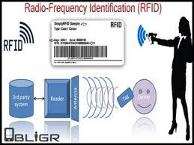
Other Devices
Other devices used to capture and store data in a technology system include:
Magnetic strip readers – used to read some loyalty and other cards.
Optical character readers (OCR) – used to scan a document into text.
Optical mark reader (OMR) – used to input survey and multipole choice forms.
Radio frequency identification systems (RFID) – known as smart labels, are used like bar codes on products for automatic identification and tracking. The technology uses radio-frequency electromagnetic fields to transfer data. Some smart labels require no battery, as they are powered by the electromagnetic fields used to read them.
RFID – the use of wireless non-contact system that uses radio waves to transfer data from a tag attached to an object or person. The technology is mainly used for purposes of automatic identification and tracking.

