Slide 1
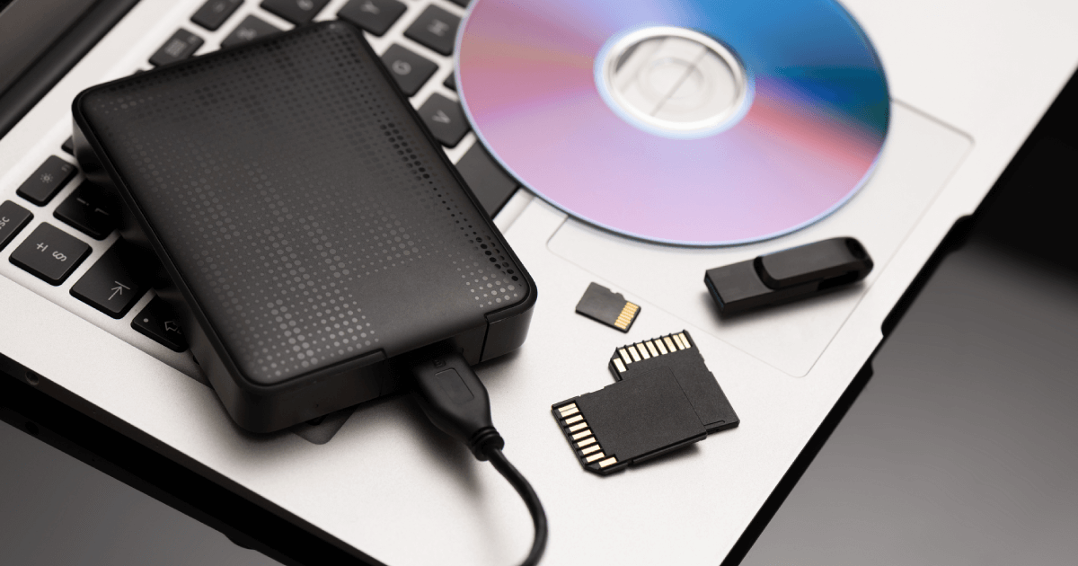
Storage
Devices

Slide 2
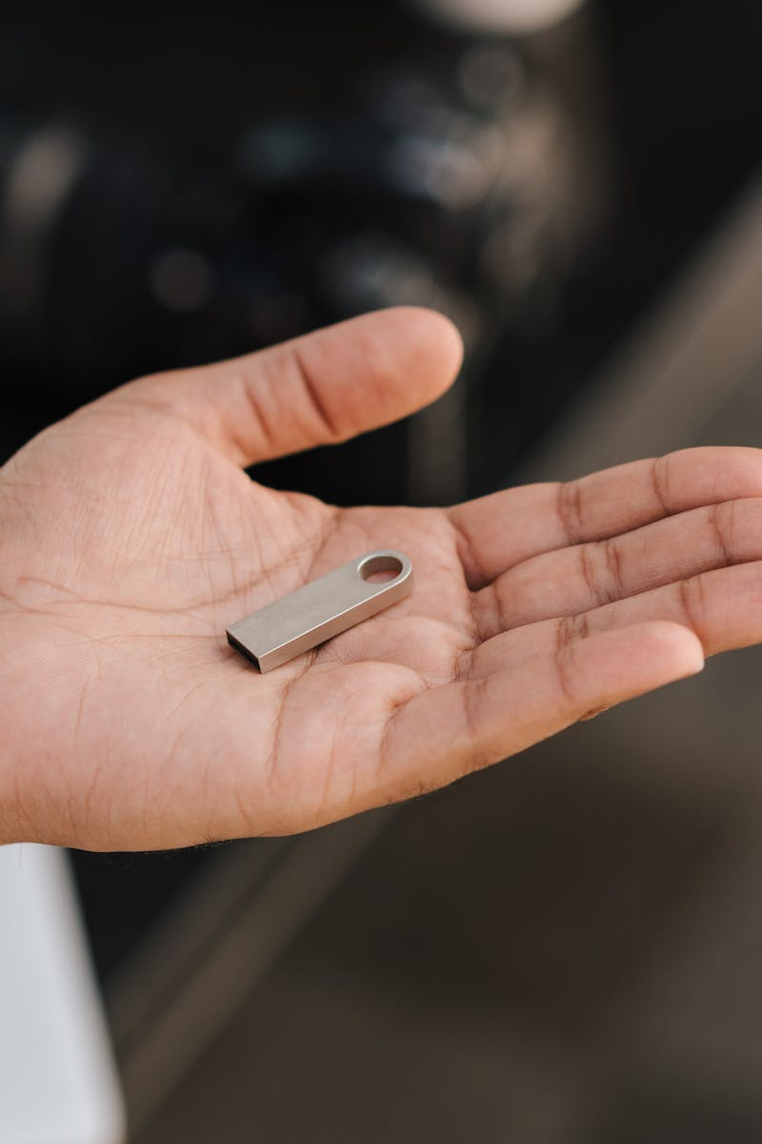
Introduction
This power point presentation will discuss the three different types of storage media:
solid state,
optical media,
and magnetic media.
Image By Anete Lusina https://www.pexels.com/@anete-lusina

Slide 3
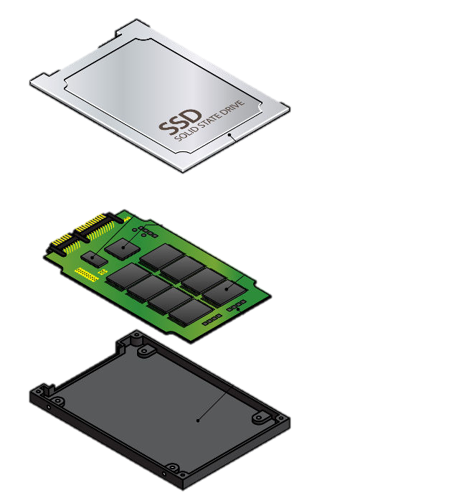
Solid State
Solid-state storage is a type of non-volatile computer memory that can retain the stored information even when not powered. It is typically used in devices such as USB flash drives, solid-state drives (SSDs), and memory cards.
Image By Anete Lusina https://www.pexels.com/@anete-lusina

Slide 4
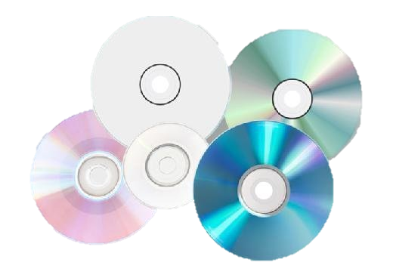
Optical Media
Optical media is a type of storage medium that uses laser technology to store information.
This type of media includes CDs, DVDs, and Blu-ray discs, which can be used to store data, music, video, and other types of information.
Image By Masha Raymers https://www.pexels.com/@masharaymers

Slide 5
Magnetic Media
Magnetic media is a type of storage medium that uses magnetism to store information. This type of media includes –
floppy disks,
hard disks,
and tapes,
which can be used to store data, music, video, and other types of information.
Image By Kevin Malik https://www.pexels.com/@kevin-malik

Slide 6
Find an image for one of the following: solid state, optical media, magnetic media. Save the image and upload below.

