Slide 1
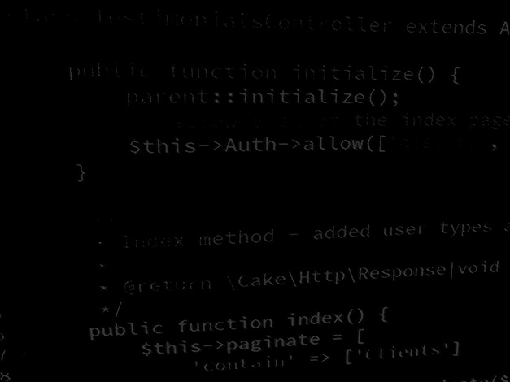
Programming Skills
Java Basics: Java Data Types
HND Computing (Year 2)

Slide 2
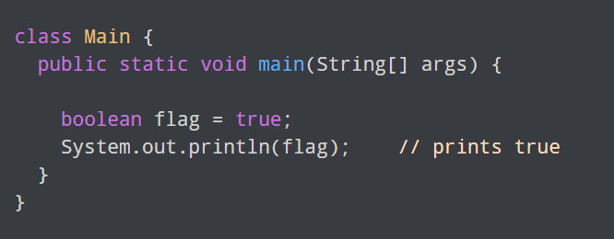
Java Data Types: boolean
The boolean data type has two possible values, either true or false.
Default value: false.
They are usually used for true/false conditions.

Slide 3
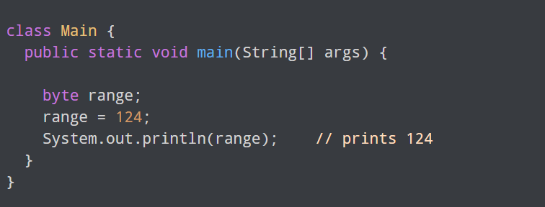
Java Data Types: byte
The byte data type can have values from -128 to 127 (8-bit signed two's complement integer).
If it's certain that the value of a variable will be within -128 to 127, then it is used instead of int to save memory.
Default value: 0

Slide 4
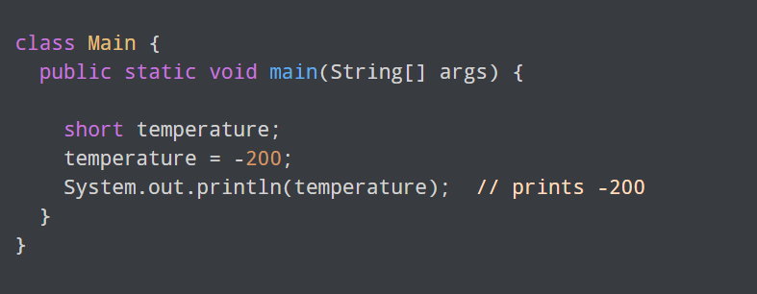
Java Data Types: short
The short data type in Java can have values from -32768 to 32767 (16-bit signed two's complement integer).
If it's certain that the value of a variable will be within -32768 and 32767, then it is used instead of other integer data types (int, long).
Default value: 0

Slide 5
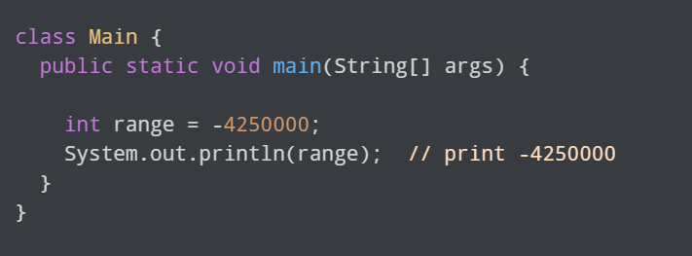
Java Data Types: int
The int data type can have values from -231 to 231-1 (32-bit signed two's complement integer).
Default value: 0

Slide 6
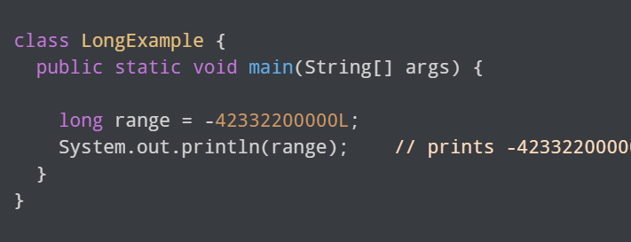
Java Data Types: long
The long data type can have values from -263 to 263-1 (64-bit signed two's complement integer).
Default value: 0

Slide 7
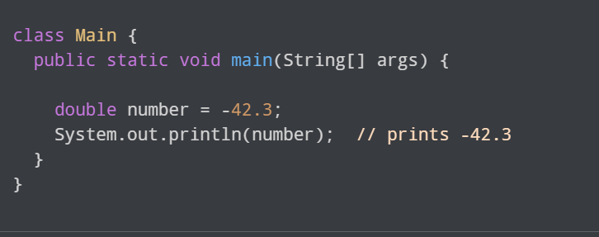
Java Data Types: double
The double data type is a double-precision 64-bit floating-point.
It should never be used for precise values such as currency.
Default value: 0.0 (0.0d)
Notes:
BigDecimal should be used for currency

Slide 8
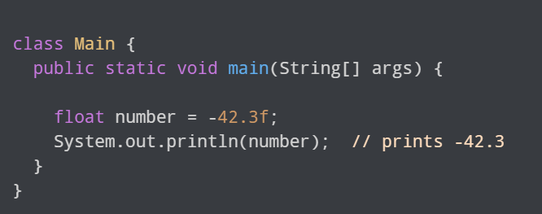
Java Data Types: float
The float data type is a single-precision 32-bit floating-point.
It should never be used for precise values such as currency.
Default value: 0.0 (0.0f)
The key difference between a float and double in Java is that a double can represent much larger numbers than a float. Both data types represent numbers with decimals, but a float is 32 bits in size while a double is 64 bits. A double is twice the size of a float — thus the term double
Notes:
BigDecimal should be used for currency

Slide 9
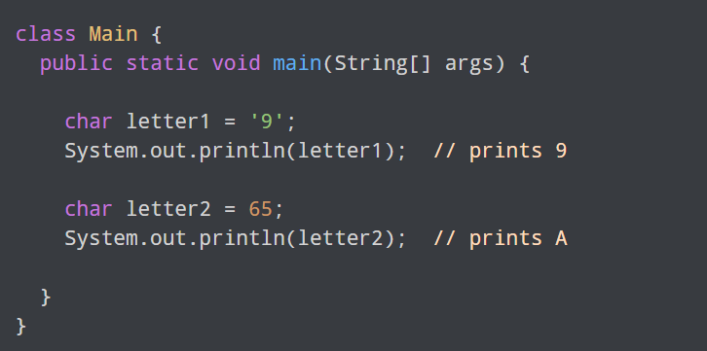
Java Data Types: char
It's a 16-bit Unicode character.
The minimum value of the char data type is '\u0000’ (or 0) and the maximum value of the is '\uffff’ (or 65,535).
Default value: '\u0000’ (or 0)
Here, we have assigned 9 as a character (specified by single quotes) to the letter1 variable. However, the letter2 variable is assigned 65 as an integer number (no single quotes).
Hence, A is printed to the output. It is because Java treats characters as an integer and the ASCII value of A is 65.

Slide 10
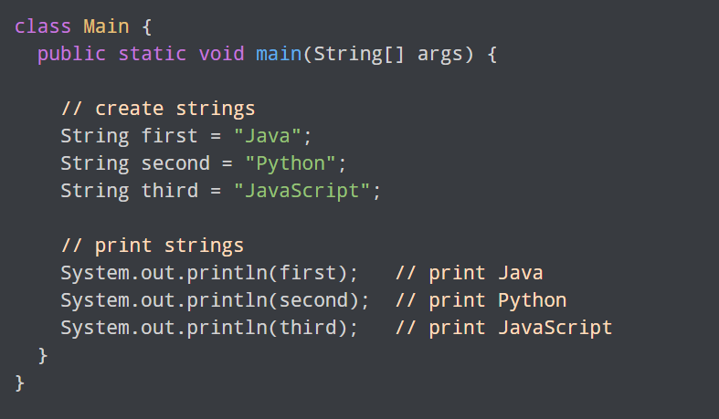
Java Data Types: string
In Java, a string is a sequence of characters.
For example, "hello" is a string containing a sequence of characters 'h', 'e', 'l', 'l', and 'o'.
We use double quotes to represent a string in Java.

Slide 11
Java Data Types:
Declaration and Assigning values
To create a variable in Java: int speedLimit = 80;
Here, speedLimit is a variable of int data type and we have assigned value 80 to it.
In this example, we have assigned value to the variable during declaration. However, it's not mandatory.
You can declare variables and assign variables separately. For example,
int speedLimit; speedLimit = 80;
Note: Java is a statically-typed language. It means that all variables must be declared before they can be used.
To change the value of a variable in Java: speedLimit = 90;

Slide 12
Java Data Types:
Valid Names and Good practice
Java programming language has its own set of rules and conventions for naming variables. Here's what you need to know:
Java is case sensitive. Hence, age and AGE are two different variables. For example:
  int age = 24;
  int AGE = 25;
  System.out.println(age); // prints 24
  System.out.println(AGE); // prints 25
  Valid names and good practice:
    int age; // valid name and good practice – all lower case
    int _age; // valid but bad practice
    int $age; // valid but bad practice
    int 1age; // invalid variable – Can’t start with a number
    int my age; // invalid variable – Can’t have whitespace
    int myAge; // valid name and good practice - all lowercase letters for the first word and capitalise the first letter of each subsequent word

Slide 13
Java Data Types: Type Casting
The process of converting the value of one data type (int, float, double, etc.) to another data type is known as typecasting.
In Java, there are 13 types of type conversion. However, we will only focus on the major 2 types.
  1. Widening Type Casting
  2. Narrowing Type Casting
Notes:
To learn about other types of type conversion, visit Java Type Conversion (official Java documentation).

Slide 14
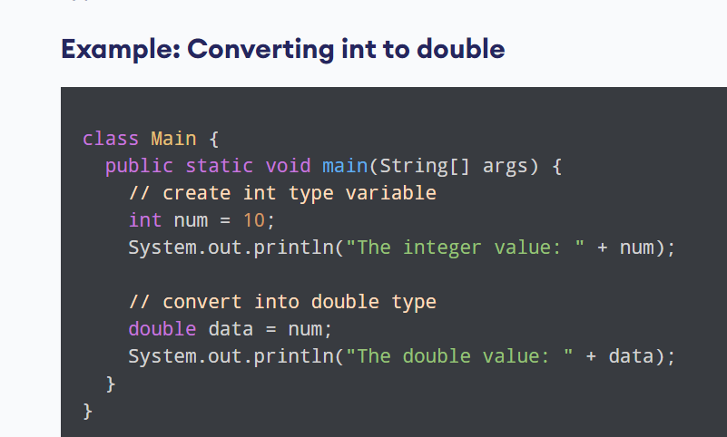
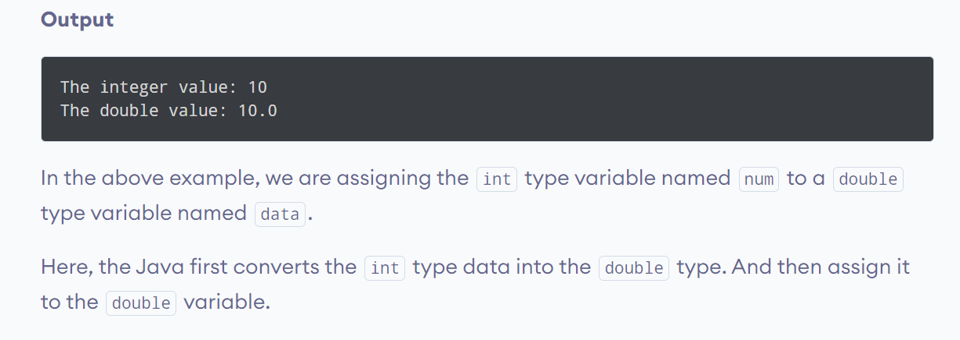
Java Data Types:
Widening Type Casting
Notes:
To learn about other types of type conversion, visit Java Type Conversion (official Java documentation).

Slide 15
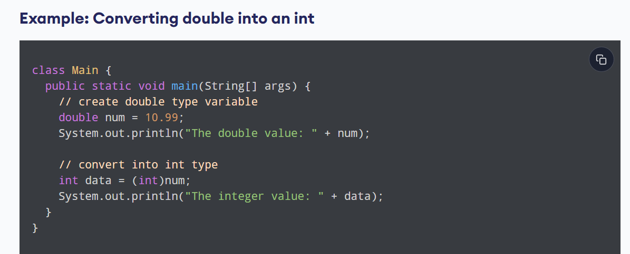
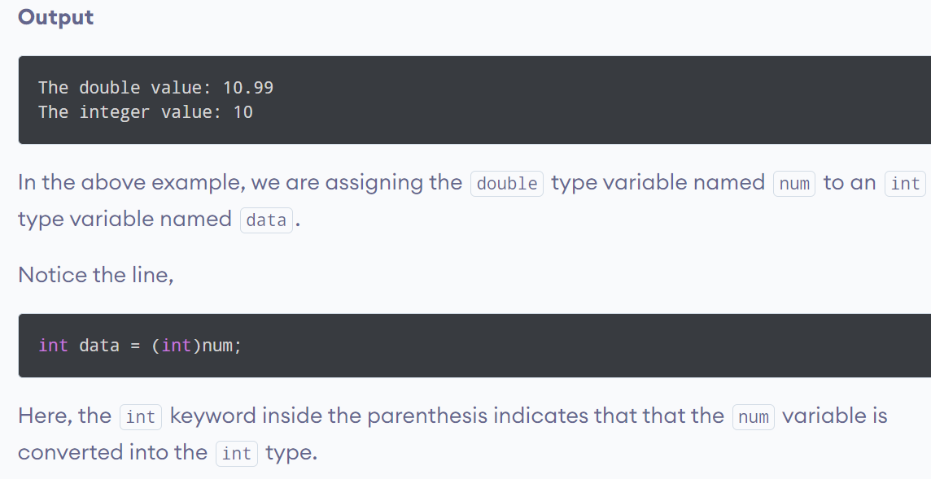
Java Data Types:
Narrowing Type Casting
Notes:
To learn about other types of type conversion, visit Java Type Conversion (official Java documentation).

Slide 16
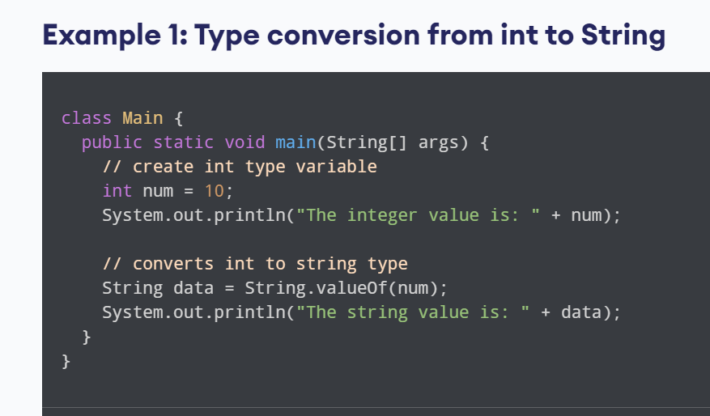
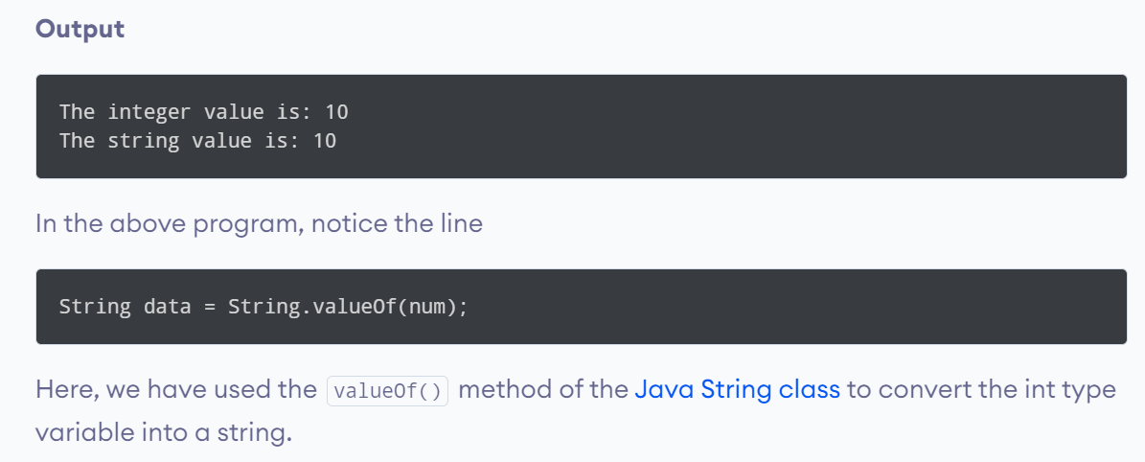
Java Data Types:
Type Casting Examples
Notes:
To learn about other types of type conversion, visit Java Type Conversion (official Java documentation).

Slide 17
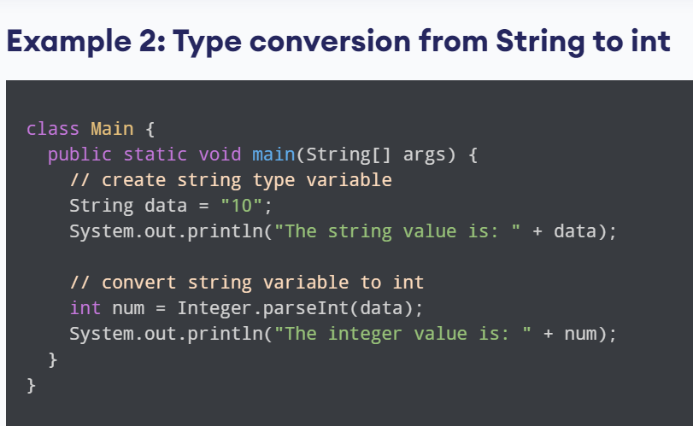
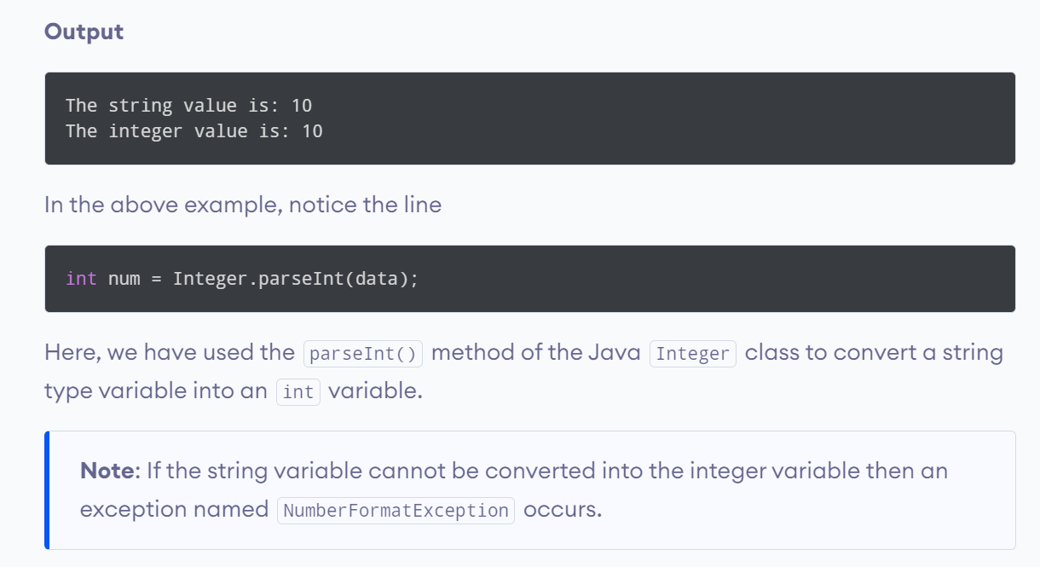
Java Data Types:
Type Casting Examples
Notes:
To learn about other types of type conversion, visit Java Type Conversion (official Java documentation).

