Slide 1
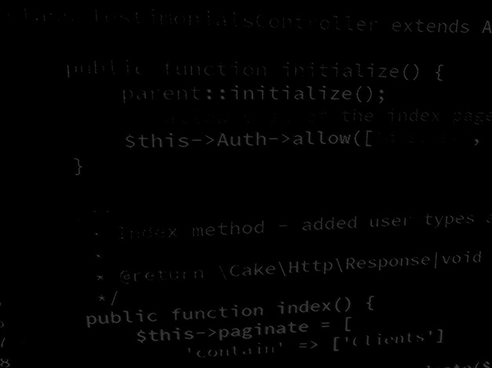
Programming Skills Java Basics: Java Operators
HND Computing (Year 2)

Slide 2
Java Operators: Arithmetic

Slide 3
Java Operators: Assignment

Slide 4
Java Operators: Relational

Slide 5
Java Operators: Logical

Slide 6
Java Operators: Unary

