Slide 1
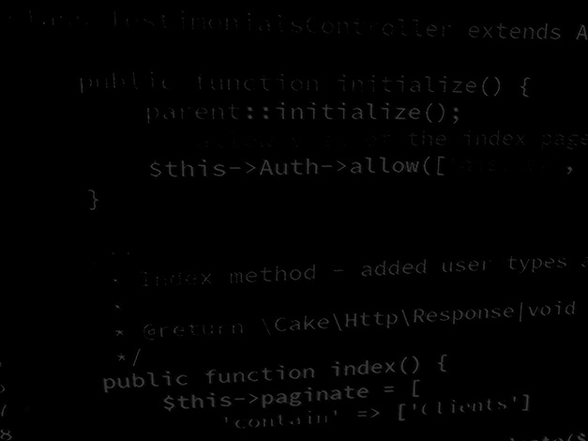
Programming Skills Java Basics: Java Input and Output
HND Computing (Year 2)

Slide 2
Java Output

Slide 3
Java Output

Slide 4
Java Output: Variables

Slide 5
Java Output: Strings

Slide 6
Java Input

Slide 7
Java Input: Integers

Slide 8
Java Input: Floats, Doubles and Strings

