Slide 1
Unit 2: Technology Systems
BTEC Level 1 / Level 2 First in Information and Creative Technology

Slide 2
Physical methods of transferring data
Physical methods of transferring data between devices use cabled topology to connect the devices together.
Cabling must always meet the requirements for specified users and purposes.
Cabled methods include:
Optical fibre
UTP – unshielded twisted pair
Coax – coaxial cables

Slide 3
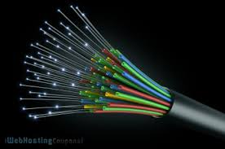
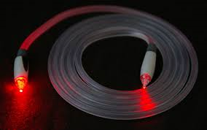
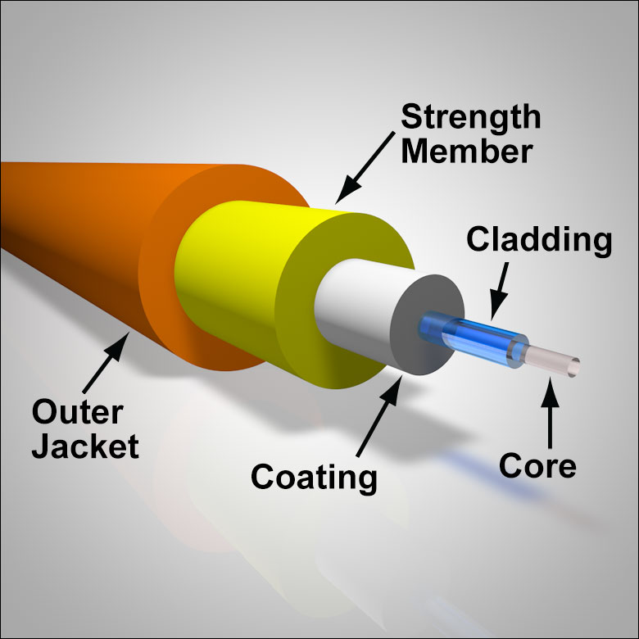
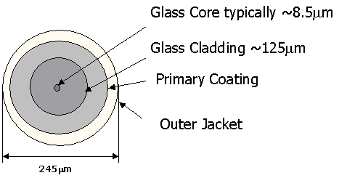
Optical fibre
This is used for very fast connections between switches in a network and to bring broadband to buildings and business premises.
Optical fibre cables are great for fast connections, but not very good for places where the cable might be moved, such as a connection to a workstation.

Slide 4
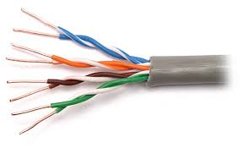
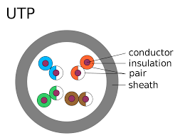
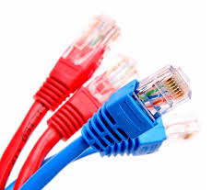
Unshielded twisted pair
Used widely to connect computers and printers to switches in LANs with CAT6 or CAT5 cabling.
UTP is a great all-rounder for cabled LANS, but is poor at very high speeds.

Slide 5
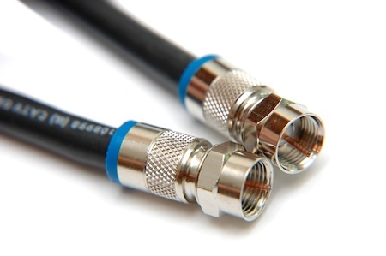
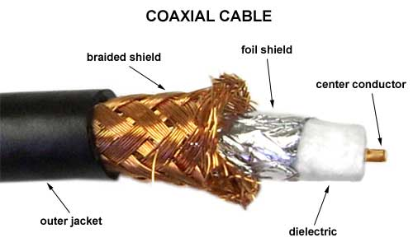
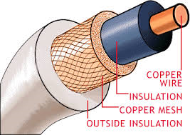
Coaxial Cables
Coax is used to connect homes to optical broadband systems.
Coax is good for short distances, but poor for longer stretches.
Older networks used copper coaxial cabling, which was a lot slower, this has mostly been replaced by UTP.

Slide 6
Wireless methods of transferring data
Wi-Fi
Wi-Fi is a very common technology built into every laptop for connection to LANs.
Many printers and desktop computers have built in Wi-Fi for connection to a wireless network and so they are easily positioned without a network cable.
Other computers that need a wireless connection can have a Wi-Fi network card installed or Wi-Fi devices can connect via the USB port (universal serial bus)
Wi-Fi needs a wireless access point (WAP) which is often part of a router and acts like a switch to connect the wireless devices together.

Slide 7
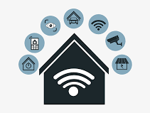
Wireless methods of transferring data
Wi-Fi
802.11 protocol defines how Wi-Fi devices can transmit and receive data. 802.11 has several variations – 802.11g at 54 Mbps and 802.11n at up to 300Mbps are the current standards.
When looking for a wireless router, you first want to check whether it’s b, g or n. The letters refer to the wireless communication standard on which the router is based: 802.11b, 802.11g, and 802.11n.
The first generation of wireless routers was b, followed by g, and now n – the newest generation.
The primary difference among the router standards is and range.
You won’t find many b routers available anymore (except on eBay, perhaps) because it’s old technology.

Slide 8
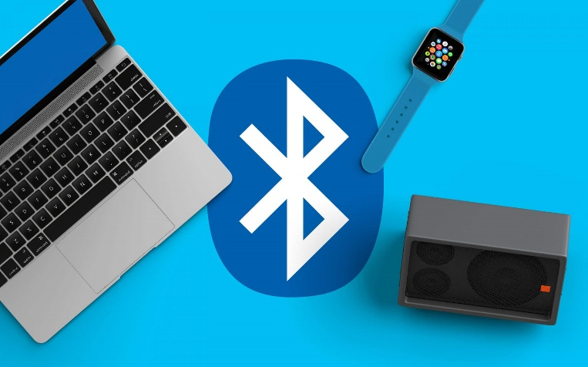
Wireless methods of transferring data
Bluetooth
Bluetooth is a short-range, fairly slow wireless technology that is built into most mobile devices. It is used to connect mobile phones to headsets and for data transfers such as MP3 music between phones and computers.

Slide 9
Methods of transferring | Benefits | Drawbacks

