Slide 1
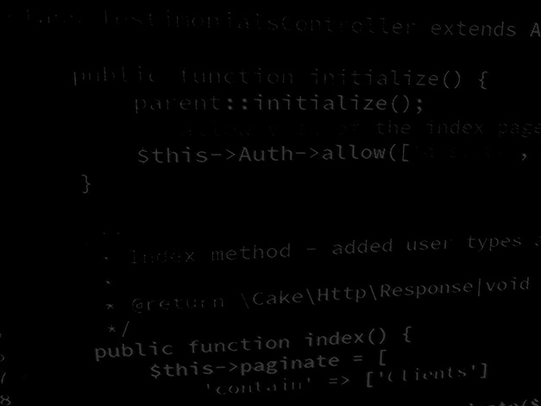
Programming Skills Java Methods
HND Computing (Year 2)

Slide 2
Introduction
Methods are used to perform certain actions, and they are also known as functions.
A method is a block of code which only runs when it is called.
Why use methods?
To reuse code: define the code once, and use it many times.
Dividing a complex problem into smaller chunks makes your program easy to understand.

Slide 3
Introduction
In Java, there are two types of methods:
User-defined Methods: We can create our own method based on our requirements.
Standard Library Methods: These are built-in methods in Java that are available to use.
Example: System.out.println()

Slide 4
Declaring a Method
A method must be declared within a class.
It is defined with the name of the method, followed by parentheses ()
public class Main
{
static void myMethod()
{ // code to be executed
}
}
myMethod() is the name of the method
static means that the method belongs to the Main class and not an object of the Main class. You will learn more about objects and how to access methods through objects in the next topic.
void means that this method does not have a return value. You will learn more about return values later in this topic

Slide 5
Calling a Method
To call a method in Java, write the method's name followed by two parentheses () and a semicolon;
In the following example, myMethod is used to print a text (the action), when it is called:

Slide 6
Calling a Method
A method can also be called multiple times:

Slide 7
Parameters and Arguments
Information can be passed to methods as parameter.
Parameters act as variables inside the method.
Parameters are specified after the method name, inside the parentheses. You can add as many parameters as you want, just separate them with a comma.
The following example has a method that takes a String called fname as parameter. When the method is called, we pass along a first name, which is used inside the method to print the full name:
When a parameter is passed to the method, it is called an argument.
So, in this example above: Fname is a parameter, while Liam, Jenny and Anja are arguments

Slide 8
Multiple Parameters
You can have as many parameters as you like:
Note that when you are working with multiple parameters, the method call must have the same number of arguments as there are parameters, and the arguments must be passed in the same order

Slide 9
Return Values
The void keyword, used in the examples, indicates that the method should not return a value.
If you want the method to return a value, you can use a primitive data type (such as int, char, etc.) instead of void, and use the return keyword inside the method:

Slide 10
Return Values
This example returns the sum of a method's two parameters:

Slide 11
Return Values
You can also store the result in a variable (recommended, as it is easier to read and maintain):

Slide 12
Return Values

Slide 13
Return Values

Slide 14
Java Standard Library Method

Slide 15
Java Method Reusability

