Slide 1
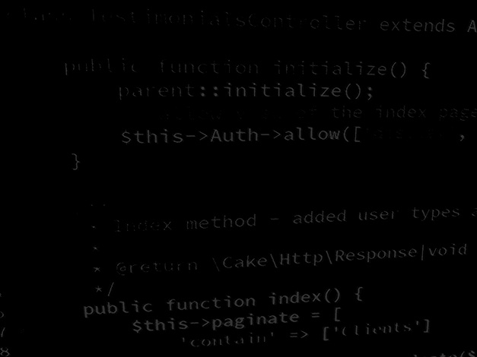
UI design and build using Java Project 1 – Hangman.
BSc Applied Computing

Slide 2
In this session…
Project specifications.
Task.

Slide 3
Project specifications
BSc Applied Computing

Slide 4
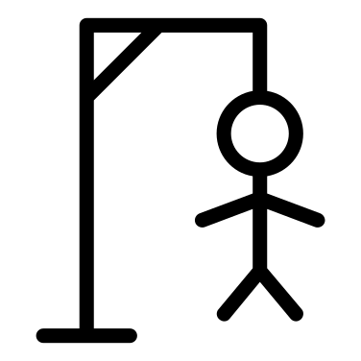
Project specifications
You have been tasked with designing and building a program which plays the classroom Hangman game.
The first stage is to design a UI layout appropriate for a game of hangman.
The UI should scale to fit different screens.
The UI should have:
an area for displaying the game status (drawing the hanged man).
An area for the user controls. These controls will allow the user to guess a single letter at a time.
An area for displaying how much of the puzzle word has been correctly guessed.
Create a layout design for this project (or several).

Slide 5
Any questions?
Next session
Learning PHP #1

