Slide 1
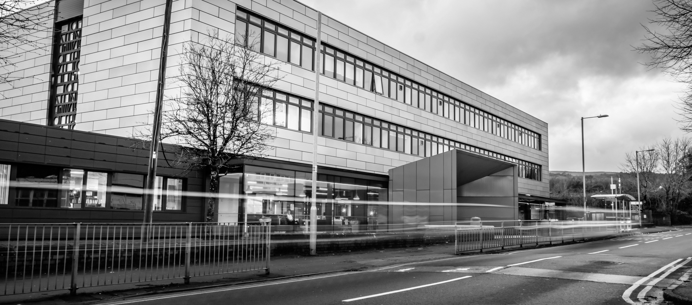
2025
CDT Taster Day
https://www.nptcgroup.ac.uk
Take a Look

Slide 2
About the College
NPTC Group of Colleges is one of Wales’ largest further education providers, offering academic and vocational courses from entry level to degrees.
Formed in 2013, it serves communities across Neath Port Talbot and Powys through its four main locations.
https://www.nptcgroup.ac.uk

Slide 3
We offer 14 full-time courses in IT, Digital Technologies, Computer Science, Esports, and Game Design, from Level 1 and A-Level up to Degree Level, preparing you for careers in the digital and creative industries.
What We Offer
Our Locations
We deliver these courses at our four main campuses—Neath, Afan, Brecon, and Newtown—covering around 30% of Wales' landmass
https://www.nptcgroup.ac.uk

Slide 4
Our Newest Courses
Level 2 Game Design
Level 3 Game Dev
Level 3 Esports
2 GCSEs at Grade C or above or alternatively a relevant Level 1 Qualification.
5 GCSEs A*-C, or relevant Level 2 qualification (including Maths and English)
5 GCSEs A*-C, or relevant Level 2 qualification (including Maths and English)
https://www.nptcgroup.ac.uk

Slide 5
Progression Opportunities
Level 1
Level 2
A-Level / Level 3
>>> Information Technology
>>> Information & Creative Technology
>>> Esports
>>> Game Development
>>> Computer Science
>>> Digital Technology
>>> Esports
>>> Game Development
https://www.nptcgroup.ac.uk

Slide 6
Progression Opportunities
Level 4
Level 5
Level 6
>>> HNC Applied Computing
>>> HND Applied Computing
>>> BSc (Hons) Applied Computing
https://www.nptcgroup.ac.uk

Slide 7
Level 1
Information Technology
Course Description
>>> This is a 1-year, full-time course enabling learners to develop their understanding and practical skills through looking at how ICT is used in industry and commerce.
Semester One
>>> Being Organised
>>> Developing a Personal Progression Plan
>>> Using Digital Communication Technologies
>>> Creating a Spreadsheet to Solve Problems
>>> Creating a Computer Program
Semester Two
>>> Working with Others
>>> Researching a Topic
>>> Solving Technical IT Problems
>>> Creating a Website
>>> Creating a Digital Animated Graphic
>>> UAL Game Design
Entry Requirements
>>> A minimum of 2 GCSEs at Grades E & F

Slide 8
Level 2
Information & Creative Technology
Course Description
>>> This is a 1-year, full-time course for learners who wish to develop their ICT skills and it will provide the knowledge, understanding and skills needed to prepare for employment in the IT industry.
Semester One
>>> The Online World
>>> Technology Systems
>>> Spreadsheet Development
>>> Website Development
Semester Two
>>> Digital Portfolio
>>> Database Development
>>> Software Development
>>> Installing & Maintaining Computer Hardware
Entry Requirements
>>> 3 GCSEs at Grade C or above to include Maths or English

Slide 9
Level 2
Esports
Course Description
>>> This is a 1-year, full-time course for learners who wish to develop their ICT skills and it will provide the knowledge, understanding and skills needed to prepare for employment in the IT industry.
Course Units
>>> Esports Games, Teams and Tournaments
>>> Establishing an Esports Organisation
>>> Streaming for Esports
>>> Plan for an Esports Event
>>> Start an Enterprise in Esports
>>> Design an Esports Game
>>> UAL Game Design
Entry Requirements
>>> 3 GCSEs at Grade C or above to include Maths or English

Slide 10
Level 2
Game Design & Dev
Course Description
>>> This 1-year, full-time UAL Level 2 course is designed to develop practical and creative skills for the thriving games industry in Wales, preparing learners for Level 3 study, apprenticeships, or careers in the digital and creative sectors.
Course Units
>>> Introduction to creative media methods and skills
>>> Introduction to production techniques in creative media
>>> Understanding an audience in creative media production
>>> Contextual research for creative media production
>>> Exploring audio production and technology
>>> Exploring visual production and technology
>>> Exploring interactive media production and technology
>>> Personal project and presentation in creative media production
Entry Requirements
>>> 3 GCSEs at Grade C or above to include Maths or English

Slide 11
A-Level
Computer Science
Course Description
>>> This 2-year, full-time course is designed to develop a sound theoretical background as well as relevant skills in various aspects of computing.
Year One - AS
>>> Knowledge and understanding of software, system development, data and applications, and using this knowledge to develop a solution to a given problem.
Year Two - A2
>>> Builds on the foundation of year one and leads to the development of a solution to a substantial problem of the candidate’s own choice.
Entry Requirements
>>> 6 GCSEs at grades A*–C, including at least a Grade B in Mathematics and a Grade C in English. ICT/DT or Computing is not required.

Slide 12
A-Level
Digital Technology
Course Description
>>> This 2-year, full-time course is designed to develop a sound theoretical background as well as relevant skills in various aspects of computing.
Year One - AS
>>> Covers the use of innovating digital technologies in society. The coursework involves planning a project that leads to the creation, testing and refinement of a video game that meets the needs of a particular audience or user.
Year Two - A2
>>> Covers cyber security, system resilience, and how digital and mobile networks support communication and data transmission. Students plan, build, and test a fully functional transactional website with a connected backend database, based on a real-world scenario.
Entry Requirements
>>> 6 GCSE passes at Grade A to C (including Mathematics and English at Grade C or above). ICT/DT or Computing is not required.

Slide 13
Level 3
Information Technology
Course Description
>>> This 2-year, full-time course in computing and IT, combines hands-on skills with industry-relevant knowledge. It prepares students for careers in the sector or progression to university-level study.
Year 1 - Semester One
>>> Information Technology Systems 1
>>> Creating Systems to Manage Information
>>> Using Social Media in Business
>>> Programming 1
Year 2 - Semester One
>>> IT Project Management 1
>>> Cyber Security and Incident Management
>>> Mobile Apps Development
>>> Digital Graphics
Year 1 - Semester Two
>>> Information Technology Systems 2
>>> Data Modelling
>>> Website Development
>>> Programming 2
Year 2 - Semester Two
>>> IT Project Management 2
>>> IT Service Delivery
>>> Computer Games Development
>>> The Internet of Things
Entry Requirements
>>> 5 GCSEs at Grade C or above (or equivalent) to include Mathematics and English.

Slide 14
Level 3
Esports
Course Description
>>> This 2-year, full-time course offers a pathway into Esports and related digital fields such as game design, content creation, digital marketing, and events. Endorsed by the British Esports Association, it equips learners with transferable skills for employment or further study.
Year 1
>>> Introduction to Esports
>>> Esports Skills, Strategies & Analysis
>>> Enterprise & Entrepreneurship in the Esports Industry
>>> Health, Wellbeing & Fitness for Esports Players
>>> Producing and Esports Brand
>>> Video Production
>>> Games Design
Year 2
>>> Live-streamed Broadcasting
>>> Business Applications of Esports in Social Media
>>> ESport Coaching
>>> Psychology for Esports performance
>>> Nutrition for Esports performance
>>> Ethical and Current Issues in Esports
>>> Computer Networking
Entry Requirements
>>> 5 GCSEs at Grade C or above (or equivalent) to include Mathematics and English.

Slide 15
Level 3
Game Design & Dev
Course Description
>>> This 2-year, full-time course blends digital and creative disciplines, from programming to game production, preparing students for careers or further study in the growing games and media industries.
Year 1
>>> Introduction to media processes and technical skills
>>> Introduction to design and research skills in creative media production
>>> Introduction to professional practice in creative media production
>>> Critical and contextual awareness in creative media production
>>> Investigating audio production and technology
>>> Investigating visual production and technology
>>> Investigating interactive production and technology
>>> Developing a creative media Production project
Year 2
>>> Characteristics and contexts in creative media production
>>> Engaging with an audience in creative media production
>>> Preparing for progression in creative media production
>>> Specialist study in creative media production
>>> Extended project in creative media production
Entry Requirements
>>> 5 GCSEs at Grade C or above (or equivalent) to include Mathematics and English.

Slide 16
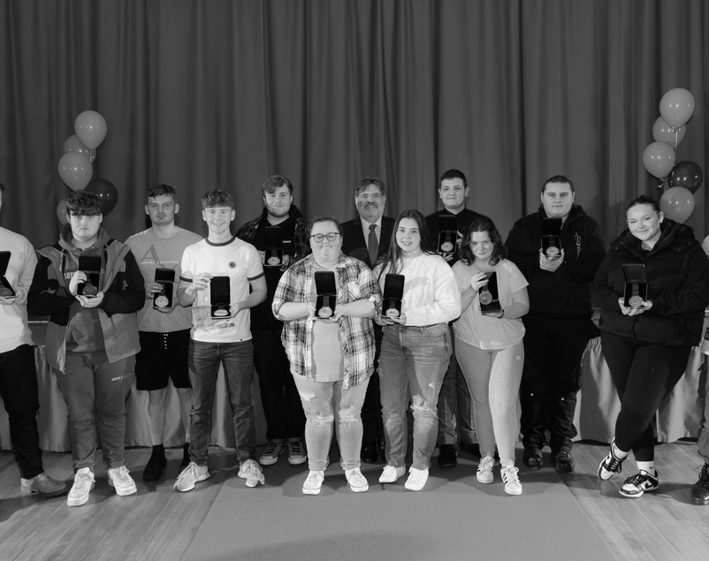
Industry-Led Learning
College Facilities
Extracurricular Activities
Experienced staff with a wealth of industrial competency, with the chance to experience a range of IT and Computing specialisms.
Access to industry-standard hardware and software in bespoke computing labs.
Opportunities to compete in WorldSkills events, including Web Design, Cyber Security, Coding, and Inclusive ICT Skills.
https://www.nptcgroup.ac.uk

Slide 17
Contact Information
How to contact us.
Any questions?
Phone Number
(03308) 188100
Email Address
enquiries@nptcgroup.ac.uk
Mailing Address
NPTC Group of Colleges
Dwr-y-Felin Road,
SA10 7RF

