Slide 1
FRUIT 🥷 NINJA
🍓
🍓
Using GameMaker Studio

Slide 2
Getting Started
Create a new Blank Game
Give it a sensible title, such as “Fruit Ninja”
Make sure you save it to M:Drive

Slide 3
Game Assets (Sprites & Objects)
Alt+S to make a Sprite 1) Make empty Sprites called the following… “Apple”, “Banana”, “Grapes”, “Orange”, “Pear”, “Watermelon”, “Bomb”
2) Import images for each of the sprites (from the downloaded assets – see video on next slide…)
Alt+O to make an Object 3) Create Objects for each of the sprites as follows;
“ObjApple”, “ObjBanana”, “ObjGrapes”, “ObjOrange”, “ObjPear”, “ObjWatermelon”, “ObjBomb” 4) Drag each Sprite to its respective Object name

Slide 4
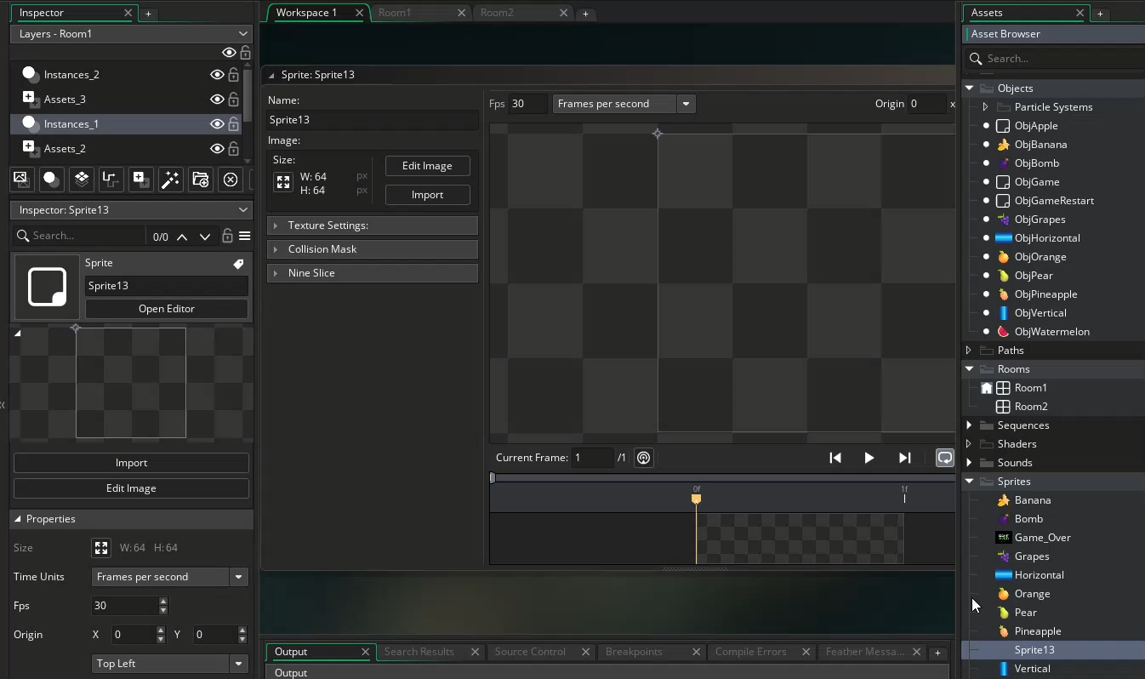

Slide 5
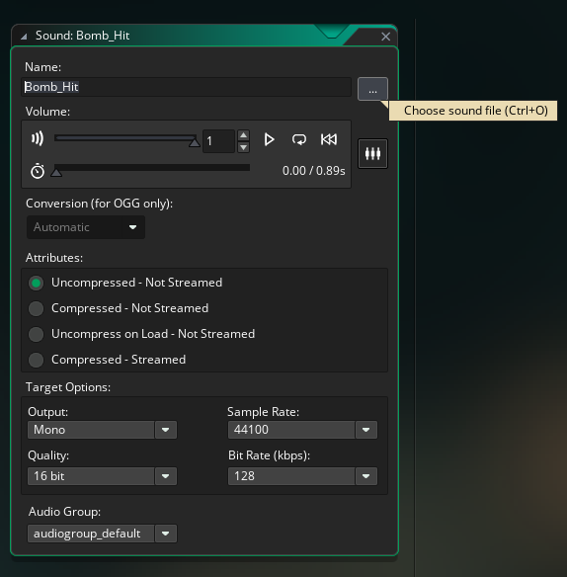
Game Assets (Sounds)
Alt+U to make a Sound 1) Make an empty Sound called called “Fruit_hit” 2) Import the sound file for Fruit_hit called Fruit_hit.mp3 (click on the three dots ➡️)
3) Make an empty Sound called called “Bomb_hit”
4) Import the sound for Bomb_hit called Bomb_hit.mp3 (click on the three dots ➡️)

Slide 6
Game Assets (Sprites, Objects, Sounds)
Alt+S to make more Sprites 1) Make empty Sprites called the following… “Game Over”, “Horizontal” & “Vertical”
2) Import images for each of the sprites (from the downloaded assets
Alt+O to make more Objects 3) Create Objects called the following
“ObjGame” &“ObjGameRestart”, “ObjHorizontal”, “ObjVertical”

Slide 7
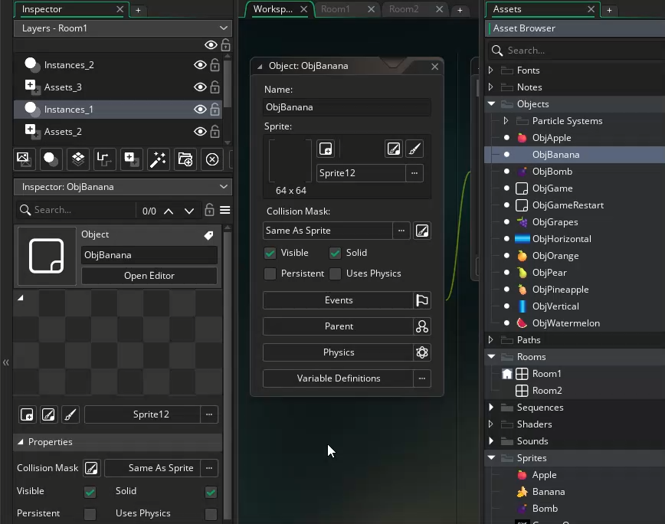
All Sprites need an Object container because a Sprite on its own can’t have an Event (behaviour)❗
⬆️Note – All objects have additional properties – we want all ours to be Solid ☑️

Slide 8
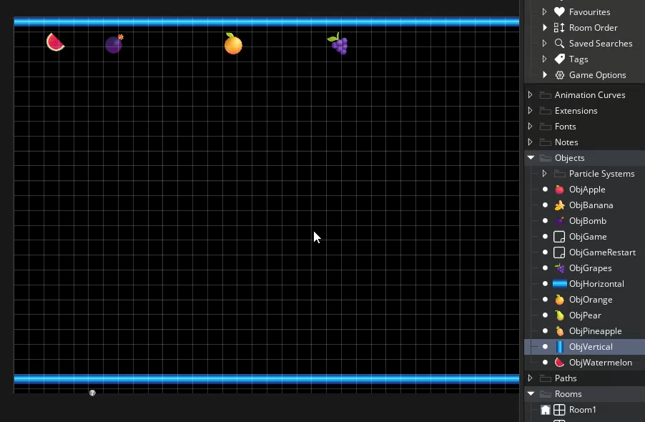
Game Environment
Drag a ObjWatermelon,🍉 ObjOrange, 🍊 ObjPineapple 🍍 ObjGapes 🍇 near the top! (From the Objects NOT the Sprites)
Drag ObjBomb near the top!💣
Drag ObjHorizontal near the top and stretch it across
Repeat for ObjVertical and stretch down (see video)
Scale to 0.6
We’re going to set up our Game environment (Use Room1)!

Slide 9
Movement
90º
180º
0º
270º
🍊
🍌
🍉
🍇
🍎
🍍
💡speed=5 direction = 270
💡speed=5 direction = 270
💡speed=5 direction = 270
💡speed=5 direction = 270
💡speed=5 direction = 270
💡speed=5 direction = 270
Note – these all have the same direction as we want them to move top to bottom!

Slide 10
Behaviours / Collisions
ADD EVENT 💡CREATE
Note – these all now have slightly different speeds…
🍊
🍌
🍉
🍇
🍎
🍍
💡speed=5; direction = 270;
💡speed=7; direction = 270;
💡speed=10; direction = 270;
💡speed=12; direction = 270;
💡speed=15; direction = 270;
💡speed=20; direction = 270;
💣
ADD EVENT
COLLISION (This line of code needs repeating for ALL Fruit objects and the Bomb)
💡speed=? direction = 270
ObjVertical
ObjHoriziontal
direction = irandom(360)
direction = irandom(360)

Slide 11
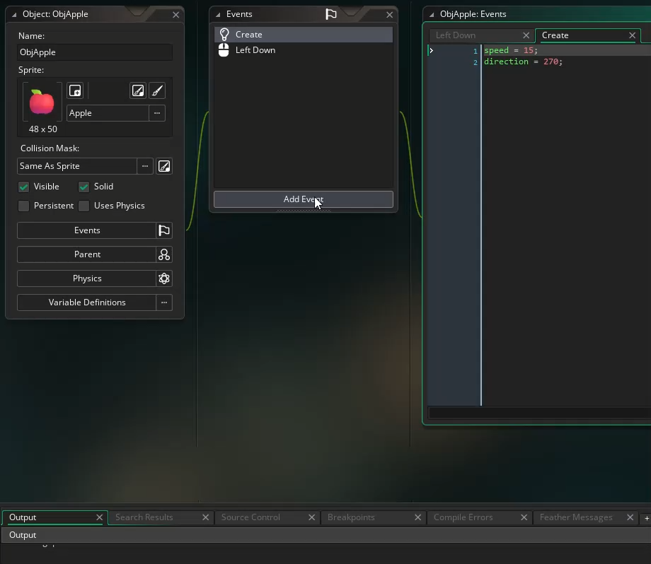
ADD EVENT
ADDING A COLLISION (This line of code needs repeating for ALL Fruit objects and the Bomb)
direction = irandom(360)

Slide 12
Events – Mouse - LeftDown
🍊
🍊
global.score = global.score + 10;
audio_play_sound(Fruit_Hit,1,false);
instance_destroy();
var new_object = instance_create_layer(random_range(100,1200), 50, layer, ObjOrange);
var new_object1 = instance_create_layer(random_range(100,1200), 50, layer, ObjPear);
var new_object2 = instance_create_layer(random_range(100,1200), 50, layer, ObjBomb);
🍐
💣
🖱️
Take your time to type this in! Note - You can Copy & Paste lines of code!
🍉
global.score = global.score + 30;
audio_play_sound(Fruit_Hit,1,false);
instance_destroy();
var new_object = instance_create_layer(random_range(100,1200), 50, layer, ObjWatermelon);
var new_object1 = instance_create_layer(random_range(100,1200), 50, layer, ObjBanana);
var new_object2 = instance_create_layer(random_range(100,1200), 50, layer, ObjBomb);
🍉
🍌
🖱️
💣
Note – you can copy code blocks by COPYING & PASTING an EVENT
Notes:
Instance Destroy is to make that instance of an object DISAPPEAR! Random Range is used to move the object between the left and right side o

Slide 13
🍇
🍇
global.score = global.score + 50;
audio_play_sound(Fruit_Hit,1,false);
instance_destroy();
var new_object = instance_create_layer(random_range(100,1200), 50, layer, ObjGrapes);
var new_object2 = instance_create_layer(random_range(100,1200), 50, layer, ObjApple);
var new_object1 = instance_create_layer(random_range(100,1200), 50, layer, ObjBomb);
🍎
🖱️
💣
Events – Mouse - LeftDown
🍍
global.score = global.score + 100;
audio_play_sound(Fruit_Hit,1,false);
instance_destroy();
var new_object = instance_create_layer(random_range(100,1200), 50, layer, ObjPineapple);
var new_object2 = instance_create_layer(random_range(100,1200), 50, layer, ObjOrange);
var new_object1 = instance_create_layer(random_range(100,1200), 50, layer, ObjBomb);
🍍
🍊
💣
🖱️

Slide 14
💣
global.lives = global.lives -1;
audio_play_sound(Bomb_Hit,1,false);
instance_destroy();
var new_object = instance_create_layer(random_range(100,1200), 50, layer, ObjGrapes);
var new_object1 = instance_create_layer(random_range(100,1200), 50, layer, ObjApple);
var new_object2 = instance_create_layer(random_range(100,1200), 50, layer, ObjBomb);
🖱️
We need to subtract 1 from the lives each time a Bomb is clicked!
🥷
🥷
🥷
Time to Test what we have achieved so far…

Slide 15
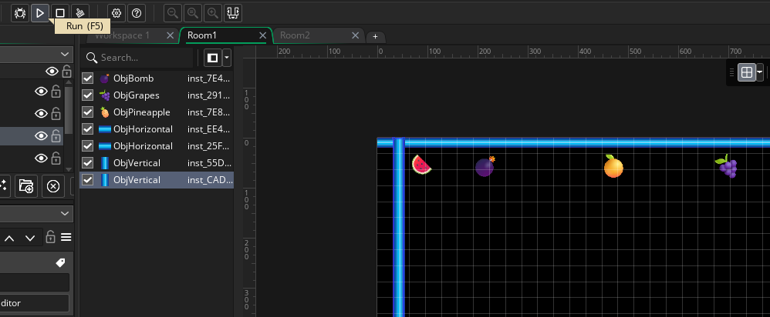
Press F5 or Click the Triangle to Run, Square to Stop
Any issues? – talk to your partner
Still any issues? – ask your Tutor

Slide 16
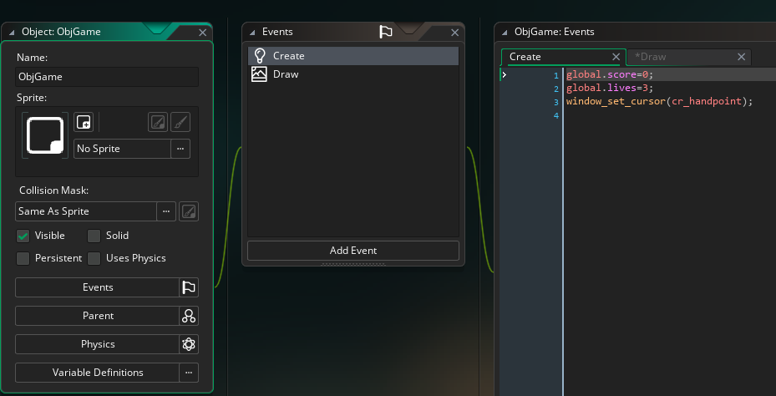
Coding our ObjGame
global.score=0;
global.lives=3;
window_set_cursor(cr_handpoint);
Note – drag this Object somewhere on Room 1 when you have finished

Slide 17
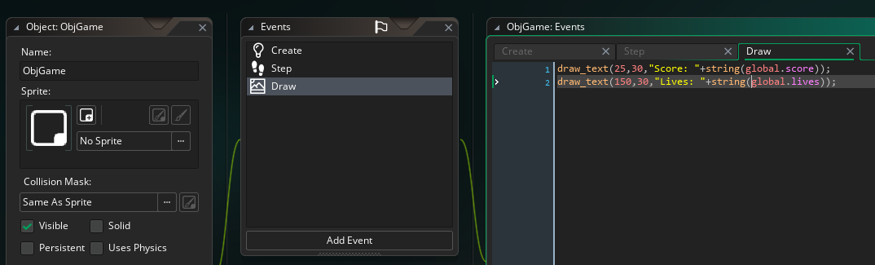
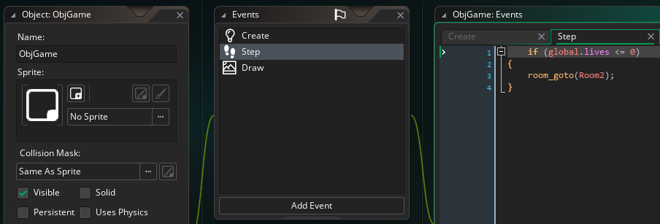
Finishing Touches (ObjGame Code)
If (global.lives <=0) { room_goto(Room2); }

Slide 18
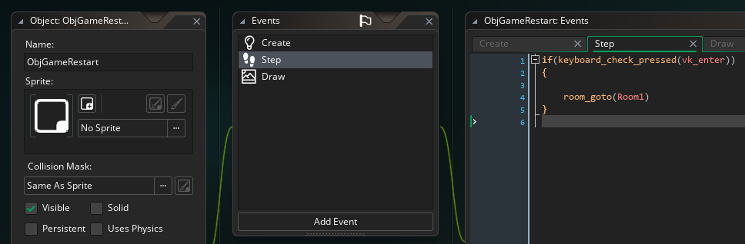
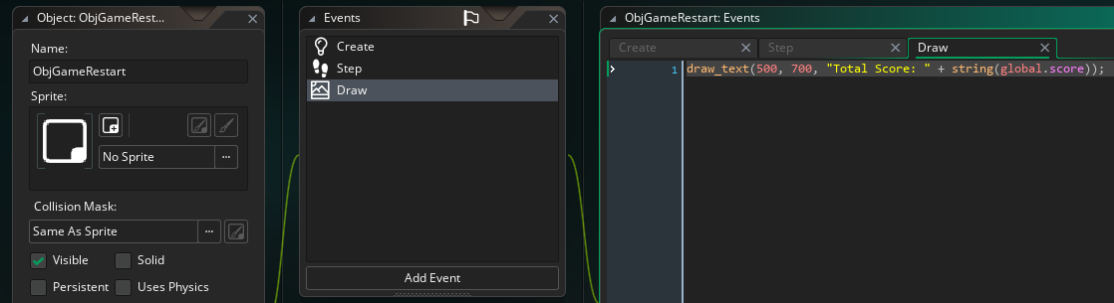
Finishing Touches (ObjGame Restart Code)

Slide 19
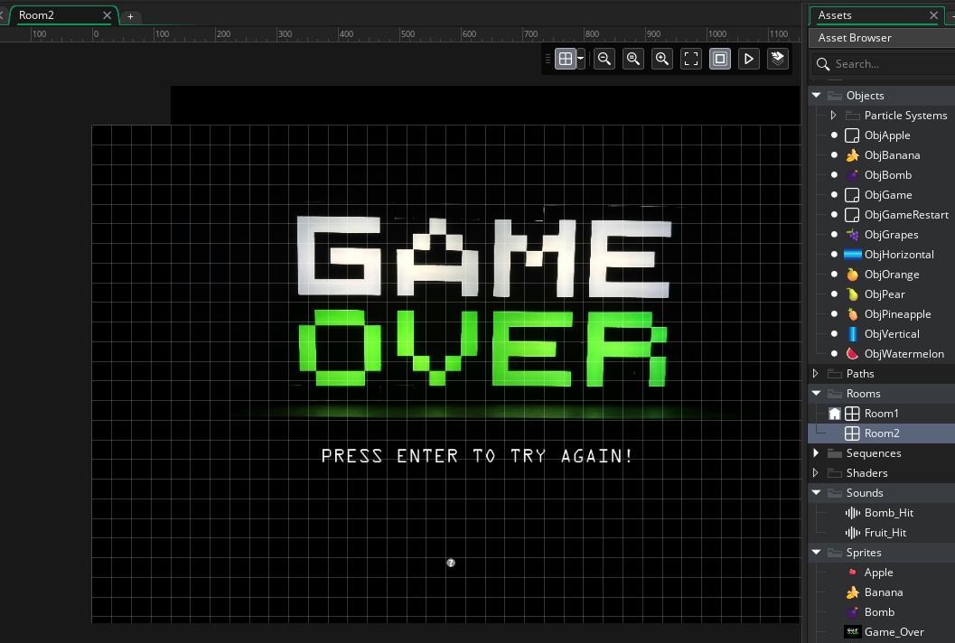
Drag ObjGameRestart onto Room & add Sprite

Slide 20

How can I make the game more difficult?

