Slide 1
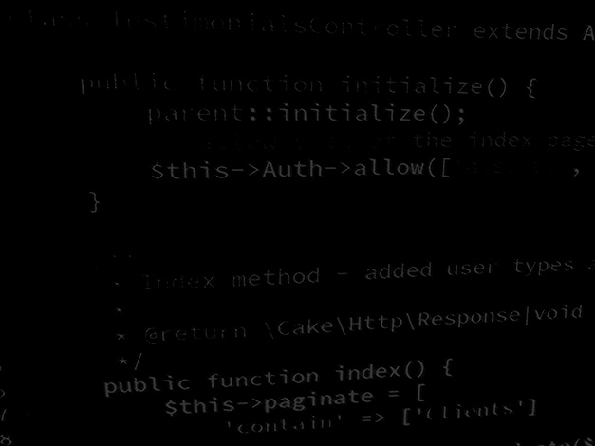
Software design and build
Project 1 – Hangman.
BSc Applied Computing

Slide 2
In this session…
Project specifications
Task
Considerations
Design choices
Questions

Slide 3
Project specifications
BSc Applied Computing

Slide 4
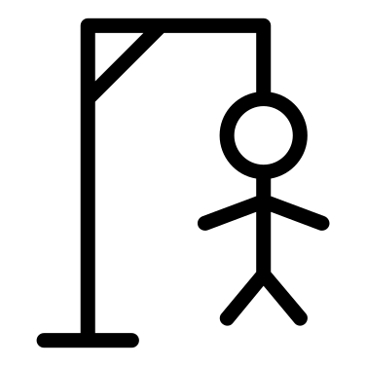
Project specifications
You have been tasked with designing and building a program which plays the classroom Hangman game.
  Hangman is a single player game.
  The game involves revealing a hidden puzzle word by correctly guessing which letters it contains.
  The player loses on their 11th incorrect guess.
  There are 26 possible guesses (A-Z).
  A previously guessed letter may not be re-guessed.
  The player wins when the whole puzzle word is revealed.

Slide 5
Task
Create a Hangman game in a language and environment of your choice.
Design:
  Inputs, processes, and outputs (algorithms)
  Objects and project structure (UML)
  UI (wireframe designs)

Slide 6
Considerations
Some things to think about…
Where will the game get the puzzle word from?
  Hard coded list?
  Local file (CSV, XML, JSON, etc)
  API (Wordnik?)
How will you make the game usable?
  Single or multi-form?
  Buttons or text input?
  Layout model (diagonal, central)
  Source of images required?

Slide 7
Considerations
Some more things to think about…
How will you determine the player’s proficiency?
  Time taken
  Number of incorrect guesses
How will the player know how well they have done?
  High score table (per word)?
  Best time?

Slide 8
Design choices
There are many aspects of this project which are simpler than alternatives.
Sometimes these make the software less engaging than the more challenging choices.
Sometimes they are just the best choice.
This project afford practice in making these choices and getting to a functional program in time.
Deadline: Session 7

Slide 9
Any questions?
You have 6 sessions… best make a start!
Ideally:
  Sessions 1 (this) and 2: design
  Sessions 3 to 6: development.

