Slide 1

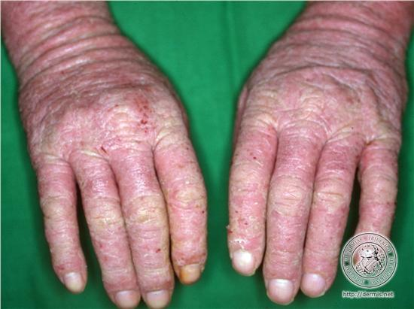
Unit: UV20556
Level 2 Award in Preventing Contact Dermatitis

Slide 2
Unit: UV20556
Occupational hand dermatitis in Hairdressers/Beauty therapists was first described as early as 1898 and still up to 70% of hairdressers suffer some form of skin damage during their career.

Slide 3
Unit: UV20556
Approximately 70% of hairdressers suffer with some form of skin damage
Dermatologist suggest that between 42-57% of these will develop contact dermatitis
Hairdressers are more likely to get contact dermatitis than any other occupation

Slide 4
In the chat
Can you list 3 things you know about contact dermatitis?
Let's find out what it is............

Slide 5


Slide 6
Dermatitis is a skin condition caused by contact with something that irritates the skin or causes an allergic reaction. It usually occurs where the irritant touches the skin, but not always.
There are two types:
Allergic contact dermatitis
Irritant contact dermatitis

Slide 7
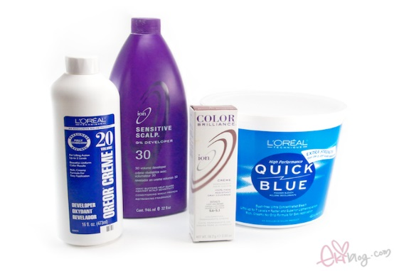
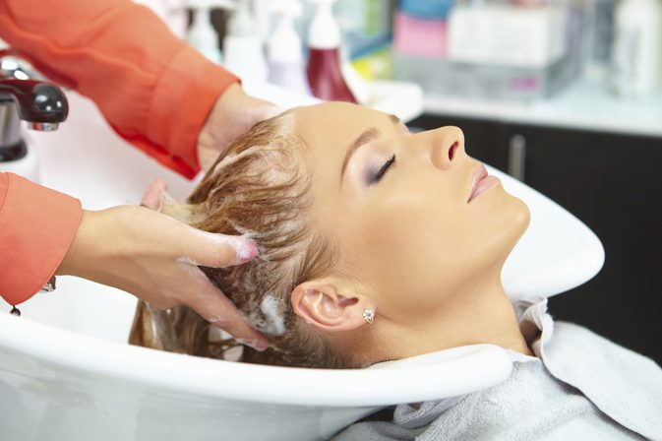
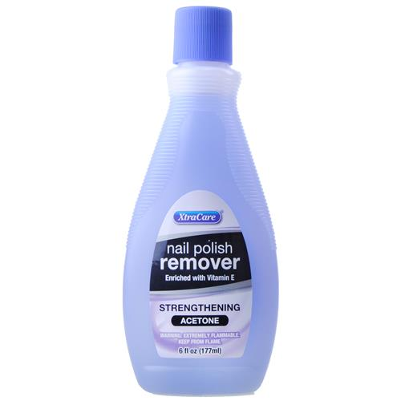
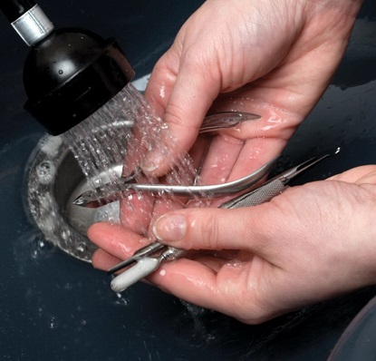
Irritant Contact Dermatitis
Can be caused by a single heavy dose or prolonged exposure to a substance such as hair bleach, strong soaps, solvents such as acetone nail polish remover, wet work and milder chemicals such as shampoo.

Slide 8
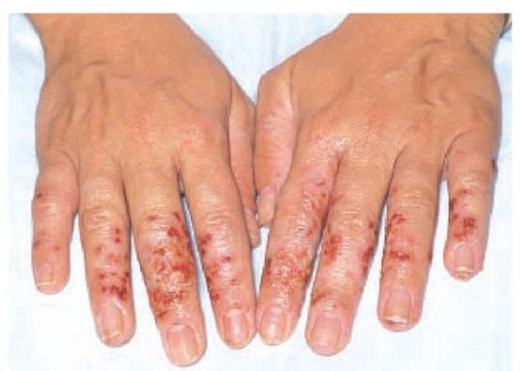
Allergic Contact Dermatitis
Allergic contact dermatitis can be caused by repeated exposure and sensitisation.

Slide 9
What Causes Dermatitis in a Hair or Beauty Salon?
Dermatitis can affect all parts of the body but most commonly it just affects the hands. People that work with irritants in their job, or those whose work involves a lot of water, are more at risk of suffering from dermatitis than others – which is why hairdressers and Beauty Therapists need to be extra careful.

Slide 10
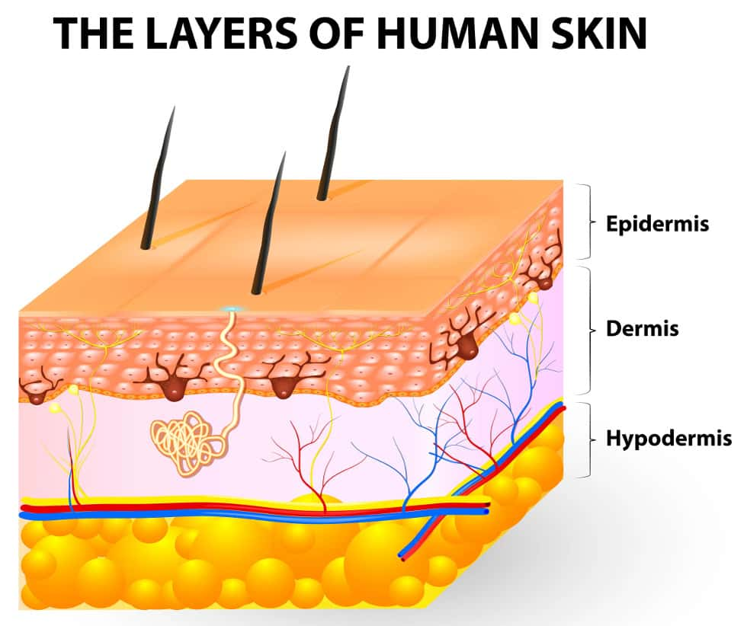
Unit: UV20556
Contact dermatitis is a form of eczema. The outer most layer of the skin (the horny cell layer of the epidermis) is the protective layer which acts as a barrier to prevent potential allergens from penetrating the skin.

Slide 11
Who is at risk?
Anyone that is in regular contact with substances such as:
water/wet work
degreasing agents
detergents
solvents
metal fluids
acids/alkalis

Slide 12
Can be caused by
Frequent contact with water.
Contact with the chemicals in hairdressing and beauty products, e.g. shampoo, bleach or hair colour, oils, creams or waxes.
Contact with cleaning chemicals or detergents.

Slide 13
Allergic Contact Dermatitis (ACD)
Some hair dyes
UV cured printing inks
Adhesives
Some plants (e.g. chrysanthemums)

Slide 14
Irritant Contact Dermatitis (ICD)
Wet work
Soaps, shampoos and detergents
Solvents
Oils and greases
Dusts
Acids and alkalis

Slide 15
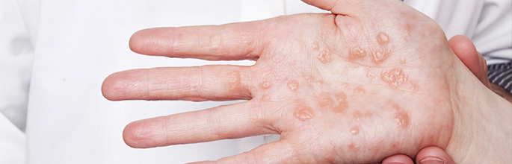
Areas of Contact
How is the skin exposed to substances?
Direct handling
Touching contaminated surfaces
Splashing
Soiled gloves
Incorrect removal of gloves

Slide 16
Health & Safety legislation
HASWA (Health and Safety at Work Act 1974)
COSHH (Control of Substances Hazardous to Health)
RIDDOR (Reporting of Injuries, Diseases and Dangerous Occurrences)
PPE (Personal Protective Equipment)

Slide 17
COSHH in Hair & Beauty
What does the law require?
The law requires employers to prevent or, where that is not reasonably practicable, adequately control exposure to materials in the workplace that cause ill health like dermatitis.
The Control of Substances Hazardous to Health Regulations 2002 (COSHH) require employers to:
■ assess risks;
■ provide adequate control measures – and ensure the use and maintenance of these;
■ provide information, instruction and training; and
■ in appropriate cases, provide health surveillance

Slide 18
Employee/Employers Responsibility
Employee Responsibilities
Employer Responsibilities
Provide information, instruction and training on risks and precautions.
Personal protective equipment for staff
Regular hand checks
Appropriate hand wash/lotions.
Safe working with equipment
Maintain a safe working environment
Wear/use personal protective equipment

Slide 19
What does it feel like?
Someone who has dermatitis may experience symptoms of itching and pain.
Severe symptoms include the skin cracking and bleeding.
The signs and symptoms of this condition can be so bad that the sufferer is unable to carry on at work.

Slide 20
Facts of Dermatitis
facts on
It is NOT contagious
Contact dermatitis is due to exposure
Three out of four cases involves the hands

Slide 21
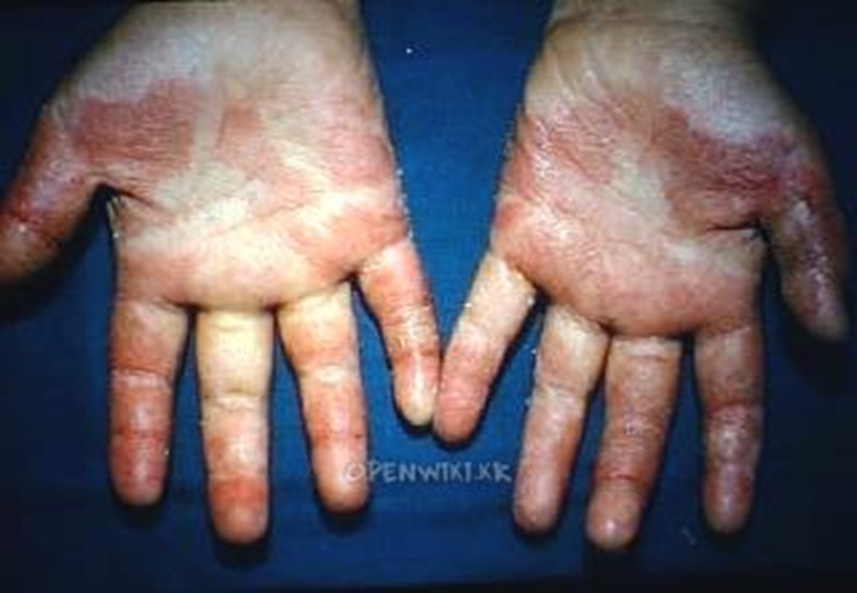
Prevention
Here's how to wave goodbye to bad hand days. Five small steps to prevent dermatitis becoming a big problem.

Slide 22
How to prevent dermatitis
Step 1 - Wear disposable non-latex gloves when rinsing, shampooing, colouring, bleaching, etc.
Step 2 - Dry your hands thoroughly with a soft cotton or paper towel.
Step 3 - Moisturise after washing your hands, as well as at the start and end of each day. It's easy to miss fingertips, finger webs and wrists.
Step 4 - Change gloves between clients. Make sure you don't contaminate your hands when you take them off.
Step 5 - Check skin regularly for early signs of dermatitis.

Slide 23
Remember……..
Most are to do with irritants not allergies.
It is NOT contagious.
Prevention is always better than cure.
Remember your hands are your tools for your profession!

