Slide 1

Skin Types

Slide 2
The skin types are:
Normal, Dry, Oily, Combination
The skin conditions are:
Mature, Sensitive, Dehydrated, acnefied

Slide 3
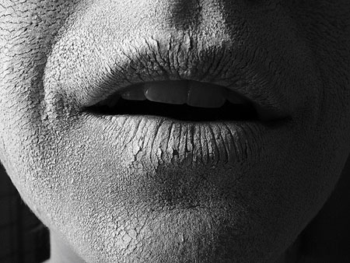
Dry Skin Type
Reduced oil and moisture balance – (insufficient secretion of sebum to lubricate surface cells and keep them compacted – result cells curl up and flake)
Pores are small and tight
Skin texture is, coarse, thin with visible flaking
Sensitivity (Broken capillaries)
Premature ageing is common
Skin pigmentation may be uneven
Milia often found in cheek and eye area
Skin can appear dull, matt and lack of suppleness
Skin will feel tight

Slide 4
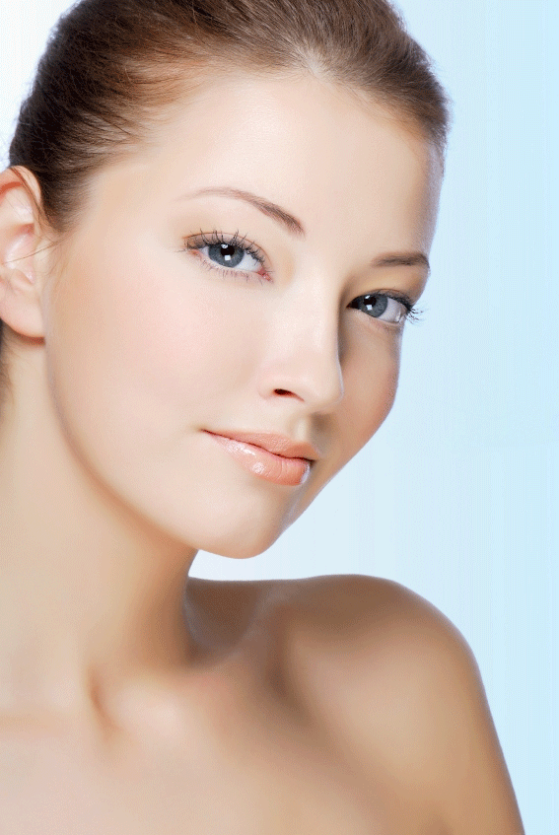
Normal SkinType
Ideal balance of oil and moisture.
Pore size small or medium
Skin texture is even
Colour is healthy
Skin elasticity good
Skin feels firm to touch
Even coloured pigmentation
Little to no blemishes/imperfections

Slide 5
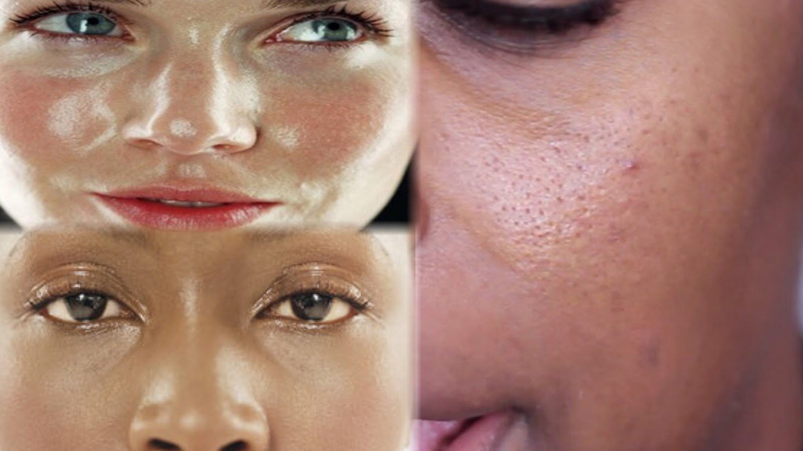
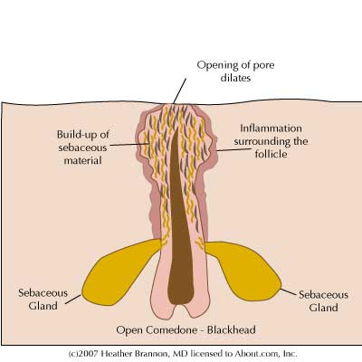
Oily Skin Type
Over production of oil from the sebaceous glands and low fluid balance
Pores are enlarged
Skin is coarse, thick, shiny and dull
Sallow in colour
Skin tone good
Uneven pigmentation
Comedones/ pustules/ papules are often present

Slide 6
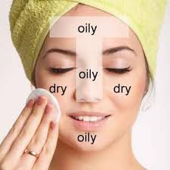
Combination Skin Type
Can be any combination where each area shows different characteristics
Classic combination is oily T zone (more sebaceous glands on T panel) and dry/normal cheek and neck.
Additional Characteristics:
Sensitive
Dehydrated

Slide 7
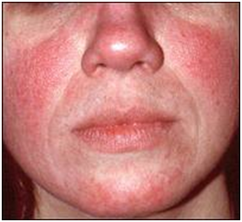
Sensitive Skin Condition
High colour
Dilated capillaries
Fine in texture
Feels warm to touch
Superficial flaking
Dryness and irritation
Tightness after cleansing
Easily stimulated and reacts quickly to external stimulus and products

Slide 8
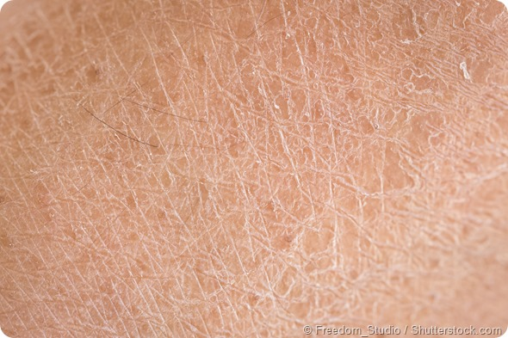
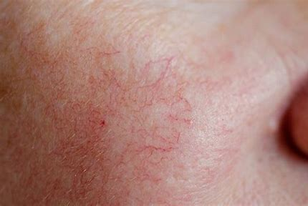
Dehydrated Skin Condition
Fine orange peel effect,
caused by lack of moisture
Superficial flaking
Fine, superficial lines
Broken capillaries

Slide 9
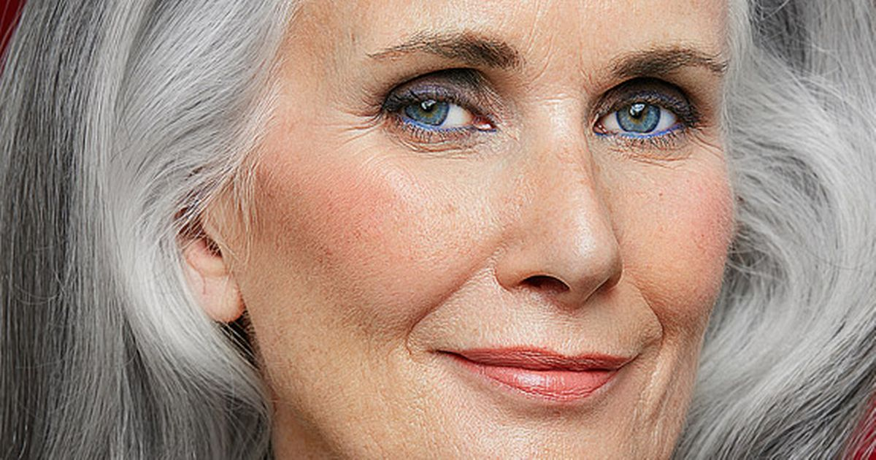
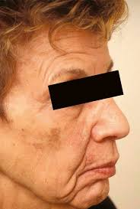
Mature Skin condition – skin has lost the firmness and suppleness of youth
Skin texture changes – becomes coarse and thickens (mouth and chin)
Skin becomes loose and crepey (elastin fibres reduce)
Elasticity and plumpless (collagen fibres reduce) decreases
Dilated capillaries on cheek
Pigmentation changes occur

Slide 10
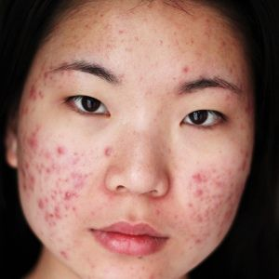
Acnefied Skin Condition
Hormonal imbalance (puberty) with increased sebum produced from the sebaceous gland.
Comedones
Papules
Pustules
Acne cysts
Scarring
Erythema
Shiny appearance
Generally found over the face, chest and back area.

Slide 11
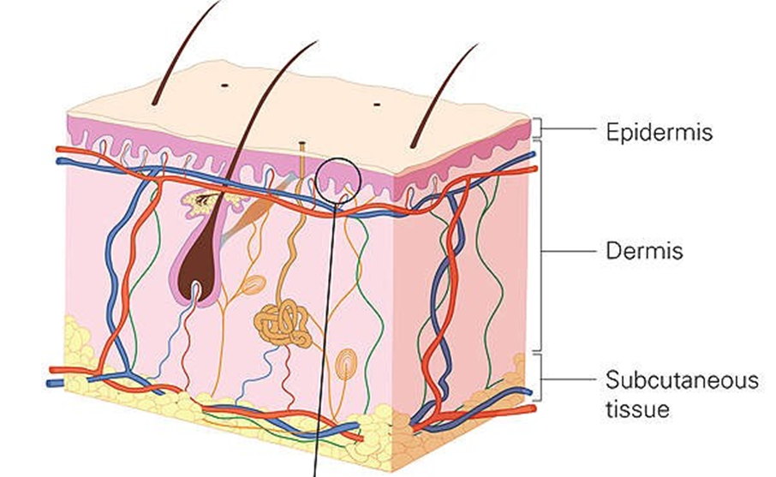
The Skin- Anatomy
The skin can be divided into two distinct layers:-
The EPIDERMIS – the outer thinner layer.
The DERMIS – the inner thicker layer.
The SUBCUTANEOUS layer is attached to the underlying organs and tissues lies below the dermis.

