Slide 1
Coronavirus (COVID-19)

Slide 2
What is Coronavirus?
Coronaviruses (CoV) are a large family of viruses that cause illness ranging from the common cold to more severe diseases
Typical symptoms of Covid-19 include fever and a cough that may progress to a severe pneumonia causing shortness of breath and breathing difficulties.
Generally, coronavirus can cause more severe symptoms in people with weakened immune systems, older people, and those with long-term conditions

Slide 3
BBC News- 5 things you need to know video
https://www.bbc.co.uk/news/av/health-51470859/coronavirus-in-the-uk-5-things-you-need-to-know-about-covid-19

Slide 4
Should I be concerned?
Currently the risk level is Moderate
There is only 15 confirmed cases in the UK, out of the 7000+ people who have been tested
People have been asked to self quarantine if they have been to affected areas, such as the lockdown areas in China and Northern Italy
The government will contact us if there is a change in circumstances and we will let you and your parents know
There is no need to panic, the government and NHS are prepared

Slide 5
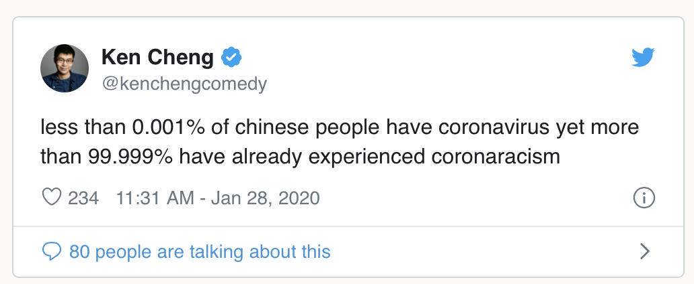
Don’t spread misinformation - it’s harmful and hurtful to others
Make sure you get information from trusted sources, such as BBC News and NHS

Slide 6
Some common myths
Myth | Truth
It’s not safe to open packages from China | It’s safe, the virus can’t survive on objects, such as letters and boxes.
Getting COVID-19 is a death sentence | Around 81% of people who are infected with the coronavirus have mild cases of COVID-19 and will recover
Face masks don’t work | Masks are effective at capturing droplets, which is the main transmission route of coronavirus
Eating garlic will help prevent infection | Though garlic is healthy, there is no evidence that it has prevented people from getting Covid-19

Slide 7
Why are some people self isolating?

Slide 8
What can I do?
Wash your hands regularly
Use hand sanitiser
Dispose of your tissues after use
Maintain at least 1 metre (3 feet) distance between yourself and anyone who is coughing or sneezing

Slide 10
If you want more information:
Look at trusted and reliable sources
NHS https://www.nhs.uk/conditions/coronavirus-covid-19/
BBC News https://www.bbc.co.uk/news
World Health Organisation https://www.who.int/emergencies/diseases/novel-coronavirus-2019/advice-for-public
The Guardian https://www.theguardian.com/world/2020/feb/28/coronavirus-truth-myths-flu-covid-19-face-masks

