Slide 1
Sustainable Construction Techniques
Carl James

Slide 2
Fit for purpose
Sustainability is now a very real need. In the life of this planet, human beings have existed the equivalent of no more than two seconds of time compared to the billions of years Earth has existed. Yet what a statement we have created on the Earth in so short a time.
We have been prolific in our gorging of the environment – clearing the natural landscape, extracting wantonly its resources, developing uncontrolled communities and not restricting our growth.

Slide 3
So now the Earth has awoken from its undisturbed slumber and is fast gaining momentum to fight back. Polar ice caps are receding, temperatures and sea levels are rising, hurricanes are increasing in numbers, flooding is increasing and areas are experiencing drought.

Slide 4
Do we, the human inhabitants, sit back and just watch? You have that choice and you alone can make it, but you must consider the present needs against the needs of future generations – this is sustainability.

Slide 5
Just look at it this way: go into your living room before you go to bed – is the TV on standby? What about the DVD player, the video and the digital TV box? And when you get ready to go out in the morning, are there thousands of cars on our roads and motorways driving somewhere with just one occupant? The answer is ‘yes’.

Slide 6
The list of how we are using up the resources of our planet is endless. So, it’s now time to take a long, hard look at the protection of the environment. It must be fit for the current diverse economic, political and social needs of every country.

Slide 7
Techniques - Energy

Slide 8
This is the easy one to tackle. Reduce the amount of energy that we use by employing more efficient technology, reducing waste and utilising alternative energy sources. This will make the finite resources we have last a lot longer with a reduced reliance and consumption.
Electrical technology is now producing grade A appliances that require less electricity to run them. The cost of manufacturing low energy light bulbs has fallen and they are now available in a wide range of fittings. New buildings are subject to air leakage tests which reduces the amount of energy lost through unwanted ventilation.

Slide 9
Improved energy efficiency
Energy efficiency can be improved by the use of efficient boilers that take the heat out of exhaust gases, and by improved thermal insulation in housing that reduces the heat losses.
Combined heat and power plants that produce electricity and heat are a third more efficient and are a growing technology that reduces our energy consumption. Heat pumps that extract waste heat from systems and harness it to heat water are a steadily developing technology.

Slide 10
Use of renewable energy and alternative sources of energy
Alternative sources of energy and renewable energy are the newer breed of energy sources that are starting to come on line. Examples include:

Slide 11
wind turbines for home use – a leading DIY store is now providing a fixing service
solar panels built into roof tiles format – so they look attractive and fit into the roof ’s profile
geothermal energy using heat within the soil – a trench is dug in your garden to capture latent heat
bio fuels – crops can now be grown to produce fuels when distilled
wave turbines hydroelectric schemes
hydrogen fuel cells.

Slide 12
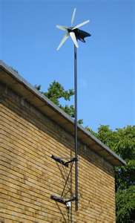
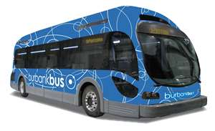
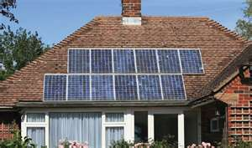
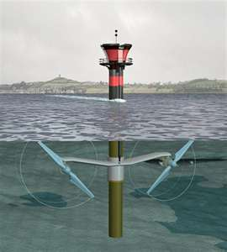
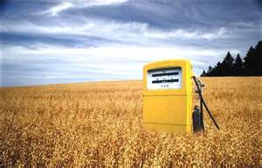
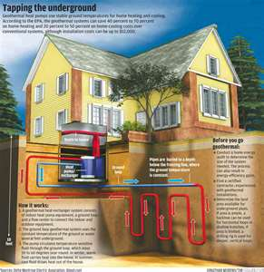

Slide 14
Specification of renewable materials
This technology in construction is slowly developing. Sheep’s wool insulation is a natural product that is renewable, is very efficient at thermal insulation and breathes with humidity.
Recycled newspaper and paper products can be used to form cellulose loose fill insulation for lofts. Cedar timber cladding is a renewable material that can be used on the exterior of houses, with excellent green properties. Green roofs that are manufactured from selected plants can now be used as a weatherproof covering that is natural and renewable.

Slide 15
Timber engineering is taking strides in maximising the use of timber products to develop joists of the same depth, but using smaller sections of timber built up, that can cover large spans so replacing the use of concrete beams.
Timber beams using recycled timber boarding cores can now be used instead of solid timber joists. These use less timber in their manufacture and are considerably stronger.

Slide 17
Embodied energy consideration
Anything that can be used twice halves the amount of embodied energy used in its manufacture. concrete and brickwork from demolition can be crushed onsite and used as a hardcore base for buildings, which also saves transport costs.
Using high-performance, hardwood windows instead of UPVC saves energy and oil in the long term, and timber is a renewable source. Steelwork can be recycled and used to produce new structures which reduces the amount of energy consumed in the production of the raw materials.

Slide 18
Using high-performance, hardwood windows instead of UPVC saves energy and oil in the long term, and timber is a renewable source. Steelwork can be recycled and used to produce new structures which reduces the amount of energy consumed in the production of the raw materials.

Slide 19
Low energy manufacture of materials and components
Any manufacturer of construction materials that can reduce the energy usage in the manufacturing process will save embodied energy within the product. This could be achieved in several ways.
Waste heat can be recycled and taken out of exhaust gases and used to produce electrical energy which can be recycled back into the product. Many producers are starting up combined heat and power plants to gain the maximum benefit from their energy usage on site.

Slide 20
Reduction of waste
Waste costs money, as it has to be dealt with, the only disposal being incineration or landfill. Waste can be reduced by several methods, including:

Slide 21
recycling the materials back into the process, e.g. steelwork
finding a processor for the waste product to use in their manufacturing process
ordering the correct amounts of material and managing the use of raw materials efficiently
using the waste as fuel for energy production
careful packaging to prevent breakages
training in the use of a material
educating that waste costs the environment

Slide 22
A reduction in wastage can often be brought about by education of the people using the materials into the environmental costs of wasting these materials. Incentive schemes could help along with a top-down management approach to reducing the effects of construction on the environment, for example the manager using a smaller company car, leading by example.

Slide 23
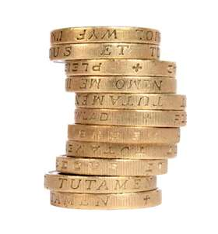

Slide 24
Recycling
In construction this has to be undertaken in certain ways; clients still want a brand new building, not one with certain reused elements within it. However, there are materials that can be reused as follows:

Slide 25
Crushed concrete – this can be used as a fill material to raise levels.
Facing bricks – when cleaned and reused in housing gives an aged appearance.
Slates – these can be redressed or crushed and combined with an adhesive to form a reconstituted slate tile.
Brick hardcore fill – this uses crushed bricks as a fill material.

Slide 26
Glass – this can be melted and reformed.
Structural steel – this uses recycled steel in its production.
Plastics – these are used as timber-like products.
Gabions – these are steel cages used as earth retainers which are filled with crushed concrete or brick.
Timber – this can be engineered and recycled into structural products.
Packaging of materials – suppliers can be encouraged to reduce the amount of packaging.

Slide 27
The possibilities are fast developing with new technologies and new products continually coming into the marketplace; recycling waste into materials is starting to take hold.

Slide 28
Offsite fabrication
This is recent development by UK manufacturers where a timber-framed house kit can be assembled offsite and delivered by lorries and site assembled using a crane to form the insulated internal skin of a complete house including the roof panels.
The only additional elements are the cladding external finish, which can be in a brick skin or a timber-cladded product, and the roof tile installation. This type of construction is very thermally efficient, saves time and energy, uses timber renewable products and has relatively low carbon emissions in manufacture.

Slide 29
Offsite fabrication has been tried with house construction using modules that bolt together to form a house, but this has had limited success in domestic construction. Fast-food chains have taken this concept on board with modular units produced for site assembly.

Slide 30
Modern methods of production
Offsite fabrication of structural elements of commercial and domestic construction are the new approach to the production of houses and offices.
Modules that simply bolt together are fast and efficient methods of producing a structure that is factory produced with minimal resulting wastage. This method is very efficient and is aimed at producing affordable social homes in the current economic climate.

Slide 31
Just in time (JIT) construction is where all the materials for incorporation into the structure are delivered just at the point they are needed in the construction process. This avoids the need to store materials onsite for long periods, where they could be damaged, or moved around the site.
Precast concrete is returning as a modern method of construction enabling benefits from factory-produced concrete members that are site assembled with no waste or secondary support systems like formwork.

