Slide 1
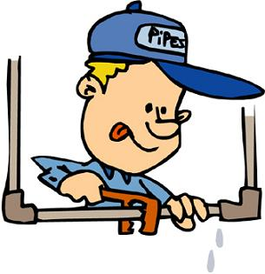
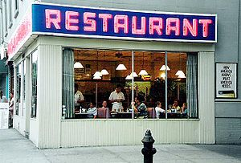
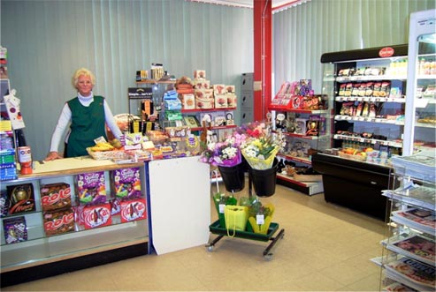
Private sector: private businesses and enterprises
Private Sector: Business activity owned financed and controlled by private individuals
Notes:
Plumbers, accountants, local shop owners, small builders

Slide 2
Private sector
Self-employed traders/Sole Traders
Professional firms
Small and large businesses
International companies
Partnerships
Cooperatives
Ltds
PLCs

Slide 3
Aims
As previously discussed their objectives include,
Profitability
Profit maximisation
Increasing shareholder value
Survival
Gaining market share
Brand identity
Ethics

Slide 4
Public sector: businesses owned and run by the government are public enterprises
Public Sector: Business Activity owned, financed and controlled by the state through government or local authorities
Government – key departments set policy and monitor implementation i.e. The Treasury, Ministry of Defence, Food and Rural Affairs etc.
Local Authorities – County Councils, District Councils
Schools
Hospitals
Libraries
Public Corporations – BBC
Transport
These are also know as merit goods.

Slide 5
Public Sector
Organisations owned and run by the Government that includes some of the largest employers in Europe as well as the UK.
Some goods and services we need in our lives would not be provided by the private sector looking to make profits.
They provide good/services we benefit/gain from but without paying, known as ‘public goods’. They are
Non-rivalry - the consumption of the good by one individual does not reduce the amount available for others e.g. social services
Non-excludability - it is impossible to exclude others from benefiting from their use i.e. people who use the street will benefit from the street lighting provided

Slide 6
Public sector objectives
The main objective a privately owned business is
to make a profit, where as the objectives for
public sector organisations are to provide,
A quality service
Value for money
for customer/consumers’ needs
Not waste tax payers money

Slide 7
Non-profit-making: a third type of enterprise
Non-profit-making organisations include charities and voluntary organisations.
These organisations are set up to fulfill a perceived social need or to provide help to a specific section of the community.

Slide 8
Similarities and differences
The difference between these two is that public sector organisations is run by or on behalf of the government whilst non-profit-organisations could easily be set up by private individuals who want to support a specific cause.
The government focus on enriching society and ensuring a basic standard of living

Slide 9
All organisations in the public and private sector are involved in some form of business activity and it is only their objectives that differ. For example: what, whom and why they produce goods and services.
Other groups that the private sector supplies, but the quantity supplied is likely to be far less than is good for the economy include,
Education (private schools)
Health care (private hospitals)
The Government spends on the NHS and Education to ensure an effective service and well educated and trained work force.

Slide 10
Government measures
To improve efficiency.
The sales of nationalised industries
The sale of parts of nationalised industries
Deregulation
Contracting out
Outsourcing
Task
In groups of 3 discuss the advantages and disadvantages of privatising public services.

Slide 11
Privatisation
Advantages
Sale of assets generate a great deal of income
Nationalised industries were inefficient
Once sold little political interference
Increase share ownership
Improve accountability to shareholders and consumers
Disadvantages
Privatisation has been expensive
Argued that privatisation has not led to greater competition
Nationalised industries were sold off too cheaply
Natural monopolies have been sold off
Once part of the private sector, any parts that make a loss will be closed down.

