Slide 1
Piling

Slide 2
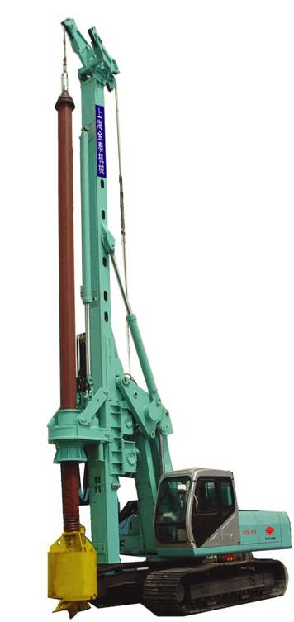
Piling is used in situations when the ground is unsuitable for heavy load and in particular where the loading of the building is transmitted by a framework in such a way that the total load is concentrated on a few points.

Slide 3
Piling
Piles are employed usually where, because of soil conditions, economic or constructional considerations, it is desirable to transmit the load of the building to strata beyond the depth of the practical reach of spread foundations.
There may be a high water-table level where spread foundations could be employed but where piling may provide a cheaper answer than lowering the water table.
Piled foundations may also provide a satisfactory solution where a site is restricted and spread foundations or their excavation may cause problems to adjacent buildings.

Slide 4
Piling
Piles can also act in tension to resist uplift, which might be caused by wind loads, or buoyancy conditions from a fluctuating water-table level.
Piles are designed to take vertical loads but can accommodate some horizontal movement – where this horizontal movement is expected to be of a sizeable nature, raking piles are usually used. Piles can be either replacement or displacement.
Replacement piles remove the earth and place another material – typically concrete – in the hole created by the boring tool. Displacement piles are driven by a machine by dropping a hammer a ‘set’ number of blows.

Slide 5
Piling
The following are the main types of pile:
Bearing piles – transmit the building load directly to solid strata.
Sheet piles – used to contain earth and prevent movement that would result in a weakening of the natural foundation. They are more frequently used for temporary works but can be permanent.

Slide 6
Friction piles – rely on shape and frictional resistance to the ground. They are used where safe bearing strata cannot be reached.
Consolidated piles – used in a situation where the ground is weak or waterlogged, the aim being to strengthen the overall nature of the ground rather than to provide a specific point support.

Slide 7
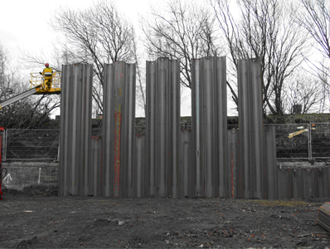
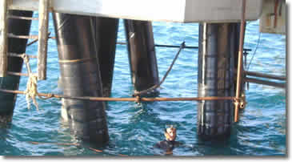
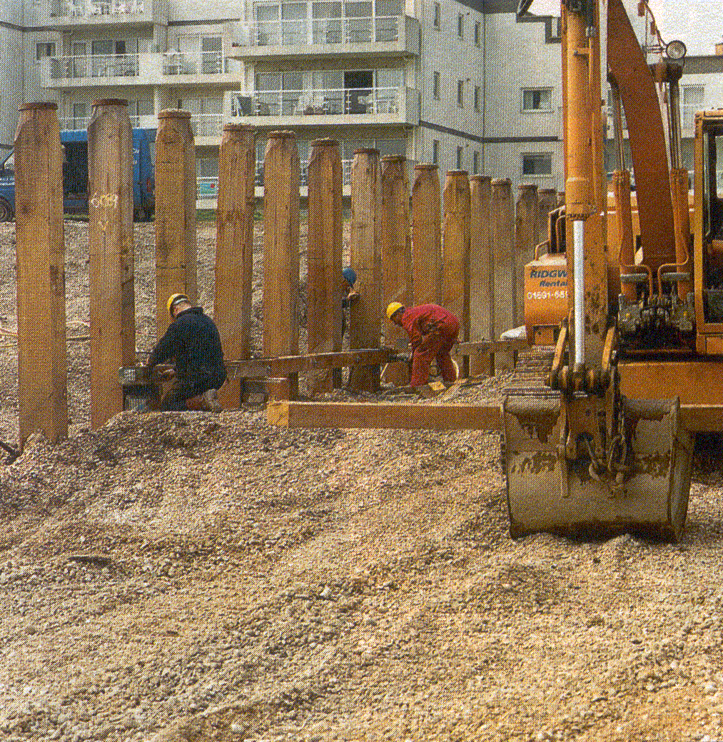
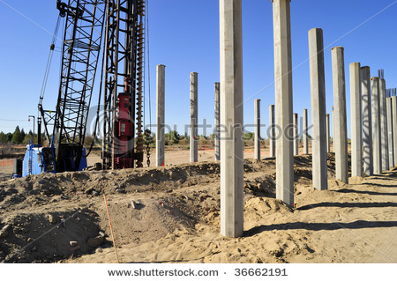

Slide 8
Piling
The method of driving and sinking the piles depends on site conditions, space and height available, proximity of buildings, avoidance of vibration, number of piles required.

Slide 9
Materials used for piling
Timber
Timber is a suitable material, but the length and sectional area are limited. Timber piles are frequently used adjacent to water forming piers, jetties and landing points.
They are prone to rotting if alternately wet and dry conditions exist.

Slide 10
Steel
Steel
Piles from steel generally consist of two types: bearing and sheet.
Sheet piles will be considered in more detail later. Load bearing piles are usually single or multiple, universal beam or column, which provides a good profile for the required friction in the ground.
The use of multiple sections also creates stiffness and rigidity in the section used. Steel is a material that is flexible and versatile – it can be cut and welded fairly easily on site.

Slide 11
Concrete
Concrete
Concrete piles driven in one section are suitable for unrestricted sites where long piles do not pose handling problems. They require minimum site work in that, once driven, the pile is ready apart from stripping of the top to expose and integrate the reinforcement to the main structure.
These piles are generally cheaper than a cast in situ and control on quality is very good. Protection to the head of the pile may be necessary to allow the pile to be driven, but this is more for practical purposes than appearance since the top of the pile is cut away.

Slide 12
Concrete
Some disadvantages do exist – the pile could be deflected by obstructions too long to be driven. Pre-cast piling such as this requires an extensive site investigation in order to determine the subsoil conditions to avoid problems such as those mentioned above.

Slide 13
Piling
Piles can also be driven using short lengths that are easier to manipulate on site and transport. They consist of concrete shells, which are driven by a steam hammer transmitted to a special concrete or steel shoe. When driven, there exists a watertight concrete tube in the ground and the main reinforcement is inserted into this – the whole is then concreted.
The advantage of this method is that using prepared casings, the ground can be fairly unstable such as running sand, made up ground, gravels, etc. Pre-cast piles are hollow inside and are guided into the casings using a steel mandrel. A cage of reinforcement steel is prefabricated and lowered into the pile. The casings are then withdrawn by a hoist.

Slide 14
In situ Piles
Using a sealed tube and mandrel, the tube is sunk by a piling rig to the correct depth. The concrete and reinforcement is then introduced.
The concrete assumes the ground profile, but care must be taken to ensure that the level of concrete is above the bottom of the sleeve since the earth pressure can cause ‘necking’ or ‘waisting’ at low levels. An alternative is to drive the pile with a steel cylinder weight complete with a semi-dry concrete mix in the bottom of the pile.
When the pile reaches the required set, the plug is forced out, concrete and reinforcement is introduced to form the completed pile.

Slide 15
In Situ Excavated Piles
A single flight auger drill on the end of a Kelly bar is used to bore a hole into the earth. Extending the Kelly bar can increase the depth. The spoil is removed by retracting the drill to the surface. This method is generally slow and is restricted to depths of up to about 13 metres.
Using a continuous fight auger, the earth is removed, which gives a belated indication of the subsoil conditions. The use of a lining in cohesion less soils may be necessary to prevent collapse of the pile into the vacant hole. Some piles may have an added advantage of being hollow through which the concrete is pumped under pressure as the drill is retracted. This creates two major positive features: first, the need for a lining is removed; second, the concrete is forced into the surrounding subsoil which provides a good frictional interface.

Slide 16
Piles can also be under-reamed to provide increased base for end bearing piles. However, under-reaming is a slow process requiring a stop in the drilling to change the tool for the actual under-reaming operation.
In some clay soils it may prove more profitable to use a deeper, straight-sided shaft. Consideration should be given to arranging the piles into a pattern that might include clusters of piles grouped together with a pile cap.

