Slide 1
Branding

Slide 2
Branding
You know more about branding than you think!
How many brands are you wearing (or in your bag) do you have right now?
Who is most brand loyal person in the class?
What creates brand loyalty?
Would you eat ASDA Ketchup if there was also Heinz on the table?

Slide 3
What brand is this?
Notes:
Coca Cola

Slide 4
What brand is this?
Notes:
Microsoft

Slide 5
What brand is this?
Notes:
Cadbury

Slide 6
What brand is this?
Notes:
Marks and Spencer

Slide 7
What brand is this?
Notes:
McCain (chips)

Slide 8
What brand is this?
Notes:
Tesco

Slide 9
What is branding? (according to Business link the govt website)
Branding is a way of clearly highlighting what makes your product or service different to, and more attractive than, your competitors'. Business Link
A brand goes much deeper than just your company logo. You could define a brand as a set of associations that an existing or potential customer has of a company, product, service or individual. These associations can be the result of your own efforts and actively promoted through marketing and corporate identity. Branding also reflects your customers' experiences of your business and affects every interaction you have with your customers and suppliers.
The intelligent use of design, advertising, marketing, service proposition, and corporate culture can all help to generate associations in people's minds that will benefit your business.
Branding is your attempt to harness these associations to help your business perform better.

Slide 10
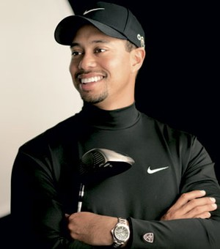
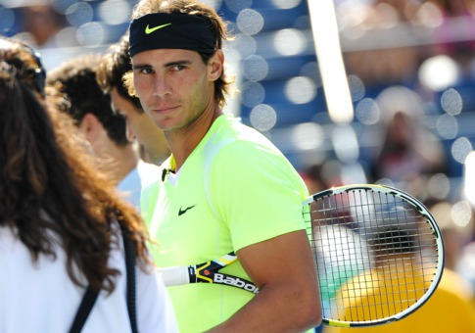
So branding is an association?
Sponsorship helps us (the consumer) associate a brand logo with being “top of your game”.
We may buy these clothes because of this association. After a while we become brand loyal.

Slide 11
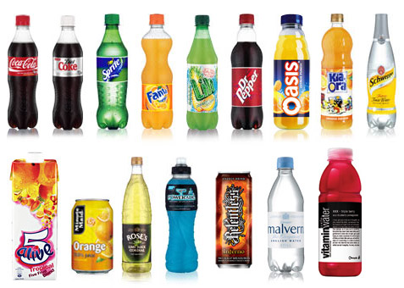
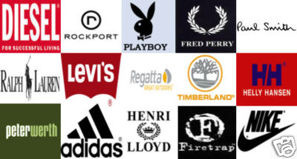
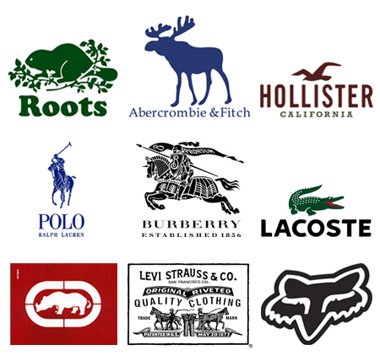
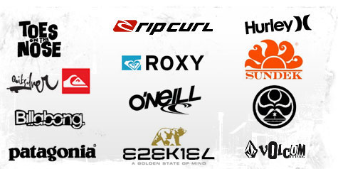
What are you brand loyal to?
Notes:
Kids should write a list of items they are loyal to. What creates this loyalty? Ideas should include shop front displays, opinions of peers , advertising, sponsorship etc.
They are unlikely to say – their loyalty is down to their own opinion. Shows in the formative years how influenced they are as consumers by media. They are the biggest consumers of the media products – tv, cinema, magazines etc so they have most exposure so most branding and advertsing is directed at them.

Slide 12
What was the last advert that you saw?
What product or service was it for?

