Slide 1
Observation and Assessment Techniques.

Slide 2
Lesson aim :-
Understand child observations

Slide 3
Lesson objectives
List different types of child observations.
Explain when to use different types of observations.
Explore how interventions can promote positive outcomes for children
Explore the importance of accurate documentation.

Slide 4
Why observe children ?

Slide 5
Importance of Observation
Why observe children?
To monitor a child’s development.
To aid with planning for future activities.
To assess and evaluate activities, lessons, strategies with children.
To report to other professionals and parents.
To observe a particular aspect of a child’s development and aid them with further support.

Slide 6
Child observations can be spilt into two categories

Slide 7
Participatory
Observer engages with child during activity or daily routine.
May not always be recorded in written format.
Could be recorded as diary – feedback to parent.
Can be difficult to manage and record.
Can be planned or unplanned.
Keep a note pad handy for spontaneous activities or events!

Slide 8
Non-Participatory
Observer stays outside activity.
Concentrates on child or aspect being watched.
Observer can watch child as an individual and in the context of an activity.
Observer needs to sit where they can see and hear without affecting child observed.
Children need to know which adults are available for help during observation.

Slide 9
Participatory & Non-Participatory
In general try to record the child’s behaviour without being involved because the observer could be influencing the child if they are involved in the activity.
It also becomes difficult to record information immediately if the observer is actively involved.

Slide 10
Structured and Naturalistic Observations
Might be set tasks which are organised in order to observe a particular behaviour with a child.
Naturalistic observations are based on events which happen spontaneously, for example a child offering to share their snack, or share a toy.

Slide 11
Observation techniques

Slide 12
Select an Appropriate Technique
Understand the purpose of the technique.
Match technique to the aim of the observation.
Different techniques gather specific data.
Using a range of techniques:
Can enable holistic development to be observed.
Can help the observer to accurately predict the child’s behaviour.

Slide 13
Written Records
Free Description or Snapshot
Participatory or non-participatory
The observer records a free flowing description
everything seen within the time period of the
observation.
Record:
Everything child does and says.
Conceptual awareness.
Skill development.
How child approaches tasks and problem solves.
Persistence, motivation and attitudes in general.

Slide 14
Disadvantages
Can be difficult to record everything being observed.
Can also be very time consuming to write up everything that has been observed.
Needs to be written up immediately after observation completed to ensure accuracy.

Slide 15
Tracking
Non-participatory
Floor map or plan of activitie.s
Tracks child’s movements between activities.
Observe:
Concentration levels.
Social interactions.
Interest in activities/experiences.
Behaviour.
Also record other relevant information.

Slide 16
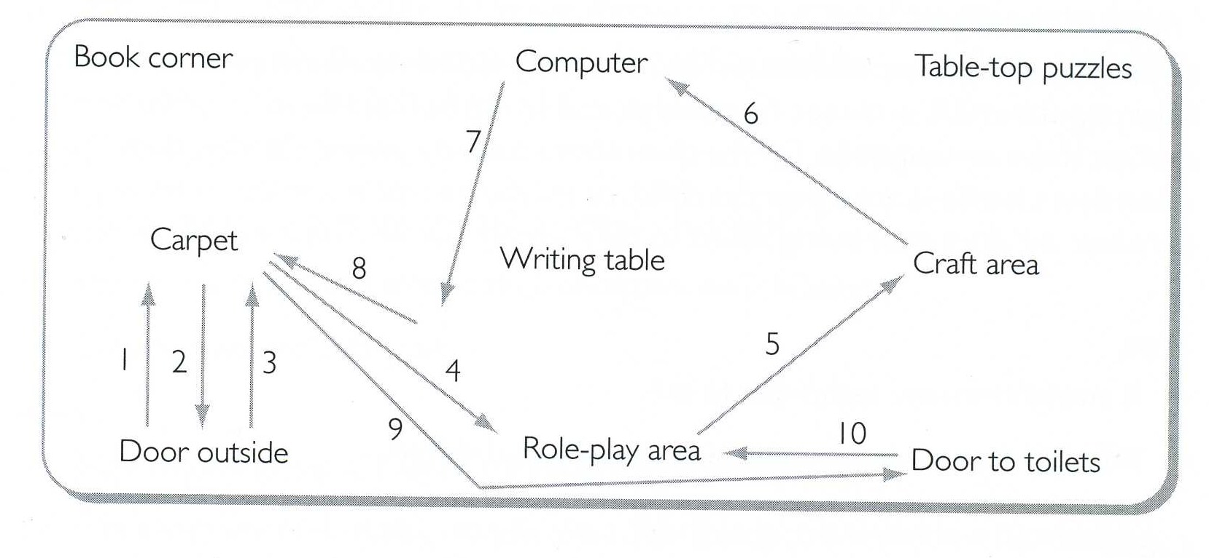
Tracking Diagram

Slide 17
Checklists or Tickcharts
Non-participatory
Often used in different settings to observe development and milestone achievement/ curriculum goals/attainment targets.
Can be used to record if a child can achieve a task, with or without assistance.
Used by a variety of early years professionals.
Simple to use and can be a quick record to use to reflect on children’s development.
Need to be prepared in advance and need to be detailed enough to ensure conclusions can be made.

Slide 18
Checklists or Tickcharts
Additional comments may be added.
Further development activities can be planned following a tick list observation.
The same tasks can be carried out at a later date to compare and check the development and progress of the child.
Can be used with many children to give a broader picture of the age range.

Slide 19
Tick List
Child’s Name: D.O.B. Date: Observer:
Developmental Checklist
By 12 Months | Yes | No | Sometimes
Walk with some help?
Transfer objects from one hand to another
Respond verbally to someone talking to her
Clap hands
Stack two blocks
Hold beaker with two hands
Respond’s to own name being called

Slide 20
Disadvantages
Only the skills assessed are recorded, they can be quite restrictive.
Does not give a rounded picture of the child, only records how they completed the task on that particular day.

Slide 21
Event Sampling or Diary Observation
Non-participatory
Records the sequence and frequency of events or a particular behaviour.
Recording takes place only when that particular behaviour occurs.
Emotional development of the child and their response to particular events can also be recorded.
Tends to be recorded over 1 – 2 days, any longer and it becomes a longitudinal study or diary observation.

Slide 22
Time Sampling
Non-participatory
A child’s behaviour is recorded at regular intervals over a set period of time.
Observations tend to focus on language and interaction over 2 minute intervals (e.g. every 10 to 15 minutes) for at least an hour.
Precise timing is required.
It is a simple method to use, but does require some preparation in advance.
Chart could include time, behaviour, language and social group

Slide 23
Frequency Sampling
Non-participatory
Observer tracks incidences of particular aspects of
behaviour e.g. child plays alone.
Can be used to monitor progress and concerns.
Look out for:
Child approaching other child, children or adult.
Whether child initiates interaction.
How interaction was initiated.
Where in the setting this interaction takes place.

Slide 24
Sociometric Observation
Participatory.
Also known as a sociogram.
This type of observation records friendships of children and may be used for research into friendship groups.
Need to plan questions to ask children about friendships.
A chart and questions needs to be prepared in advance and the results can be recorded in a pie charts or graphs.

Slide 25
What factors can affect child observations?

Slide 26
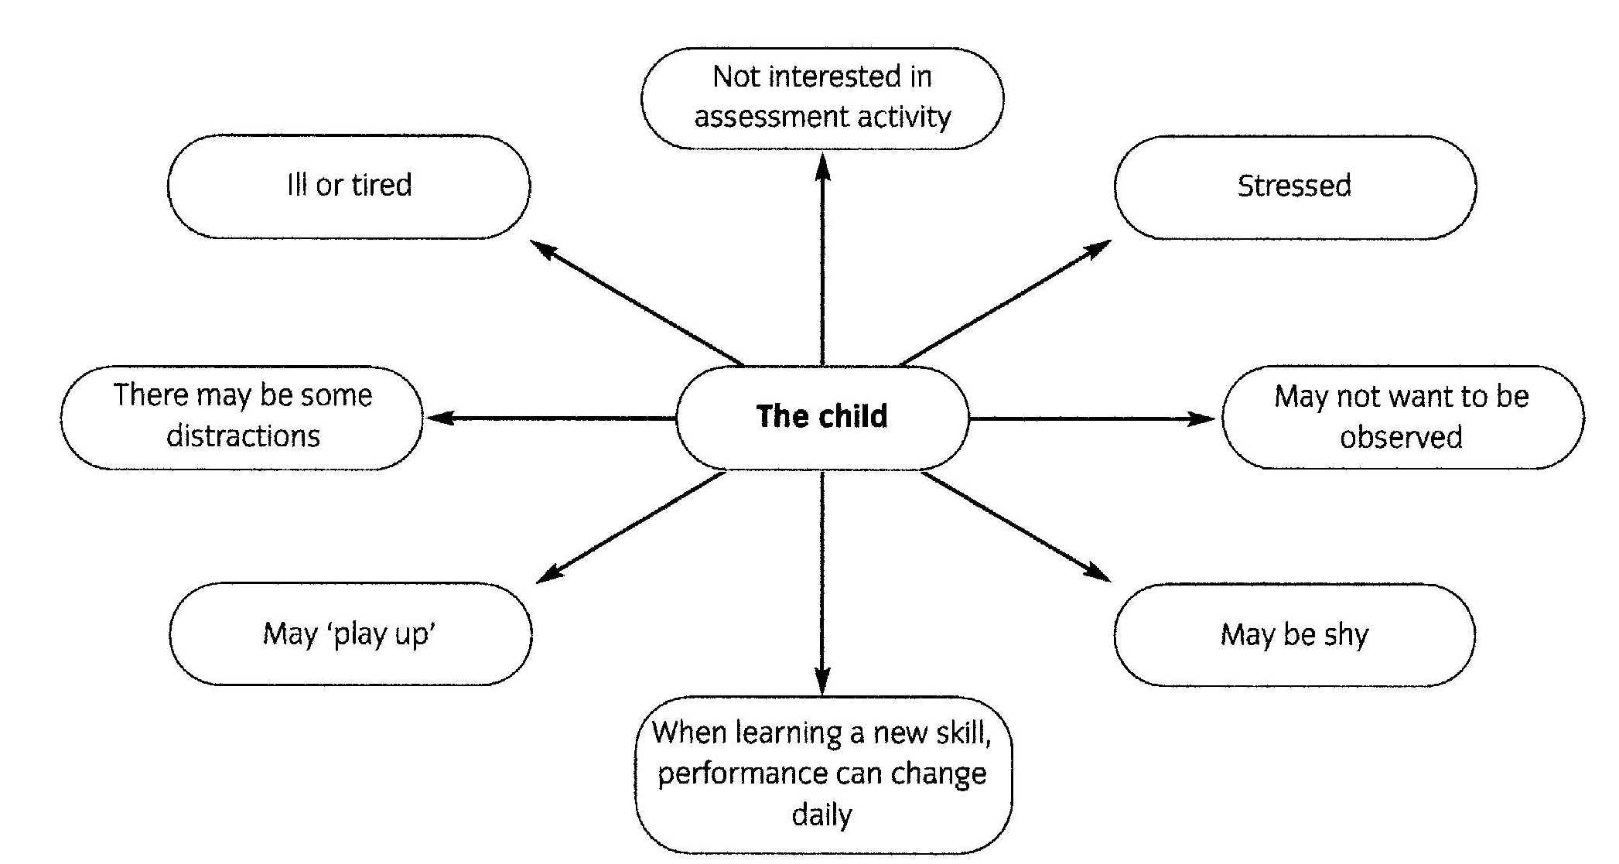
Factors affecting the child

Slide 27
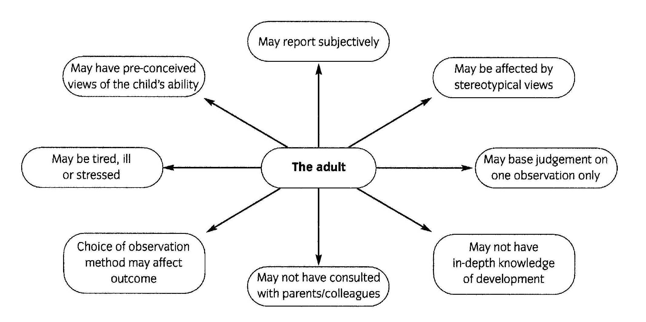
Factors affecting the adult

Slide 28
Being Objective
Being non-judgmental and unbiased.
Keep an open mind.
Do not let personal feelings affect your view of what you have observed.
Focus on the individuality of the child/young person observed.

Slide 29
Outcomes of not being objective
The child/young person may become labelled.
The family may become labelled.
The child/young person may develop a low self-esteem.
The needs of a child/young person with Special Needs may not be identified.
A child/young person may not receive appropriate support to develop.

Slide 30
Outcomes of not being objective.
An incorrect evaluation of the child/young person.
The wrong recommendations or action plans are made.
Chances to help the child/young person to develop could be missed.
Important factors affecting the child/young person’s development may not be taken into account.

Slide 31
Remember
Only write what you see
Always use present tense
Confidentiality at all times
Don't write what “you think” this could result in the child being labelled.

Slide 32
Gathering information.
Remember, parents and carers know their children! Involve them in the assessment process- their input will be valuable.
Other professionals may also be involved in assessment for example- speech therapists, social workers, health visitors, psychologists, development officers.
How can working with others promote positive outcomes for the child?

Slide 33
Lesson objectives
List different types of child observations.
Explain when to use different types of observations.
Explore how interventions can promote positive outcomes for children
Explore the importance of accurate documentation.

