Slide 1
Trends and Issues in the Tourism and Hospitality Industry

Slide 2
Contents
Social impact of tourism
Effects of globalization on tourism development
Sex tourism and exploitation of women
Trends and issues shaping tourism and hospitality development
Lifestyles
Branding
Food production and supply
Technology
Legislation and regulations

Slide 3
Positive Impact of Tourism
Creation of employment
Break down of stereotypes
Revitalization of poor or non-industrialized regions

Slide 4
The rebirth of local arts and crafts and traditional cultural activities
Aboriginal bark painting on bark: Price: AUD $185
Vanuatu's Original Bungee Jumpers: This awe inspiring ancient tradition, also known as land diving, is a feat of courage and Stone Age ingenuity that gave birth to modern bungee jumping.
The revival of social and cultural life of local population
Renewal of local architectural traditions
Promotion of the need to conserve areas of aesthetic and cultural value

Slide 5
Negative Impact
Overcrowding
Decline of traditional activities such as farming
Regions become over-dependent on tourism
Demonstration effect
Local people aspire to the material standard and sex openness of the tourists
Acculturation
Local culture gradually give way to foreign culture
McDonaldization, Coca-colaization

Slide 6
Globalization
Globalization is essentially a process by which an ever tightening network of ties that cut across national political boundaries connects communities in a single, interdependent whole, a shrinking world where local differences are steadily eroded and subsumed within a massive global social order
Mowforth & Mundt, 1998

Slide 7
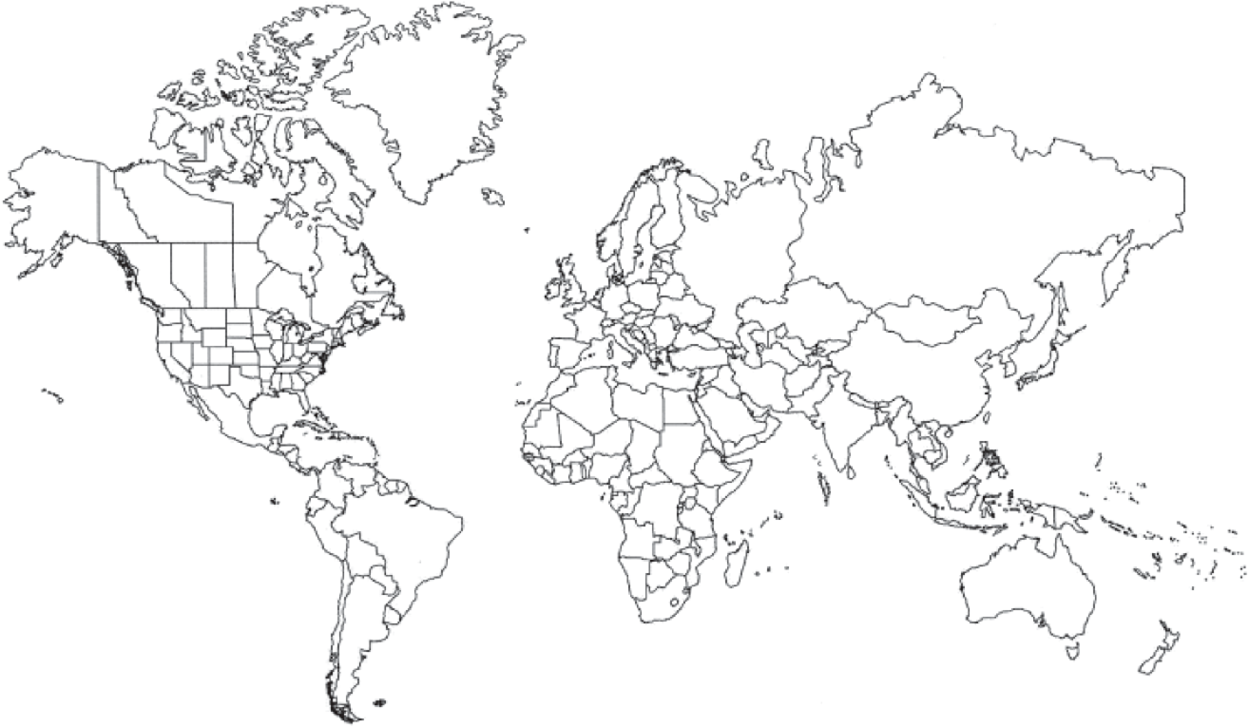
Material
Money
People
Information
Technology

Slide 8
Globalization and Tourism
Affordable air travel
Increase in disposable incomes and vacation
Look for the “new”, the “other”, “peripheral”, and “beyond the beaten track”
Increased intention to travel abroad
Information communication
Increased familiarity of people with their own country
New destinations

Slide 9
Negative Impact of Globalization
Commodification
conversion of a destination’s culture into a commodity in response to the perceived or actual demands of the tourist market
Loss of authenticity
Americanization
Homogenization

Slide 10
Tourism, Culture and Commodification
Staged and performed
Traditional
Modified to make it easily digested or consumed
Performance
Ceremonies
Souvenirs
Arts and Crafts
Tourist gaze
Exotic hotels
Architecture
Look at or take photos
Props
Costumes

Slide 11
Case Study: Maasai 馬亞賽
Tourists visit Maasai of East Africa
Dance in Maasai
Local people pose for photos
Maasai artwork as souvenirs
Azarya, V. (2004)

Slide 12
Loss of Authenticity vs. Preservation of Culture
Becomes commoditized and “made for tourists”. Local people forget its original meanings
Modified
Traditional culture
Loss of authenticity
Traditions (e.g., ceremonies) are separated and “made for locals” and traditional skills are saved from oblivion
Preserved

Slide 13
Forces against Commodification
Since 1970, Mardi Gras has become a year-round “industry”, attracting many tourists in New Orleans, USA
Gotham (2005)

Slide 14
Some companies wish to sponsor and advertise within parades
Some businesses wish to buy float ridership for their employees

Slide 15
Loss of Authenticity in Food due to Commodification
Canadians / tourists wish to taste Thai food, but not so hot or exotic
Thai food has to be adapted
Limited favoured dishes are offered
Mainly 13 dishes
Blending of culture
Illusion of homogeneity of Thai cuisines
Loss of authenticity
e.g., Tom Yam Pak

Slide 16
Americanization of Food Services
Trans-National Corporations manufactured culture products spreads throughout the world
Cultural proliferation
People everywhere eat US food, watch US films, wear US dresses
Cultural Americanization
Cities are infused with American culture
Cultural homogenization
Local culture mixed with foreign culture; city loses its identity

Slide 17
Cultural homogenization
Things, practices and values become increasing “alike” all over the world
People use similar things, eat similar food, have similar lifestyles, and believe in material, technology and competition

Slide 18
Cultural homogenization is not only about food
Fast food
Original food style becomes less original or authentic
McDonald’s
Fast food
Work orientation ↑
Familial enjoying meal together ↓
Benjamin Barber in “Globalization and Culture”, Cato Policy Report

Slide 19
However, some studies found that fast food stores in China (e.g., Grand Mother Dumpling Restaurant) were encouraged to improve their décor, hygiene and service upon the arrival of western fast food restaurants.
They learned and succeeded but were not replaced.

Slide 20
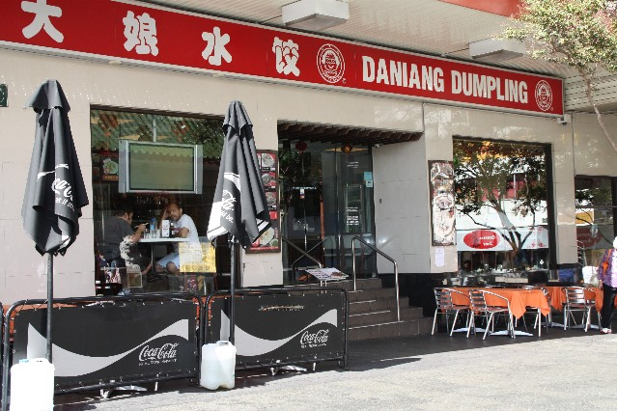
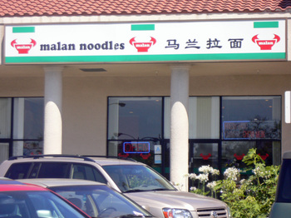
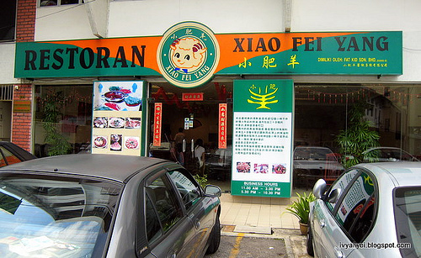
Globalization also allows Chinese, Indian and Japanese food to spread to other parts of the world
Sydney
Kuala Lumpur
Los Angeles

Slide 21
Americanization? Homogenization? Diversification?
There is also increased similarity among cities
City A
City A
City B
✗
It seems Americanization does not really occur in most cities
Rather, there is increased diversity within a city;
A tourist city is a theme park of world cuisines

Slide 22
Globalization and International Investment in Tourism
It may give tax concessions to outside developers to attract their investments
It may need to borrow money to build airports etc.
For developing countries to develop tourism, they must have world class infrastructure to become competitive
The investors may ask for change of law before going ahead with the development, e.g., more lenient environmental regulation.
Developing country

Slide 23
In Kenya, hotels are built in fragile coastal and marine eco-systems
Tour operators have marketed all-inclusive tour packages – international flight, accommodation, food, recreation, car rental, internal flight etc.

Slide 24
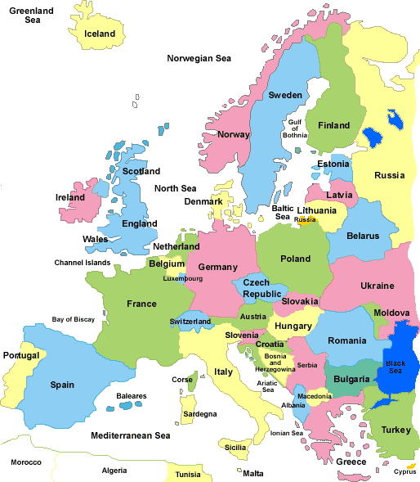
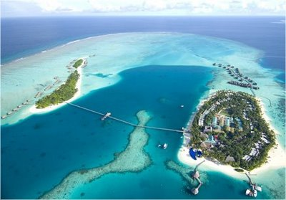
International Investment and Leakage
The Republic of the Maldives relies on tourism for its income
Profit
Leakage
Resorts are mainly funded by European tour operators
Investment
More than 50% of all labour is imported.

Slide 25
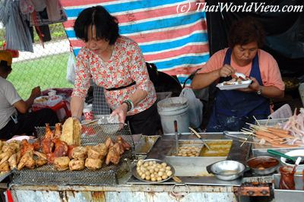
Pressure of Large Operations on SMEs
Best Western
Club Med
American
Express
Thomson
International Operations enjoy economy of scale, concerted marketing, and efficient use of computer reservation systems
STAR ALLIANCE
This puts pressure on local small and medium enterprises (SME)
B&B

Slide 26
Sex Tourism
Some tourists travel overseas for sex
Americans comprise an estimated 25% of all sex tourists
Men mostly choose Asia (Bangkok, Philippines, Indonesia, Sri Lanka), but the trends has spread to Brazil, Cuba, Costa Rica, Eastern Europe and African countries (Kenya, Tunisia, South Africa)
Women mostly choose Greece, Caribbean Basin, Genoa and Kenya (Africa), Bali (Indonesia) and Phuket (Thailand)
Omondi (2003)

Slide 27
Different forms of sex tourism
Voyeurism (watching sex shows)
Casual prostitutes
Prostitutes through intermediaries
Bonded prostitutes
Omondi (2003)

Slide 28
Motivation factors
Anonymity
Cheap
Wish to try something new with a different race
Buy their egos back
Fleeing from unhappy relationships at home

Slide 29
Supply factors
Poverty of the prostitutes
Limited alternative opportunities to improve living
Destination factors
Facilitating infrastructure (nightclubs, hotels)
Laxity of police control

Slide 30
Are the tourists helping the poor women?
Some people think that the sex workers sell their services at their own choice
Some people think that the workers are selling their service as other available labour
Sex tourism can contribute to national economy

Slide 31
But sex workers
May be infected with AIDS or other sexually transmitted diseases, and so are their family members
Only get a small portion of money; most of it goes to the pimps; some have to pay the police; some lose their money to theft

Slide 32
Trends and Issues Shaping Tourism and Hospitality Development
Lifestyles
Branding
Food production and supply
Technology
Legislation and regulations

Slide 33
Hospitality Trends
Location: restaurants and bars will be available everywhere, plus a few exceptional places being ‘destination’ restaurants
Bars in Dublin, Ireland
Meson de Candido, Spain
Jones, P. (2006). Hospitality megatrends.

Slide 34
Hospitality products are designed for market segments based on lifestyle
Family restaurants, sports bars and boutique hotels

Slide 35
Branding
It is a key factor for companies to stand out from the competitors
Trends in hospitality process design
Production lining: services are organized on a production-line basis
Decoupling: separating back-of-house from front-of-house activity in place and time
Customer participation: customers help themselves for service

Slide 36
Sustainability
Concerned about the environment
Security and assets
Customers expect that hotels are safe places for the guests and their property

Slide 37
A. Lifestyles
Lifestyle and segmentation
Different products
Different promotion
Lifestyle groups
Different expectations
Different prices
Segmentation
Different places

Slide 38
Your Generation?
You consider ’80s music to be oldies
You have a cell phone but no land line
One of your first favourite movies was ‘Star Wars’ or ‘E.T.’
You’ve used floppy computer discs but consider them old-fashioned
You were fascinated by Mickey Mouse and Donald Duck
Cigarette ads on TV once seemed normal

Slide 39
Lifestyle cohorts
Baby boomers (born between 1946 and 1964)
The working ones have less leisure time than other adults
Continue to travel and go out
Treating work and personal sacrifice as keys to success
Occupied with materialistic possessions and money
Skeptical about advertising
Prefer “classic” comfort foods
They seek new places to visit that often are off the beaten path
They avoid organized tours
Cheung, Harker, & Harker (2008).

Slide 40
Generation X (born between 1965 & 1979)
Embrace change and dislike stability
Emphasize work-home balance
Like material possessions and shopping
Associate good foods with certain brands
Those with children are family travellers. They often stay with friends and relatives when they leave home, spending less on hotel rooms. They like “packages” that are reasonably priced and convenient.

Slide 41
Generation Y (born between 1980 & 1995/2000)
Spend impulsively
Technologically savvy
Impatient and requiring immediate gratification
Want fast food, but also healthier foods
Fans for brands and fashions

Slide 42
Implications
As new lifestyle groups emerge, hospitality products will be developed to meet the tastes of different groups.
More boutique hotels providing unique experiences
The baby boomer market is important in terms of size, their propensity to travel and the willingness to spend.

Slide 43
Socio-economic Types
Budget travellers
Average income, fewer household assets, average age, but large in number
They prefer roadside or budget motels and family restaurants chains
They look at value added features, such as kids sleep free at hotels, free in-room television, discount at restaurants etc.

Slide 44
Adventure travellers
They have household income and personal assets above the norm
They take more domestic and international travel trips than the average
They want to explore new places and meet new and different kinds of people
Soft adventure group wants more services and spend more
Hard adventure types are likely to go to places without hotels and restaurants

Slide 45
Luxury travellers
They are wealthy and take the most trips and longer trips
They use travel agents
They are NOT old
They need to get rid of stress and seek new experiences
They look for excellent service and follow through
But this is a small market

Slide 46
Factors Influencing What People Eat
Cultural factors
Lifestyle factors
Food decisions
Psychological factors
Food trends
Asp (1999)

Slide 47
Cultural factors
Classification of what plants and animals are edible varies according to culture
Food is used to promote family unity when members eat together
Food can indicate ethnic, regional and national identity
Food is also used to develop friendships, provide hospitality, as a gift and for celebration
Foods that symbolize these functions are consumed

Slide 48
Psychological factors
People usually prefer foods that are
Familiar
Considered pleasant
Usually the ones eaten
Sensory attributes
Taste
Texture
Colour
Shape, form, size of pieces and temperature

Slide 49
Lifestyle factors
Lifestyles describe how people seek to express their identity in many areas, including food selection
Pleasure-oriented: sensory attributes food, brand and high-value foods, convenience foods
Nutrition-oriented: freshness, quality, safety

Slide 50
Food trends
Emerging food trends that emphasize foods that are
Fresh
Convenient
Ethnic foods with distinctive ingredients, flavors and spices
Fusion foods
Prepared home meal replacement, more food mixtures particularly those with less meat
More vegetarian meals
Labelled natural or organic
Easily available or bought
Promoting health
Physical performance-enhancing energy foods

Slide 51
B. Brand
Brand = the name, associated with one or more items in the product line, which is used to identify the source or character of the item(s)
Kotler
Brand associations
 facilitate memory retrieval
attitudes / feeling
credibility and confidence
differentiate/position
basis for extension

Slide 52
The brands of large and international hospitality firms reassure consumers that the standards and the system will be the same everywhere
Hilton, Hyatt, Toyoko Inn
Starbucks, McDonald’s

Slide 53
However, foodservice chains are less reliant on tourists than on the local population and may adapt their operation to reflect local tastes
The growth of the Internet has enabled small hotels and restaurants to promote themselves effectively in competition with big brands

Slide 54
C. The Food Supply Chain
Labour
Labour contractor
Grower / farmer
Broker
Manufacturer, Processor
Distributors, Wholesaler, Broker
Restaurant, Supermarket
Consumer

Slide 55
Genetically Modified Food
Major GM food categories
Soya beans
Maize / corn
Cotton
Canola

Slide 56
Other possible sources of GMO
Dairy products from cows injected with rbGH (a kind of genetically engineered hormone).
Food additives, enzymes, flavorings, and processing agents, including the sweetener aspartame and rennet used to make hard cheeses
Meat, eggs, and dairy products from animals that have eaten GM feed
Honey and bee pollen that may have GM sources of pollen
Contamination or pollination caused by GM seeds or pollen

Slide 57
Human health risks
Many children in the US and Europe have developed life-threatening allergies to peanuts and other foods. Introducing a gene into a plant may create a new allergen
Environmentalists are afraid that GM food may pose health risks that are not yet discovered

Slide 58
European Union
Consumers distrust biotechnology, its applications, and its regulators
EU Regulations generally assume that GM foods differ from the risk associated with other food products
Precautionary principle
North America
Consumers are much more passive than in the EU
In Canada and the US, GM foods are regulated in the same manner as food derived from conventional methods
Principle of substantive equivalence
Hobbs & Plunkett (2006).

Slide 59
Seed provider
The other parties in the supply chain may deliberately hide up information about GM or do not know the status themselves
Farmers
Manufacturer
Wholesalers
Restaurants
Consumers

Slide 60
GM labelling
In EU, products which contain 0.9% or more of authorized GMOs have to be labelled
In Hong Kong, labelling scheme is voluntary on the grounds that there is no international consensus and the cost impact to the trade
Food items with 5% or more GM materials in the ingredient(s) are recommended to be labelled as “genetically modified”

Slide 61
GM organisms traceability mechanism
Businesses should retain information about products that contain or are produced from GM organisms throughout the food supply chain
GM food causing problems
Previous steps in the supply chain
Other restaurants
Other consumers

Slide 62
The Ministry of Agriculture in China granted bio-safety certificates to two pest-resistant GM rice varieties and a corn variety in November 2009
“The application and research on GM agriculture is definitely a future trend in China and is among the strategic measures to strive for a more competitive agricultural sector through technology,” Wei Chao An, Vice Minister of Agriculture, said in March 2010.

Slide 63
D. Technology
Information Communication Technologies / Web 2.0 have great impact on the marketing of restaurants
Tripadvisor and OpenRice.com are some of the famous platform for community members to share their reviews
Reviews
tripadvisor
OpenRice.com
Ratings
Photos
O’Conner (2008)

Slide 64
Restaurant
customer
Pay to join as members
Restaurant
Review platform
Risk of dishonest reviews
Restaurant
customer
Word of mouth:
Information cost low
Review from users → More objective, credible (?)
Those not linked to a network become less competitive

Slide 65
Web 2.0 and Consumer Community
customer
customer
customer
Web 2.0 Platform
Restaurant
customer
customer
customer
Community → collective bargain power

Slide 66
Groupon: Collective Buying Power
Groupon started in November 2008 in Chicago
It features discounts of 50-90% off great restaurants and dining

Slide 67
Good business for the restaurants?
Groupon customers seldom spend more.
These customers also seldom come back unless with another groupon.
Redemption seems unrestricted by anything other than a time limit on 'the deal'. Whether a restaurant is equipped to deal with ALL people redeeming their 50% off Groupons within a short time is questionable

Slide 68
E. Legislation and Regulation
Non-smoking legislation
Smoking (Public Health) Ordinance (Hong Kong)
Hong Kong (2007), China (2006; May 2011), France (2008), Spain (2011)
Smoke-free restaurants and bars reduce exposure to tobacco smoke toxins among hospitality workers and patrons

Slide 69
In China, the law's critics say the penalties are only empty talk
The smokers can easily leave the scene long before the arrival of the law enforcement officials
Neither the smoking-control volunteers nor the area's supervision officials have the right to detain offenders even if they refuse to stop smoking.
It is complicated and time consuming for people to dial the public supervision hotline to report offenders, and wait for the law enforcement units to take over the case

Slide 70
According to a review, all of the best designed studies report no impact or a positive impact of smoke-free restaurant and bar laws on sales or employment.
But studies funded by the bar and restaurant associations and tobacco companies often find that smoking legislation has a negative effect on restaurant and bar profits
Scollo, Lal, Hyland and Glantz (2003)

Slide 71
Dutiable Commodities (Liquor) Regulations (Cap. 109B)
No licensee shall permit any person under the age of 18 years to drink any intoxicating liquor on any licensed premises.
In US, research shows young people begin to drink at 11 for boys and at 13 for girls. Youth that begin drinking prior to age 15 are 40% more likely to become alcoholics.

Slide 72
Prevention of Bribery Ordinance
參閱「食肆廚房職員疑貪污被廉署起訴」
資料來源:星島日報 2008 年1月16日

Slide 73
Minimum Wage Ordinance
The Statutory Minimum Wage came into force on 1 May 2011 and the initial Statutory Minimum Wage rate is $28 per hour
What may be the effects on the workers, the customers and the employers?

Slide 74
Corporate Social Responsibility
A corporation may be held socially and ethically accountable by an expansive array of stakeholders such as customers, employees, governments, communities, NGOs, investors, supply chain members, unions, regulators and media.
Maloni & Brown (2006)

Slide 75
Dimensions of CSR
Animal welfare
Biotechnology
Health and safety
Environment
CSR in the Supply Chain: Food Industry
Labour and human rights
Community
Fair trade
Procurement

Slide 76
Animal welfare: animals should not endure unnecessary suffering
Biotechnology: sensitive to consumer attitudes about the use of biotechnology
Community: volunteering and philanthropy (e.g., McDonald House)
Environment: sewage, air pollution, waste disposal, food miles

Slide 77
Fair trade: should support prices to the suppliers to allow them to avoid poverty and sustain business longevity
Starbucks was accused by NGOs for not providing fair trade prices to coffee suppliers
Health and safety: food security, food traceability, healthy lifestyles
Labour and human rights: worker registration, minimum wage, employment terms and conditions disclosure, safety training, work safety
Procurement: issues of favouritism and preferential treatment, bribery, gifts, obscure contract terms

