Slide 1
Events management
Investigation
Notes:
The area we have chosen to investigate is events management. We will now present our finding on exactly what events management is, what it involves and how it has developed over the years.

Slide 2
What is an event?
Occurrence happening at a determinable time and place, with or without the participation of human agents. It may be a part of a chain of occurrences as an effect of a preceding occurrence and as the cause of a succeeding occurrence.
Businessdictionary.com
Notes:
A definition from the online business dictionary states that an event is...

Slide 3
Statistics
The events industry has grown at an average pace of 6.2% each year globally since 2003 and is projected to grow 5.5% per year through 2011.
Industry Statistics
Economic impact £9.3 billion
£1 billion tax revenues
137,000 full time job equivalents
17 million visitors each year
7% of visitors and 13% of exhibitors are from overseas
Notes:
According to an article on pubexec, there is a constistent growth in the events industry, with it growing at an average pace of 6.2% each year globally since 2003 and is projected to grow 5.5% per year through 2011.
The events industry alliance organisation states on their website the financial impacts the events industry has created. A study from 2005 states that the industry had an overall economic impact of £9.3 billion to the UK. Since then the industry has grown rapidly, making the economic impact for 2012 much larger. The industry has created £1 billion in tax revenues, as well as creating 137,000 more jobs in the UK. The events industry has also attracted 17 million visitors to the UK each year.

Slide 4
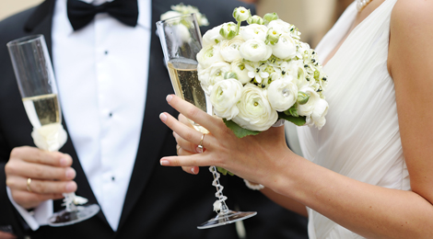
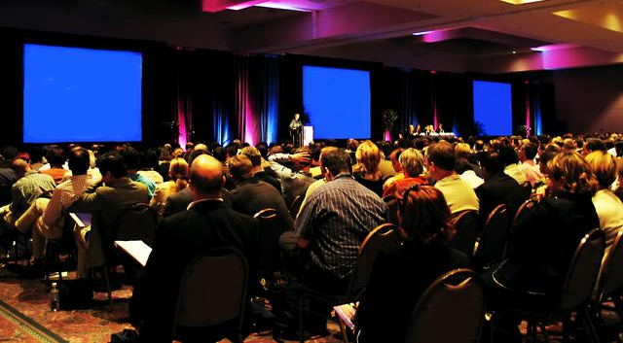
Types of events
Two main types of events
Private events
Corporate events
Notes:
Over the years, the range of events available have expanded drastically, with there now being countless types of events being held frequently. There are two main types of events, Private and corporate. Corporate events are those held by businesses, whether it be a part of a celebration for the company or a part of the company’s day-to-day operations. Private events are those held for personal reasons, such as weddings or birthday parties.

Slide 5
Corporate Events
Conferences
Seminars
Meetings
Team building events
Trade show exhibitions
Business dinners
Golf events
Press Conferences
Networking events
Executive retreats
Incentive travel
Incentive events
Opening ceremonies
Product launches
Themed parties
VIP events
Trade fairs
Shareholder meetings
Award ceremonies
Notes:
There are a large number of corporate events that take place today for a variety of reasons. Here are a list of the events that business’s may host.
Conferences
Seminars
Meetings
Team building events
Trade show exhibitions
Business dinners
Golf events
Press Conferences
Networking events
Executive retreats
Incentive travel
Incentive events
Opening ceremonies
Product launches
Themed parties
VIP events
Trade fairs
Shareholder meetings
Award ceremonies

Slide 6
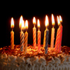
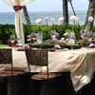
Private events
Weddings
Birthday parties
Wedding anniversaries
And other family events
Notes:
Private events may be the most obvious type of events, the ones we see and recognise most. These can include:
Weddings
Birthdays
Anniversaries
And other family events

Slide 7
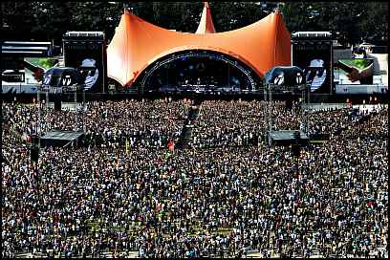
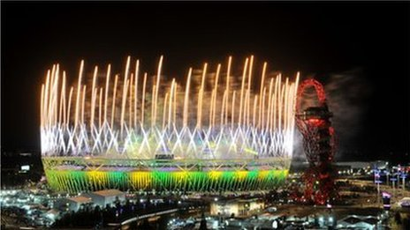
Festivals & PUBLIC EVENTS
Festivals increasing in popularity with hundreds of festivals now taking place annually in the UK.
London 2012 Olympics attracted hundreds of thousands of visitors from overseas as well as the UK to London to watch the events that took place.
Notes:
Besides corporate and private events there are also festivals and public events.
Festivals have increased in popularity drastically since the early 1970’s. For example, when glastonbury first started in 1970, 1,500 attended the festival, however now around 150,000+ people attend the festival, selling out in 2012 in just 1hr & 40 minutes. Now hundreds of festivals take place every year in the UK with attendance growing each time.
An example of a public event could be the most popular of 2012, the 2012 Olympic games & opening/closing ceremonies. The 2012 London olympics attracted extremely large numbers of people to the Uk as well from around the UK, to visit the many sporting events that took place in and around London. Sports events are increasingly identifying with the power and excitement of festival style presentation.

Slide 8
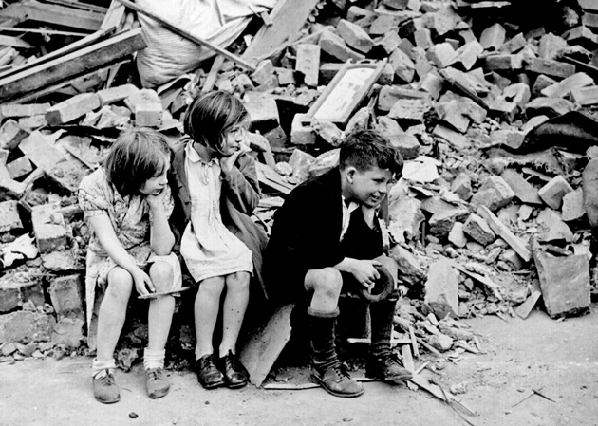
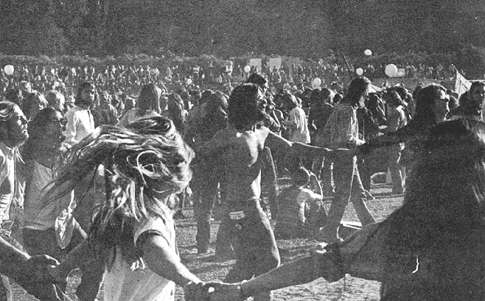
Developments
World war two ended in 1945, leaving behind bad memories and Britain in ruins.
From the 60s onwards, people turned to love & peace as a way of life, celebrating freedom and happiness.
In the 70s.. Festivals began!
Notes:
World war 2 ended in 1945, with the years to follow spent moving on from bad memories and trying to rebuild britain from the ruins. However, from the 60s onwards, peoples views turned to love and peace, in a way of celebrating the end of war and the start of freedom. This phase carried on into the 70s which is when events such as festivals like glastonbury began, a way of embracing peace, freedom and happiness that they never had just 20 years before. As previously stated, these festivals now go on into 2012-2013 with the same purpose, however with rapid growth and a wider range of types of people attending.

Slide 9
Typologies
It all depends on the type of event which determines the customer who is involved in the process.
Recently Admiral insurance company held a staff party at Cardiff castle where artists as big as Jessie J entertained guests.
Notes:
It all depends on the type of event which determines the customer who is involved in the process. Corporate events are the one’s demanded mainly by the business customer, which happens to be event manager’s most valuable customer. Business customers hold numerous types of corporate events, whether that be for them and their colleagues, their employees, or for their customers.

Slide 10
Typologies
Individuals, groups, people of different ages and cultures and people with special needs.
Customer | Event
Individuals | Weddings/Birthday Parties
Groups | Hen/stag parties or school/college educational events.
Children & families | Children’s parties or fairs
Religious customers | christening ceremonies or bah-mitzvahs.
Special needs | Fundraising events
Special interest | Music festivals, Biker festivals etc.
Notes:
Private events are usually catered for the other types of customers such as individuals, groups, people of different ages and cultures and people with special needs. Individual customers would often want to hold events such as weddings or birthday parties. Groups would want events such as Hen/Stag Parties or school/college educational events. Children’s parties and fairs would be more suited to young customers and families. There are the religious customer’s that hold events such as christening ceremonies and bah-mitzvah events. There are also events suited to the customers with special needs, for example, fundraising events for the use of guide dogs for the visually impaired. There are also events specified for people’s interests, for example, there are festivals held annually within the UK for people interested in certain genres of music, there are dancing festivals, biker and skateboarding festivals and seasonal festivals.

Slide 11
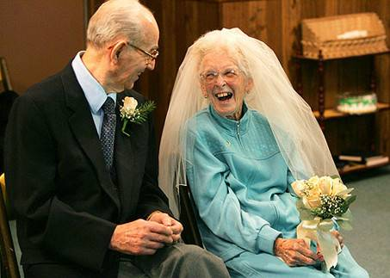
TYPOLOGIES - Developments
Its become more socially acceptable to get remarried at an older age.
More elderly people are holding weddings.
Notes:
The types of customers going to events have also changed over the years. In the post-war period, it was normal for women to get married young and stay with that person for the rest of your life, it was frowned upon to get divorced. However, as the years have passed, people’s views have developed and it has now become more socially acceptable to divorce and re-marry as much as you like. This means that more and more people are having multiple marriages and older customers are now getting married.
Also the types of customers attending festivals have changed over the years. When festivals such as Glastonbury first opened, it was only a selected type of person that went to the event (Rock/hippy). However over the years, more people of all different ages, cultures and interests are attending festivals across the UK as well as travelling to countries outside of the UK for festivals

Slide 12
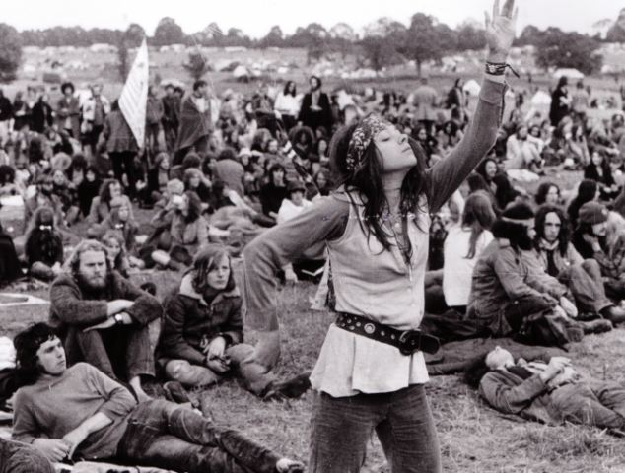
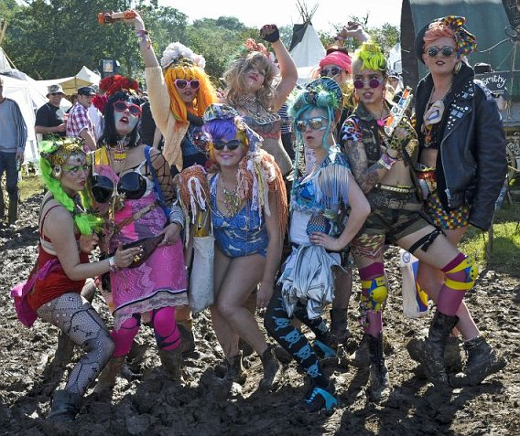
Typologies - developments
The types of customer’s attending festivals have change over generations.
As the different types of festivals have expanded, so have the types of customers to attend them.
Notes:
Also the types of customers attending festivals have changed over the years. When festivals such as Glastonbury first opened, it was only a selected type of person that went to the event (Rock/hippy). However over the years, more people of all different ages, cultures and interests are attending festivals across the UK as well as travelling to countries outside of the UK for festivals. There is a festival to meet the needs of every type of person now.

Slide 13
SUPPORTING BODIES
Association of Event Organisers Ltd (AEO)
“AEO is the trade body representing companies which conceive, create, develop or manage trade and consumer events. It is run by its members for the benefit of its members through an elected council of representatives, specialist working groups and a fulltime secretariat. Our aim is to be the voice of the multi-billion pound event organising industry, to serve the collective needs of event organisers and to promote the interests of our members and the industry at large.”
Notes:
All industries have certain bodies that help and support them in doing what they need to do, including the events industry.
One of these are the AEO (Association of Event Organisers). This is their mission statement...... ‘read the slide’ .
AEO have their own networking and events for members only, they keep their members up-to-date with all information including AEO’s activities and initiatives through a regular member communication programme, AEO provides members with free of charge guidance on issues such as health and safety compliance, security, sustainability and other technical and commercial issues. They also provide members with training programmes and a code of conduct to follow by to ensure the highest standards.

Slide 14
Supporting bodies
Association of Event Venues (AEV)
“Association of Event Venues (AEV) is an organisation serving an established event venue community, focused on creating and driving platforms that service fundamental industry needs.”
Notes:
Above is the mission statement of the Association of Event Venues. ( readslide)
AEV help their members with many aspects of the event management process. They ensure that all their members are given the best advice and guidance possible, with allowing them access to top industry research including the Sponsorium Report, EIA Facts, the Economic Impact Study and more. They help their members to save money by offering them free advertising, free consultations every month and many other relevant discounts. They also help their members to raise their profile, and support them in become a more reputable organisation.

Slide 15
Supporting bodies
National Outdoor Events Association (NOEA)
NOEA, established in 1979, is the only trade association specialising in the Outdoor Events Industry and is able to connect you to some 500 Members covering Local Authorities, Festival and Event Organisers, Universities/Students, Entertainment Agencies, Promoters, Venues and Suppliers of Equipment and Services together with Practitioners generally in the World of Outdoor Events.
Notes:
Read out the slide.
NOEA has a policy to educate, advise and enhance professionalism and business opportunities for event managers. They do this by providing regional workshops, conferences, annual conventions and tribute celebration evenings. By providing these benfites to event managers, it allowed them to find out about the latest developments in the industry, such as learning about topical issues such as the various Acts in place which affects the industry and how it operates. NEOA also help to train event managers, making them the best they could possibly be. They are currently working on the British standars for the sustainability of event management.
NOEA state that their main purpose is to debate issues, share information, network, meet new business contacts, renew old friendships and have some fun.

