Slide 1
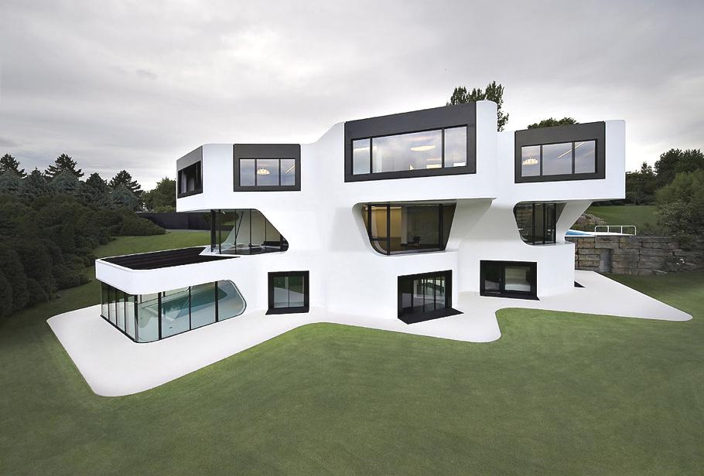
Superstructures
BTEC Unit 6

Slide 2
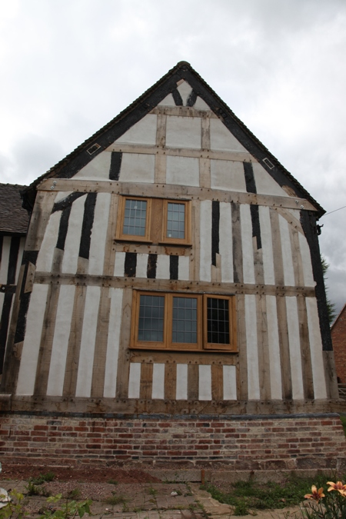
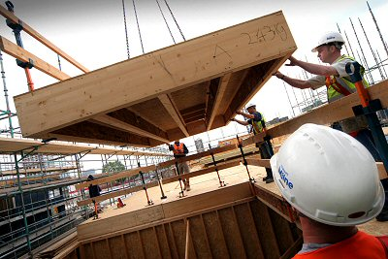
Timber frame construction

Slide 3
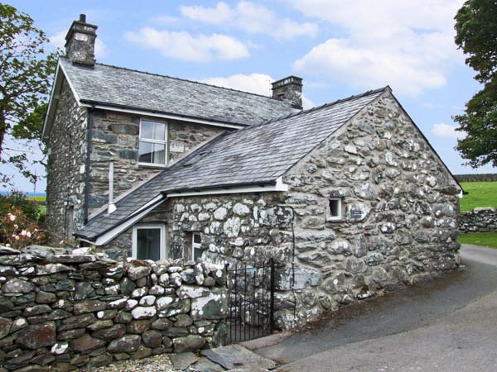
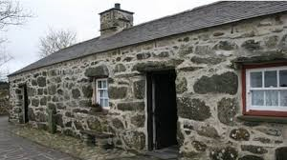
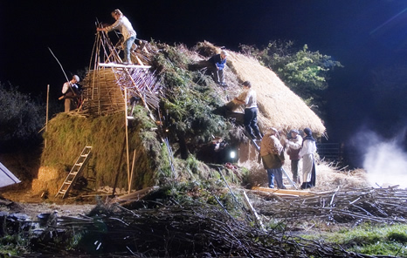
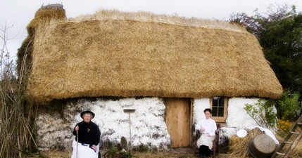
Stone

Slide 4
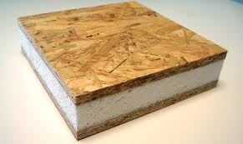
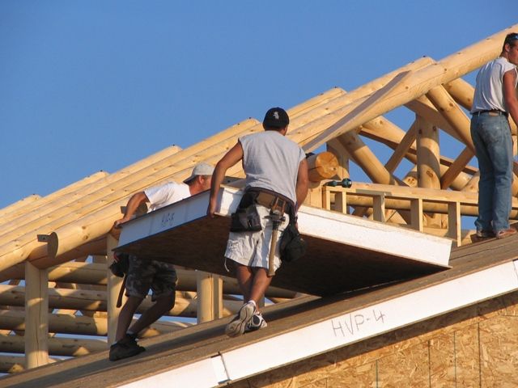
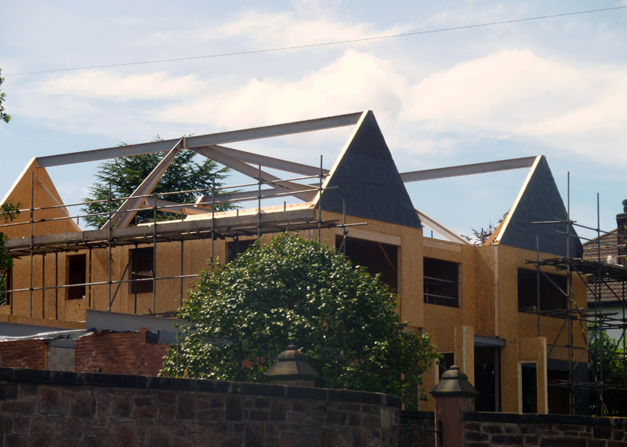
SIP Systems (Structural Insulated Panels)

Slide 5
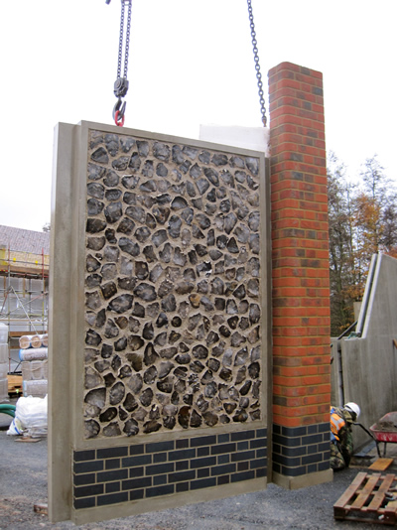
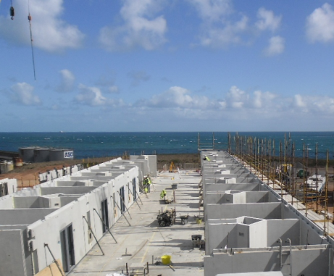
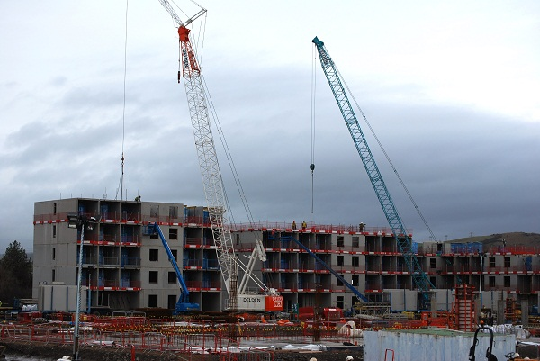
Concrete Frame Construction
Decorative panels
Swansea bay Campus

Slide 6
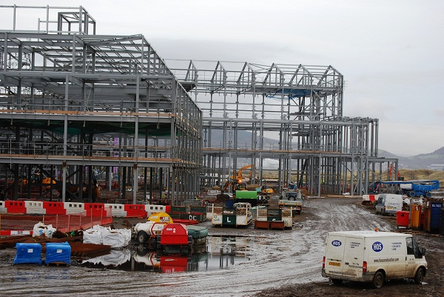
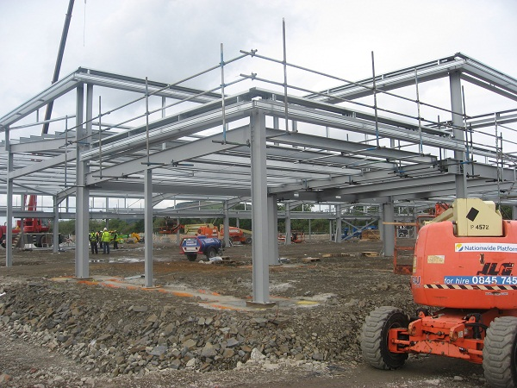
Steel Frame Construction
http://www.swansea.ac.uk/campus-development/bay-campus/
http://www.swan.ac.uk/campus-development/bay-campus/constructionphotos/

Slide 7
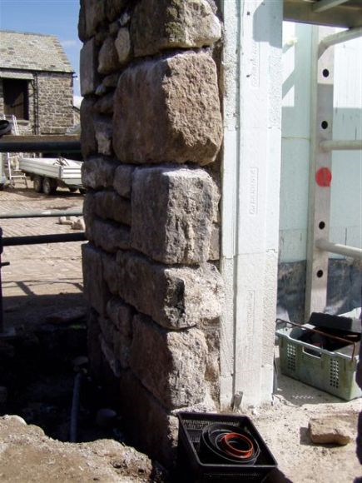
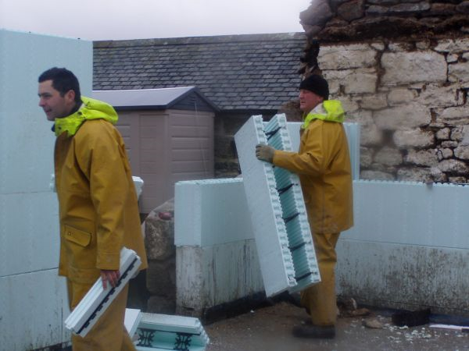
Insulated concrete forms
http://www.youtube.com/watch?v=tJ4X18Rd4dc
http://www.youtube.com/watch?v=6qOuzo_y2a4

Slide 8
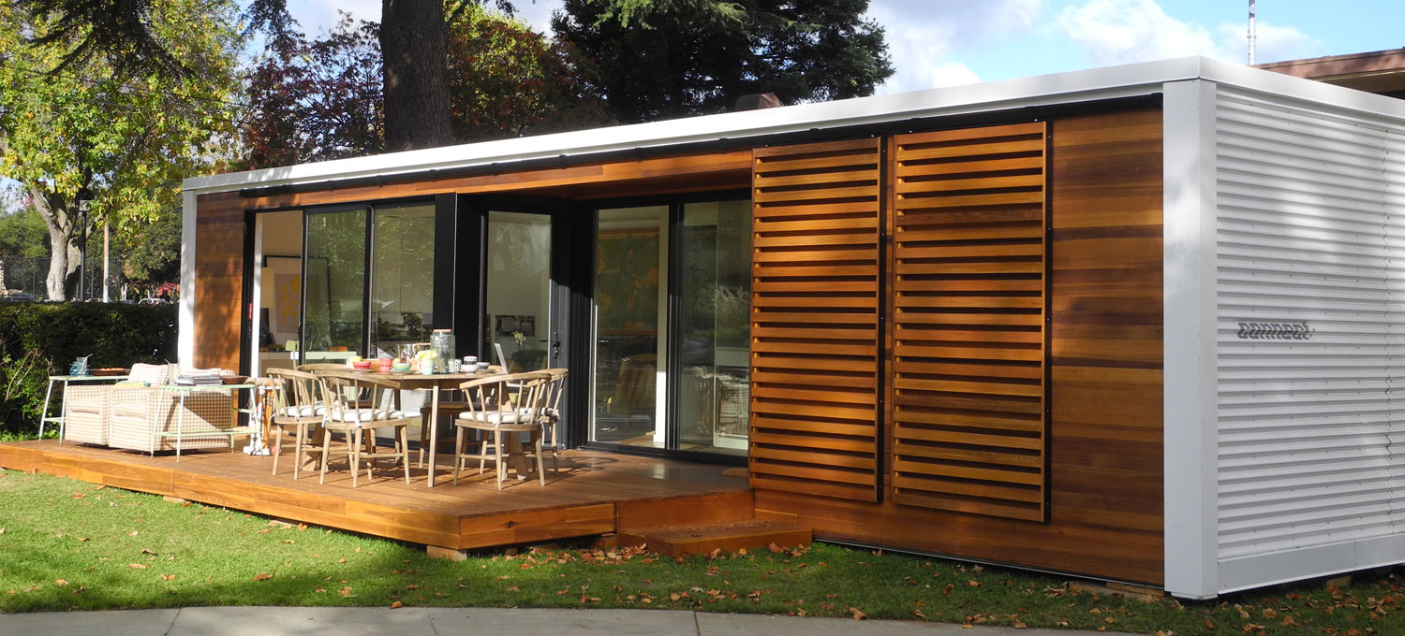
Modular Construction
http://www.youtube.com/watch?v=OMi5RJKKOlc
http://www.youtube.com/watch?v=rwvmru5JmXk

Slide 9
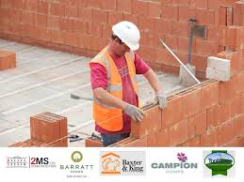
Thin Join Systems
http://www.youtube.com/watch?v=UhcPErwsf20
http://www.youtube.com/watch?v=Grb0yepuxw0

