Slide 1
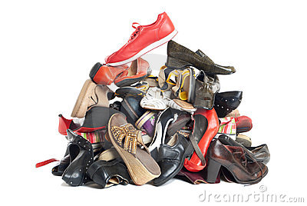
Shoe ID Game
All take off 1 shoe, put in pile on floor
On count of 3 everyone grabs a shoe
Find the person with matching shoe
Find out name and 3 things about them
Introduce partner to group.
Good in large groups, can be smelly!

Slide 2
Snowball Game
Divide group into 2. Give everyone a sheet of A5 paper ( different colour for each group)
Ask everyone to write/draw 3 interesting facts about themselves on the piece of paper. They DO NOT write their names. Everybody scrunches up their pieces of paper and then…
The snowball fight commences!
Pieces of paper are thrown at each other for 1 minute. No one is allowed to throw at faces or within 3 metres of anyone else.
After the minute is up, everyone stops and picks up piece of paper ( not the colour they wrote on)
Read out facts and guess who it is – or
Circulate and ask questions to identify owner
Then introduce other person

Slide 3
Autograph Bingo
Prepare bingo cards with 5 rows and 5 columns
Put interesting facts inside the box – eg. ‘Has gone skydiving’, ‘likes anchovies’, ‘has more than 3 sisters’
Mingle and collect signatures for facts that apply – can only sign sheet once!
5 in a row equals ‘Bingo!’

Slide 4
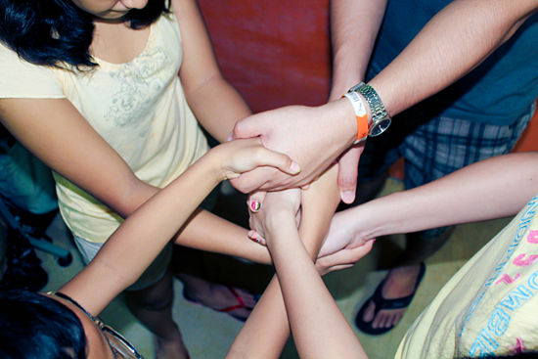
Human Knot
Get groups of 4/5 to form tight circle (shoulder to shoulder)
Lift left hand and take the hand of someone standing across the circle
Lift right hand and take hand of another person standing across the circle
Group have to untangle to form circle of people without letting go of hands

Slide 5
ID guessing game
Pass out index cards and pens
Each person writes 2 things they have done and 1 that they haven’t
Collect cards in and group votes on who they think the card represents and which item they haven’t done
Or – let each person provide their 3 facts and group guesses which is untrue

Slide 6
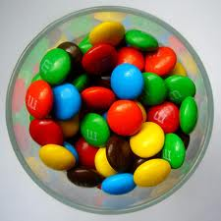
M&M game
Pour M&Ms into a bowl
Everyone takes handful, no-one eats any!
For each M&M they have to answer a question depending on the colour eg Red; embarrassing moment, Green; favourite food, yellow; favourite film, orange; furthest place of travel
Call colour – all who have it answers question and can then eat M&M

