Slide 1
The Solar System

Slide 2
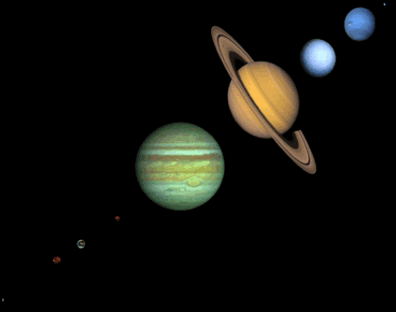
What’s in the solar system?
the sun
9 planets
more than 130 satellites of the planets
a large number of small bodies, such as comets and asteroids
the interplanetary medium

Slide 3
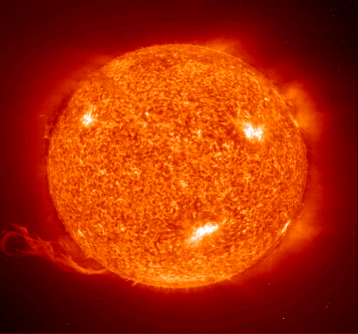
The Sun
By far the largest object in the solar system – more than 99.8% of the total mass
Around 70% hydrogen and 28% helium
Everything else (‘metals’) amounts to less than 2%
Composition changes slowly over time hydrogen converts to helium in its core

Slide 4
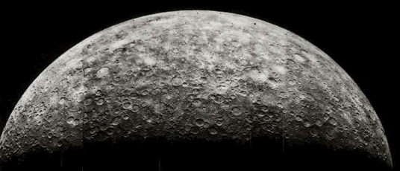
Mercury
Closest planet to the sun and the eighth largest
Highly eccentric orbit – at its nearest point, it’s 46 million km from the sun, but at furthest it’s 70 million.
Rotates three times in two of its years

Slide 5
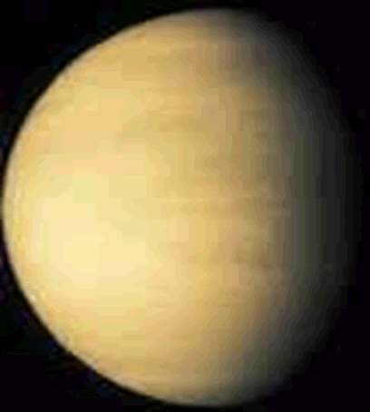
Venus
Second planet from the sun and the sixth largest
Has the most circular orbit of all the planets
Regarded as Earth's sister planet because it’s similar in size and composition
Brightest star-like object in the sky

Slide 6
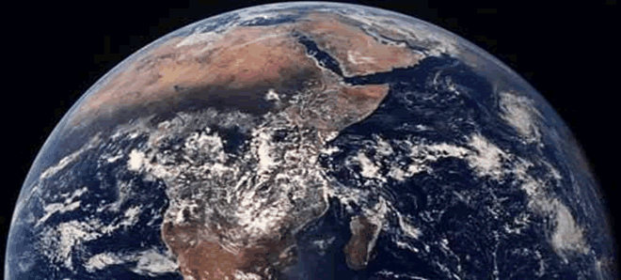
Earth
The third planet from the sun and the fifth largest
The only planet known to harbour life
A terrestrial planet, with a solid surface and an iron core
One natural satellite, the moon

Slide 7
Jupiter
The fifth planet from the Sun and by far the largest, more than twice as big as all the other planets combined
Known as the ‘wandering star’
A gas planet: no solid surface, the gas simply gets denser with depth
When looking at Jupiter, we see the tops of clouds high in their atmospheres

Slide 8
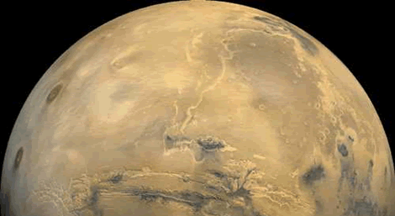
Mars
The fourth planet from the sun and the seventh largest
Though much smaller than Earth, its surface area is about the same as the land surface area of Earth
The first spacecraft to visit Mars was Mariner 4 in 1965
Called the ‘Red Planet’ and named after the god of war

Slide 9
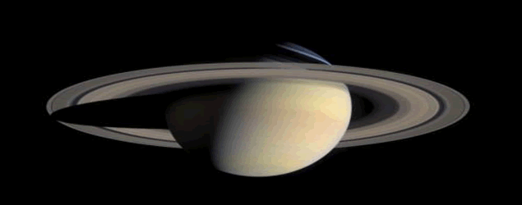
Saturn
The sixth planet from the sun and the second largest
Visibly flattened (oblate) when viewed through a small telescope – a result of its rapid rotation and fluid state
The least dense of the planets – specific gravity (0.7) is less than that of water
Has bands like Jupiter, but much fainter

Slide 10
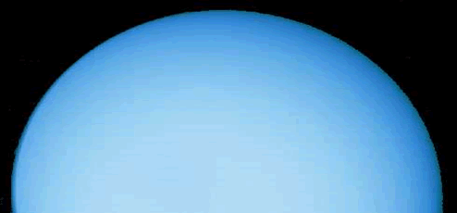
Uranus
The seventh planet from the Sun and the third largest
Larger than Neptune in diameter but smaller in mass
Composed primarily of rock and various ices
Hotter at its equator than at its poles;
The blue colour is caused by absorption of red light by methane in the upper atmosphere

Slide 11
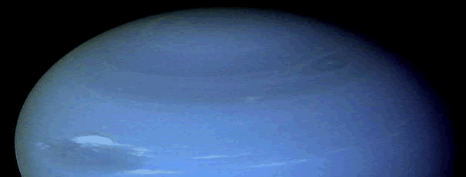
Neptune
The eighth planet from the Sun and the fourth largest
Smaller in diameter but larger in mass than Uranus
A gas giant
Methane gives it the blue appearance

Slide 12
Pluto
The farthest planet from the sun (usually) and by far the smallest
In Roman mythology, Pluto (Greek: Hades) is the god of the underworld
So far from the sun that it’s in perpetual darkness

Slide 13
Summary Slide
The solar system consists of the Sun; the nine planets, more than 130 satellites of the planets, a large number of small bodies

