Slide 1
Oakfield Castle
Restoration Project

Slide 2
Current state of castle
In urgent need of structural repair
Superficially sound, but age and neglect have undermined integrity of main building
Structural needs:
new roof
foundation strengthening
stairwell repair
new floors
extensive work on the North Turret
Also needs
rewiring
new plumbing
visitor centre
restaurant and shop
new toilet facilities

Slide 3
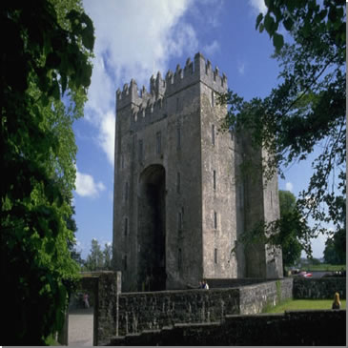
History
Built circa 1680
Centre of local life until 1820s
Sold in 1848 to Lord Cavendish
Listed in 1962
Last heir dies in 1978
Building unused since 1986
Huge potential
Needs extensive restoration

Slide 4
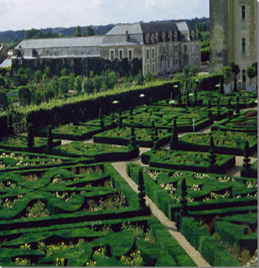
Proposed action
Strengthen structural integrity
Repair interior load-bearing walls
Strengthen foundations
Apply damp proofing
Rebuild stairwell
Repair North Tower
Refit interior
Upgrade electrical wiring and plumbing
Repair floors
Add visitor facilities:
Restaurant
Shop
Visitor centre
Toilets

Slide 5
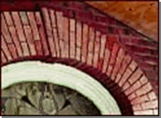
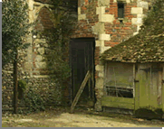
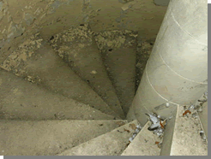
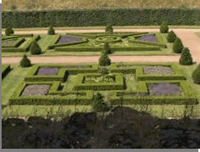
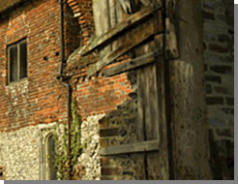
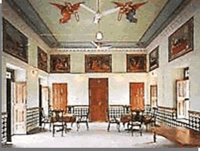
Close-up of repair work
Repair architrave
Repair stairwells
Garden restoration
Structural repairs

Slide 6
Costing details
Roof: £125,000
North Tower: £75,000
Foundations: £155,000
Interior: £100,000
Stairwells: £85,000
Flooring: £55,000
Visitor facilities: £185,000
Wiring and plumbing: £50,000
Garden: £65,000
Total: £910,000

Slide 7
Projected turnover

Slide 8
Restoration committee

