Slide 1
Famous Artists
A guide

Slide 2
Important Medieval Artists
Dionysius, Ushakov, Andrei Rublev

Slide 3
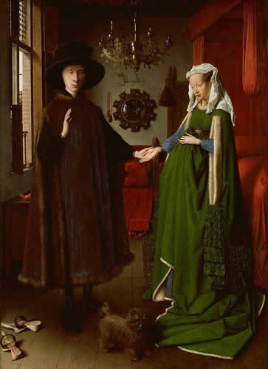
Important Renaissance Artists
Donatello, Leonardo da Vinci, Jan van Eyck

Slide 4
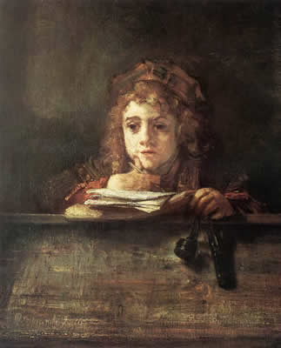
Important Baroque Artists
Rembrandt, Rubens, Caravaggio

Slide 5
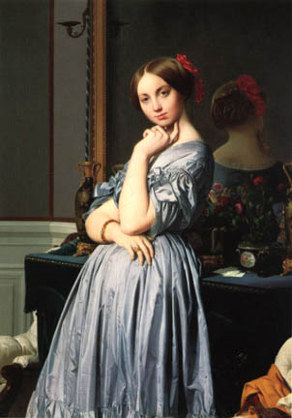
Important Neoclassical Artists
Ingres, Canova, Jacques-Louis David

Slide 6
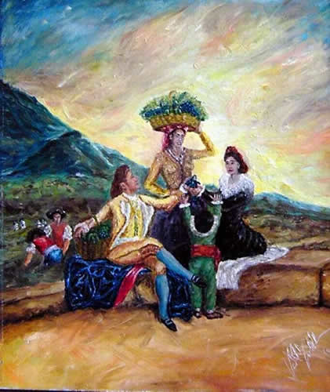
Important Romantic Artists
Delacroix, Goya, Turner, Constable

Slide 7
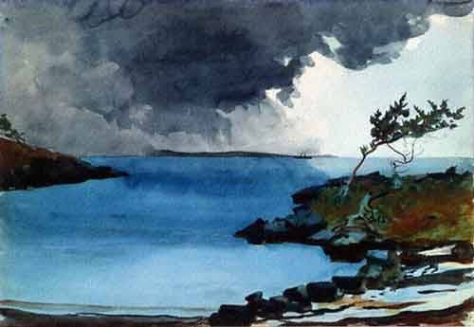
Important Realist Artists
Courbert, Manet, Winslow Homer

Slide 8
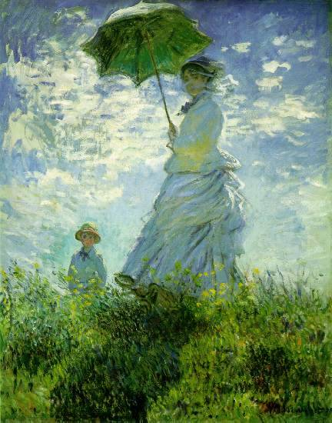
Important Impressionist Artists
Degas, Monet, Renoir

