Slide 1
History of Art
Medieval to Post-modern

Slide 2
Eras of Art Histoy
Style | Era
Romanesque | 1000
Renaissance | 1400
Baroque | 1600
Romanticism | 1800
Realism | 1850
Impressionism | 1875
Modern | 1900
Post-modern | 1950
Contemporary | 2000

Slide 3
Identify 3 artists from this era
Romanesque Artists

Slide 4
Medieval Art
Religious in focus, often funded by the church
Lack of realism and perspective
Represented ideas using iconic images instead of precise ones

Slide 5
Important Medieval Artists
Dionysius, Ushakov, Andrei Rublev

Slide 6
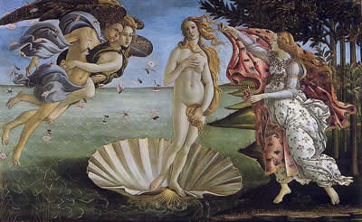
Renaissance
Use of light in painting – attempt to capture light as seen from the human eye – DaVinci, Michelangelo, Raphael
Notes:
A cultural rebirth from the 14th through to the middle of the 17th centuries.

Slide 7
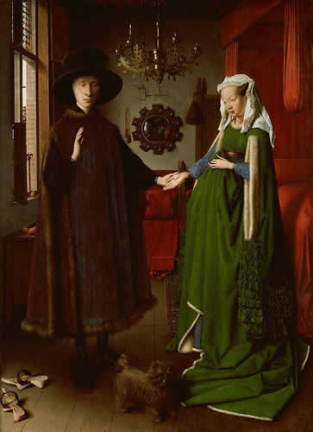
Important Renaissance Artists
Donatello, Leonardo da Vinci, Jan van Eyck

Slide 8
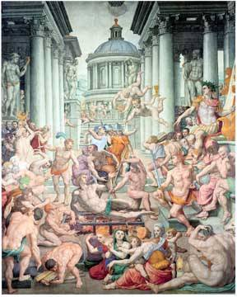
Mannerism
Emotionall content of a painting and the emotions of the painter
Artists include:
Raphael and Michelangelo Buonarroti
Notes:
A style that developed in the sixteenth century as a reaction to the classical rationality and balanced harmony of the High Renaissance.

Slide 9
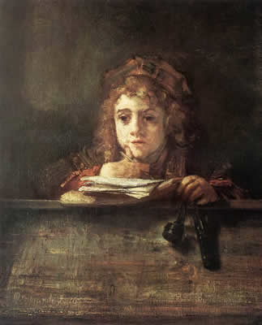
Baroque
Detail, movment, lighting and drama
Search for beauty
Rembrandt, Rubens, Caravaggio

Slide 10
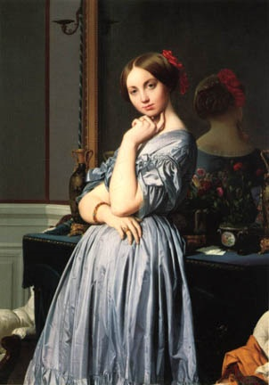
Neoclassicism
Early simpler art
Idealistic
Ingres, Canova, Jacques-Louis David
Notes:
An 18th-century artistic movement, associated with the Enlightenment, drawing on classical models and emphasizing reason, harmony, and restraint.

Slide 11
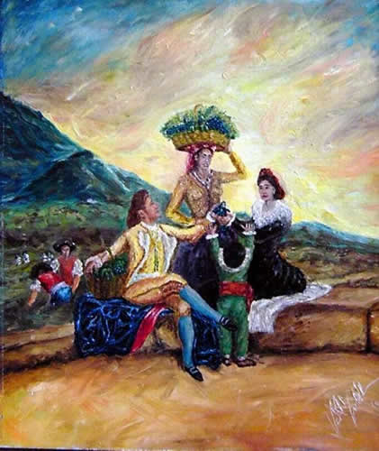
Romanticism
Use of colour and motoin to portray emotion
Emphasis on nature
Delacroix, Goya, Turner, Constable

Slide 12
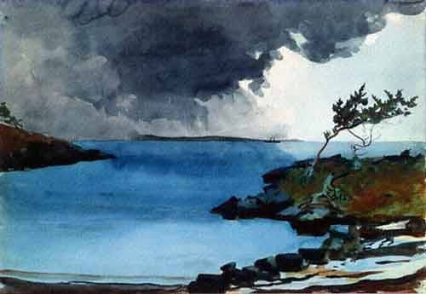
Realism
Inspired by the industrial age
Sought to accurately portray conditions and hardship of the poor
Courbert, Manet, Winslow Homer

Slide 13
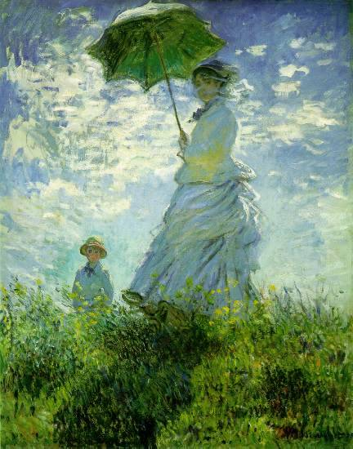
Impressionism
Use of light in painting – attempt to to capture light as seen from the human eye.
Degas, Monet, Renoir

Slide 14
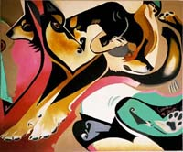
Modern Art
Wide range, anything goes
Expressionism, cubism, Abstract, Surrealism, Suprematism, Futurism, Constructivism, Minimalism, Performance art, Video art, Op art, Pop art, Concept art,

Slide 15
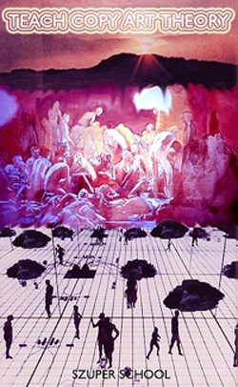
Post-Modern Art
Impossible to define clearly
Fashion, novelty

Slide 16
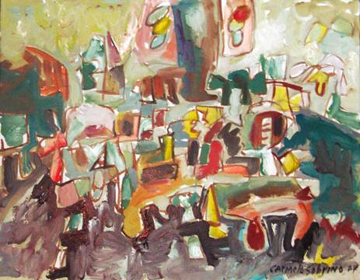
Contemporary Art
Art happening NOW!
Engages currrent issues affecting the world
Multiple formats

