Slide 1
History of art
Medieval to Post-modern

Slide 2
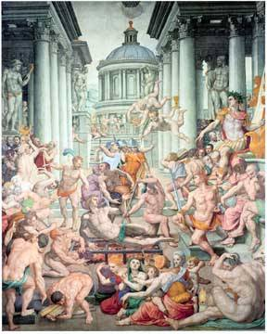
Mannerism
Emotionall content of a painting and the emotions of the painter
Artists include:
Raphael and Michelangelo Buonarroti

Slide 3
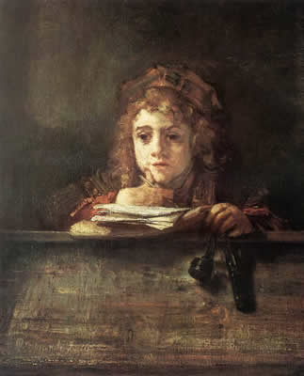
Baroque
Detail, movment, lighting and drama
Search for beauty
Rembrandt, Rubens, Caravaggio

Slide 4
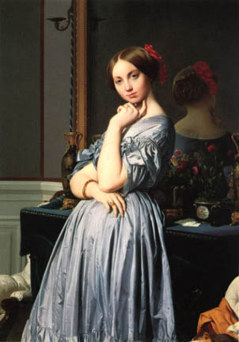
Neoclassicism
Early simpler art
Idealistic
Ingres, Canova, Jacques-Louis David

Slide 5
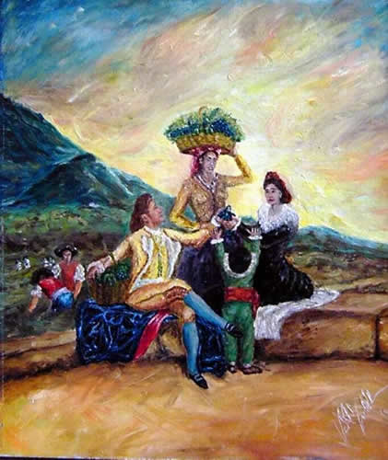
Romanticism
Use of colour and motoin to portray emotion
Emphasis on nature
Delacroix, Goya, Turner, Constable

Slide 6
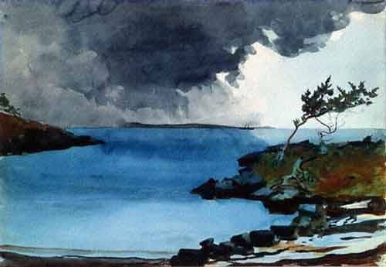
Realism
Inspired by the industrial age
Sought to accurately portray conditions and hardship of the poor
Courbert, Manet, Winslow Homer

Slide 7
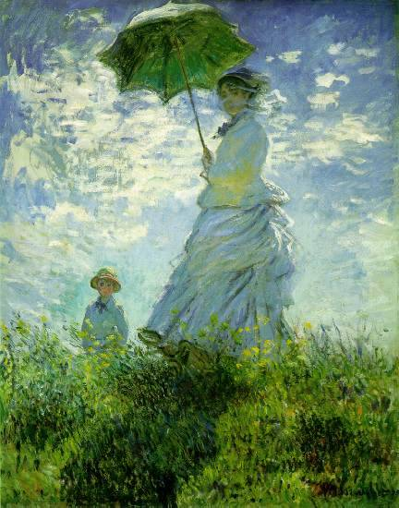
Impressionism
Use of light in painting – attempt to to capture light as seen from the human eye.
Degas, Monet, Renoir

Slide 8
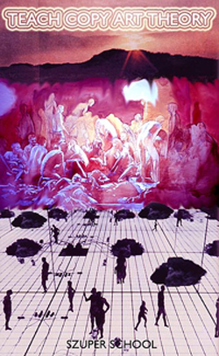
post-modern art
Impossible to define clearly
Fashion, novelty

Slide 9
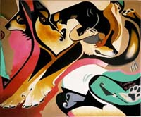
Modern art
Wide range, anything goes
Expressionism, cubism, Abstract, Surrealism, Suprematism, Futurism, Constructivism, Minimalism, Performance art, Video art, Op art, Pop art, Concept art,

Slide 10
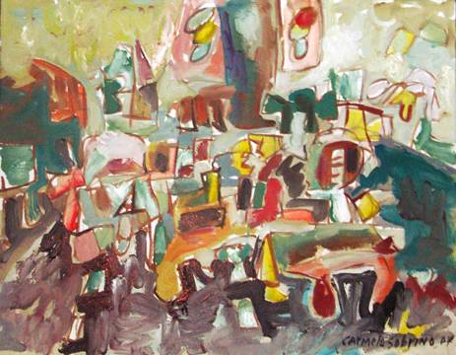
Contemporary art
Art happening NOW!
Engages currrent issues affecting the world
Multiple formats

