Slide 1
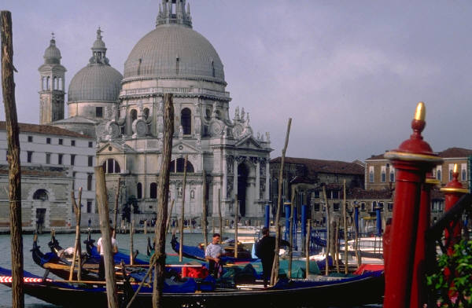
Venice Properties

Slide 2
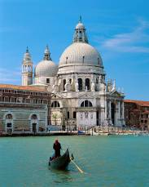
Why choose Venice?
City of canals and palaces
Lose yourself in the endless narrow streets
Stunning St Mark’s Square with St Mark’s Basilica
Explore this beautiful city on a gondola

Slide 3
When is the best time to go?
Enjoy long hot summers
Average daily temps hover around 26◦C
Lots of rain in May and June
Rainfall drops in July and August
Spring weather is crisp and clear

Slide 4
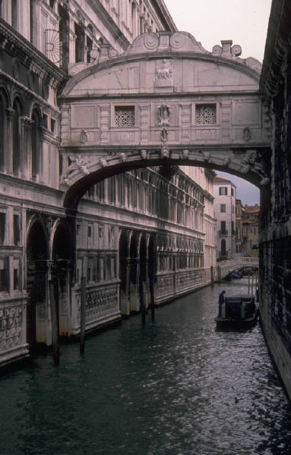
Properties
Three different properties
Three regions
Cannareglo
Castello
San Marco
Each property has luxury facilities

Slide 5
Properties for Rent
 | Location | Rooms | Sleeps | Price (£) per week
The Rise | Castello | 4 | 8 | From 220
Island Bridge | San Marco | 2 | 5 | From 300
Canal View | Cannareglo | 4 | 5 | From 250

Slide 6
Further Information
For further information please contact:
Anne Blake on 0161 8271234

