Slide 1
High Level Clouds
How they form and what they look like

Slide 2
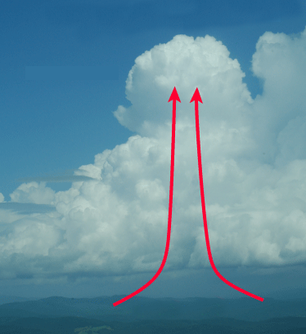
Convection

Slide 3
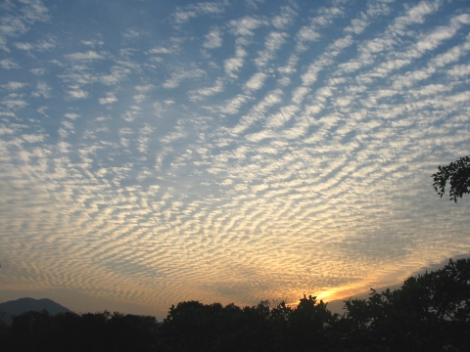
Commonly called a "mackerel" sky
Consists of tiny individual cloudlets at high level
The cloudlets may make a regular dappled or rippled pattern
May mean unsettled weather is on its way
Like all high-level clouds, cirrocumulus is made of ice crystals

