Slide 1
Toys and Games
Through the Ages

Slide 2
4000-3000 B.C.
A Babylonian board game was played – probably an ancestor of chess and checkers.
First game resembling backgammon was played in Ancient Sumeria. Games similar to backgammon had probably been played by Egyptians, Greeks, and Romans for thousands of years.
Stone marbles are first used in Egypt. Later, glass marbles were popularized in the United States in the 1800s.

Slide 3
2000-1000 B.C.
Egyptians begin to play a game that resembles modern-day checkers
Kites appear in China
They have probably been flown since before recorded history. The first three-dimensional kite was invented in the 1890s by Lawrence Hargrave in Australia.
Stone yo-yos begin to be used in Greece

Slide 4
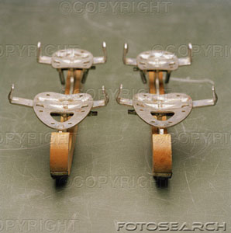
200 A.D.
The first iron skates are used in Scandinavia

Slide 5
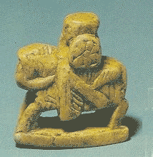
600 A.D.
An ancestor of chess begins to be played. It evolves from an Indian game called Chaturanga.
In the fifteenth century, modern chess pieces were finally standardized and the queen and bishop pieces acquired the powers that they hold today.

Slide 6
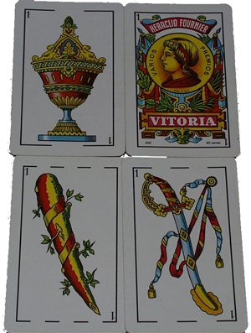
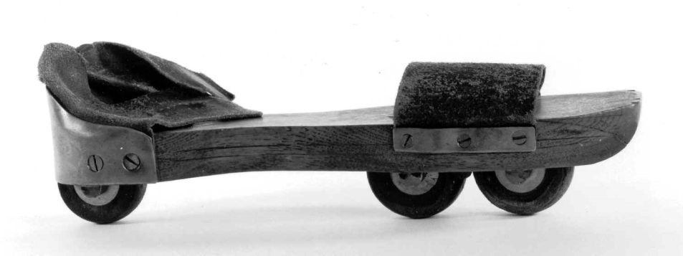
900 – 1800 A.D.
Playing cards begin to be used in Asia
♠ ♡ ♢ ♣ ♤ ♥ ♦ ♧
Roller skates are invented by Joseph Merlin

Slide 7
1800s
The first American doll maker is granted a patent and dolls
Playgrounds begin to appear in American cities.
The Mansion of Happiness is developed by S.B. Ives in Salem, Massachusetts
The first board game sold in the U.S.
The speaking doll, first invented by Johann Maelzel in 1820, is improved when Thomas Edison combines his phonograph technology with a doll, allowing it to speak

Slide 8
1900s
At just twenty-two years old, Joshua Lionel Cowen creates a battery-powered train engine as an "animated advertisement" for products in a store's display window. To his surprise, customers are more interested in purchasing his toy train, than the merchandise in the display. Lionel Trains is born.

Slide 9
1900s
In America, toy bears begin to be called "Teddy Bears" after President Theodore Roosevelt
Edwin Binney and C. Harold Smith produce the first box of Crayola crayons
Johnny Gruelle, a newspaper cartoonist, begins to sell Raggedy Ann dolls based on one he had made for his daughter, Marcella.

