Slide 1
The Food Pyramid Explained
A guide to healthy eating

Slide 2
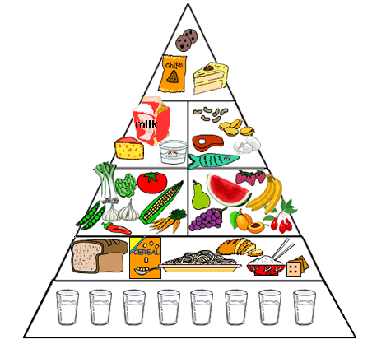
What is the Food Pyramid?
Fats and sugars
Dairy Products
Meat, Fish, Eggs, Pulses
Fresh vegetables
Fresh fruit
Breads
Cereals & Pasta
Water
Notes:
Fin to add notes here when completing file…

Slide 3
Water: The Source of Life
Water
Vital for health
Essential for your body
Blood, Perspiration, Digestion, Growth, Cell repair etc
At least 8 big glasses per day

Slide 4
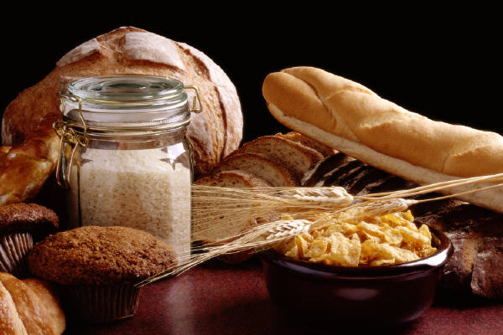
Energy Foods - Bread and Cereals
Eat high fibre cereals and breads frequently
Rice and pasta too
6 servings a day recommended
If physical activity is high, up to 12 servings may be necessary

Slide 5
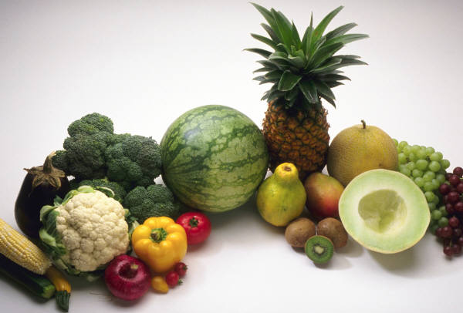
Vitamin Providers - Fruit and Veg
Any 4 daily
Dark green veg are great for anti-oxidants
Orange veg (carrots and peppers) high vitamin content
Fruit
Great source of nutrition

Slide 6
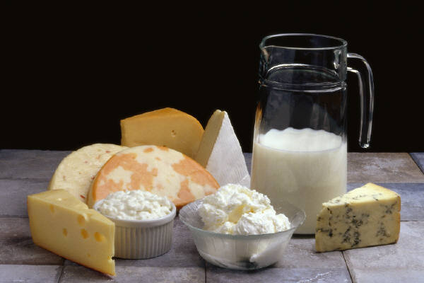
Nature’s Goodness - Dairy Products
Any 3 daily
Choose at least 4 for teenagers and 5 servings if pregnant or breast-feeding.
Choose low fat choices frequently
Mix cheeses with yoghurts and milk products

Slide 7
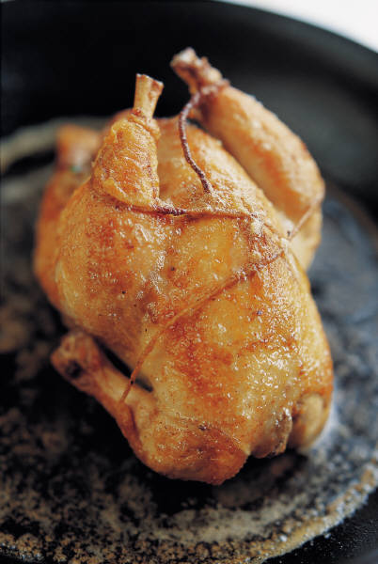
Protein Packets: Meat Fish & Poultry
Any 2 daily
Essential fatty acids
Proteins
Necessary for muscle growth and nervous system
Choose carefully
Organic is best

Slide 8
Careful: Fats and Sugars
Keep to a minimum
Avoid sugars as much as possible – rare treats
Oils – polyunsaturated varieties are best
Monounsaturated fats good too
Great risk of heart or diabetic problems

Slide 9
Words To The Wise
Fats and Sugars
Very small amounts
Meat Fish and Poultry
Choose any 2
Dairy
Choose any 3
Fruit and Vegetables
Choose any 4/5
Breads Cereals and Pasta
Choose Any 6
Drink plenty of water

