Slide 1
Practice Session
Network Analysis

Slide 2
Network Analysis
Aims and Objectives
TSSBAT know why we carry out NA
TSSBAT Know why how to set out a NA flow chart
AIM
Produce a complex NA

Slide 3
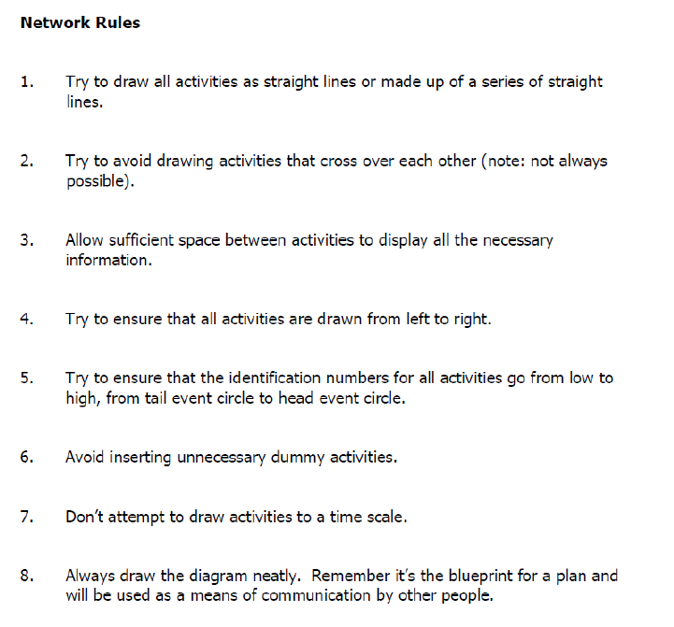

Slide 4
Critical Path
What is a critical path?

Slide 5
DUMMY
What Is a dummy?

Slide 6
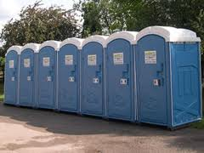
RECAP – Welfare Facilities
Welfare Facilities

Slide 7
5
10
15
10
0
0
1
2
3
4
5

Slide 8
15
9
5
1
5
0
0
1
2
3
6
12
4
10

Slide 9
5
4
11
9
15
5
0
0
1
10
2
3
6
12

Slide 10
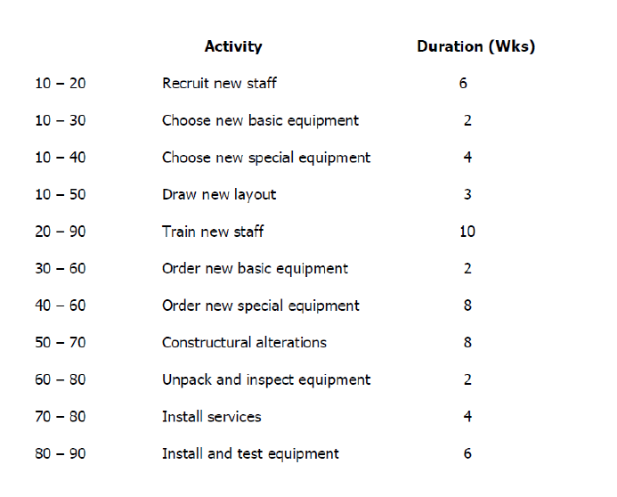

Slide 11
Microsoft Project

Slide 12
Hands on Session

